Slide 1
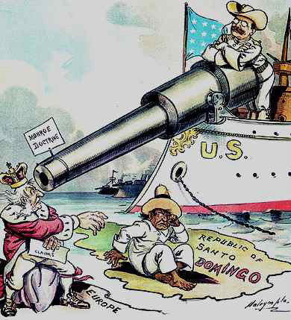
Emerging Role in World Affairs
VUS.9

Slide 4
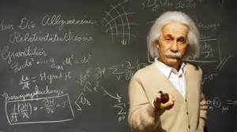
In short, American businessmen believed they could make huge profits and bring the nation economic prosperity through international trade.
With industrialization, America abandoned its traditional isolationist role to expand its influence in the world and create international markets.
The US’s growing role in international trade showed American desire to build, innovate and explore new markets.
Growth in international trade from the late 1800s to World War 1 was the first era of a true “global economy.”

Slide 5
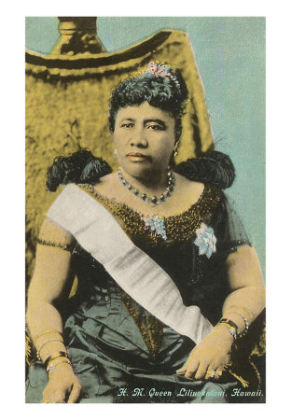
In 1899, under McKinley as President, Secretary of State John Hay proposed a policy that would
give all nations equal trading rights in China. This policy was called the Open Door Policy.
The US urged all foreigners in China to obey Chinese law and observe fair competition.
In addition to interest in China and the Philippines, Hawaii was important. The US overthrew the Hawaiian monarchy and annexed the islands. They were a source of sugar, pineapple and an important naval and shipping base in the mid Pacific. It did not gain statehood until 1959 as the 50th state.
My people are still a little ticked off about this!

Slide 6
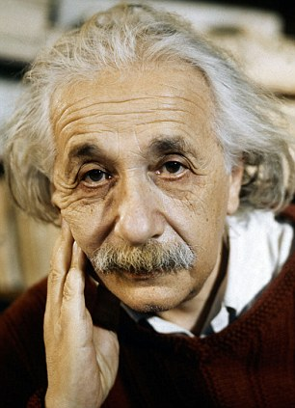
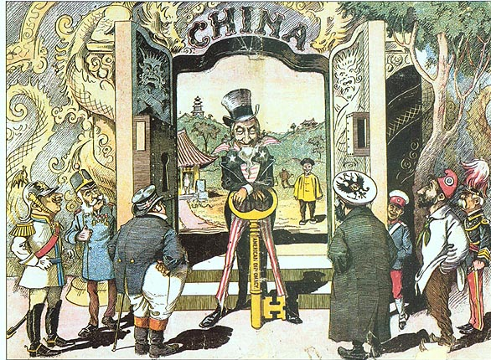
You see, the goal was to open the Chinese market to American businessmen…they had previously been excluded.

Slide 7
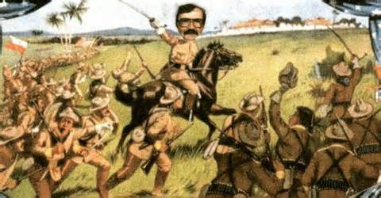
Latin America Foreign Policy
In 1898 the US entered a war against Spain to end “horrible miseries”
in Cuba caused by their Spanish rulers and protect Americans living in Cuba.
Victory was quick and it was nicknamed a “splendid little war.”
Spanish-American
War
Impact of Spanish American War
America expanded its influence in the world:
-- Spain ceded Puerto Rica & Guam to U.S.
--The US asserted the right to intervene in Cuban affairs
--Spain gave up control of the Philippines to the U.S. for 20$ Million.

Slide 8
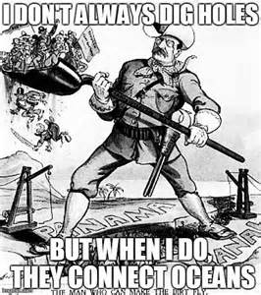
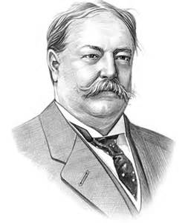
Under Teddy Roosevelt’s leadership, the US encouraged Panama’s independence from Colombia. A treaty was made to construct the Panama Canal– a major transportation shortcut that saved time and money and
enhanced military readiness.
President Taft urged American banks and businesses to invest in Latin America. He promised that the US would step in if
unrest threatened their investments.

Slide 9
The war began in Europe in 1914 when Germany and Austria-Hungary went to war with Britain, France and Russia.

Slide 10
World War I / The Great War
Causes of the Great War
Nationalism (a belief in the superiority of one’s country)
Arms race (militarism) (when a country makes it’s military a priority).
Imperialism caused Europeans to compete with each other for overseas territories like China, Africa and Asia. They already despised each other!
Entangling Alliances (agreement to support another country in a time of war).

Slide 11
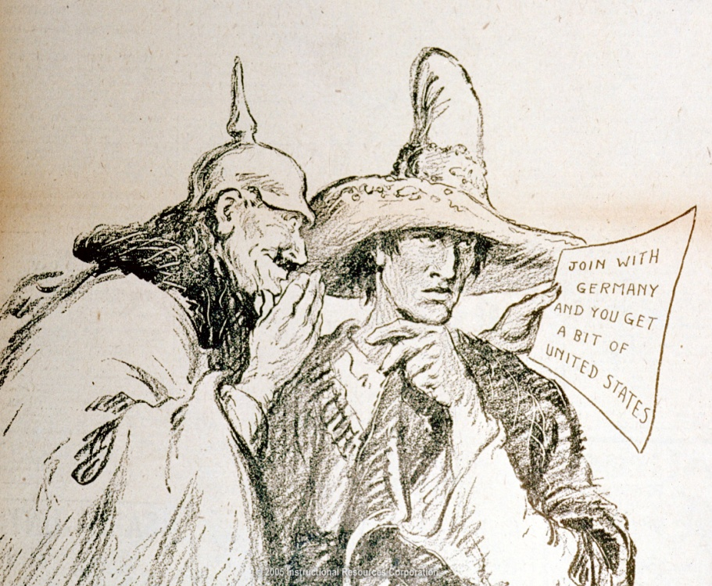
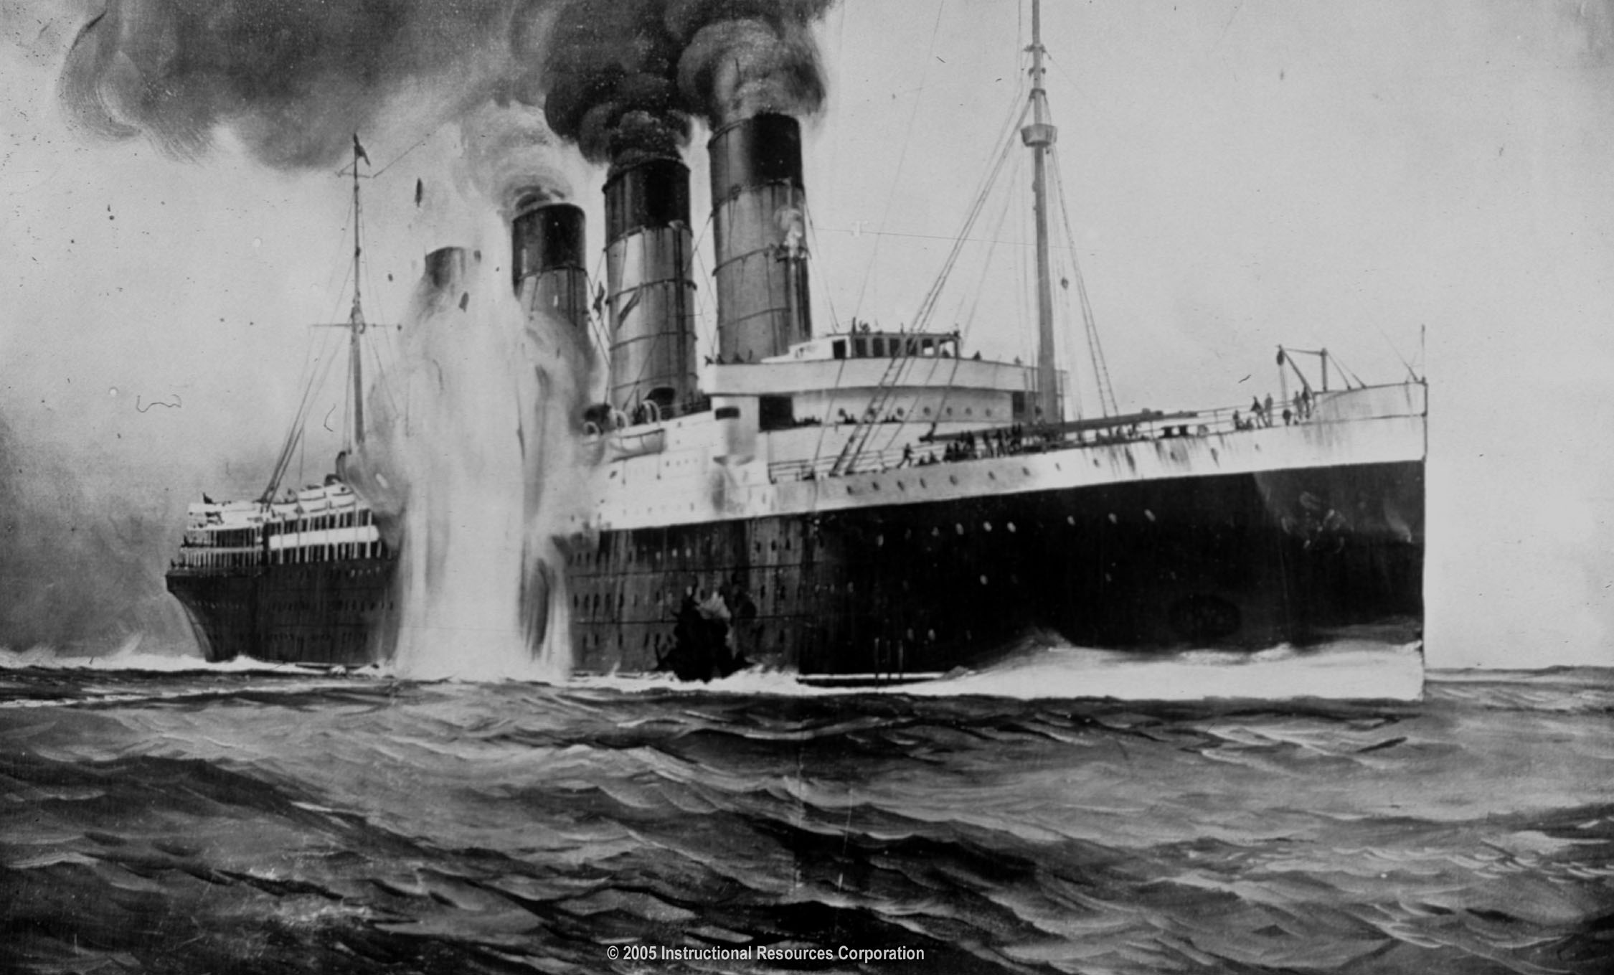
In February of 1917, the British revealed the contents of the "Zimmermann Telegraph," proposing a German-Mexican alliance under which Mexico would recover all the territory it had lost to the U.S. in the 1840s. Wilson began arming merchant ships, and on April 2, 1917, Wilson appeared before the Congress asking for a declaration of war against Germany.
American neutrality was put to the test in May 1915, when the German submarine U-20 sank the British luxury liner Lusitania, which was carrying 1200 passengers and a cargo of ammunition for British rifles. The German embassy had warned Americans that Allied vessels in the war zone were fair targets, but 128 Americans had ignored the warning and met their deaths. Wilson accused the Germans of brutality, demanded that they stop submarine warfare, and refused to ban American passengers from sailing on Allied vessels.

Slide 12
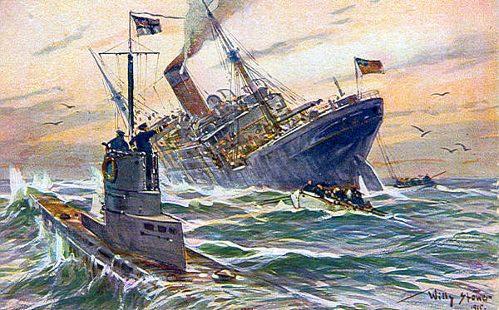
For 3 years, America remained neutral European war. The decision to enter the war was due to continuing German submarine warfare (violating freedom of the seas) and American ties to Great Britain.
On April 2, 1917, President Wilson asked Congress to declare war.

Slide 13
The Players
Allied Powers
Great Britain
France
Russia
Serbia
Italy
Central Powers
Germany
Austria-Hungary
Turkey
Bulgaria
The US will join the Allies

Slide 14
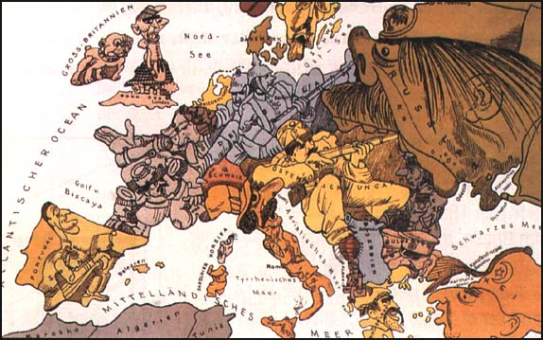
4. Aggressive Nationalism/Clanker Powers

Slide 15
The Clanker Powers--Societies and people who make use of machines powered by steam, diesel, and clockwork. Germany and Austria-Hungary are the leading Clanker powers.
Leviathan is a steampunk novel written by Scott Westerfeld and illustrated by Keith Thompson. It was released on October 6, 2009.
First of a young adult fiction trilogy set in alternate version of World War I, it has German Central Powers (Clankers) using mechanized war machines opposed by British Entente Powers (Darwinists) who fabricate living creatures genetically. The heroes are teens Aleksander, son of Archduke Franz Ferdinand, and Deryn, Scottish girl with dreams of joining the British Air Service with her brother. The sequels are Behemoth and Goliath.
Source: http://scottwesterfeld.com/blog/2009/10/leviathan-art-the-grand-map/
Source: http://en.wikipedia.org/wiki/Leviathan_(Westerfeld_novel)

Slide 16
Darwinists
The Darwinists are the
countries
(and their citizens) who use
bio-engineered
("fabricated") creatures
instead of
machines.

Slide 17
Trench Warfare

Slide 18
Trench Warfare
“No Man’s Land”

Slide 19
War Is HELL !!

Slide 20
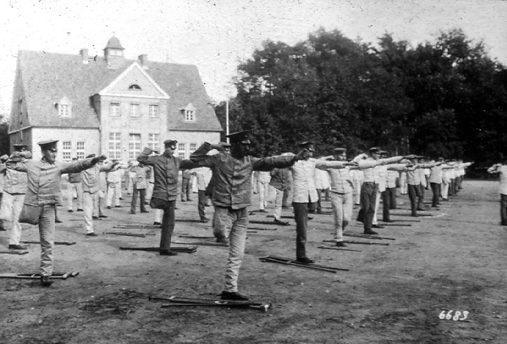
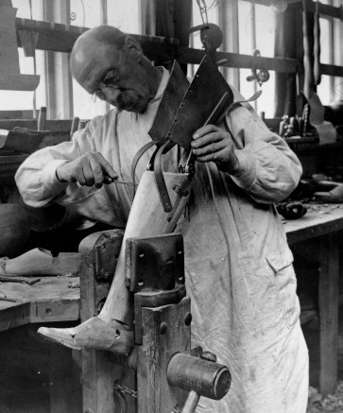
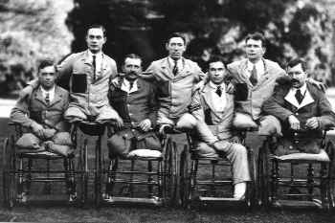
Sacrifices in War

Slide 21
Krupp’s “Big Bertha” Gun

Slide 22
French Renault Tank

Slide 23
British Tank at Ypres

Slide 24
The Airplane
“Squadron Over the Brenta” Max Edler von Poosch, 1917

Slide 25
Curtis-Martin U. S. Aircraft Plant

Slide 26
Looking for the “Red Baron?”

Slide 27
The Zeppelin

Slide 28
Flame Throwers
Grenade Launchers

Slide 29
Poison Gas
Machine Gun

Slide 30
Allied Ships Sunk by U-Boats

Slide 31
The Sinking of the Lusitania

Slide 32
The Zimmerman Telegram

Slide 33
The Yanks Are Coming!

Slide 34
Americans in the Trenches

Slide 35
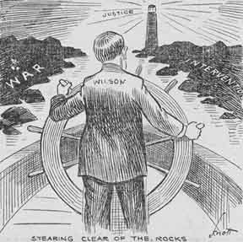
Woodrow Wilson said that Americans wanted to “make the world safe for Democracy.”
America’s military resources of soldiers and war material led to Germany’s defeat.
Armistice signed Nov. 11, 1918 at .11 a.m
Wilson’s plan to eliminate the causes of war
Key points
Self-determination
Freedom of the seas
League of Nations
Mandate system

Slide 36
WW1 Treaty (Versailles)
And debate
The French and English insisted on the punishment of Germany
A League of Nations was created.
In the Senate the debate over ratification included objections to US foreign policy decisions made by an international organization and not by US leaders.
The Senate rejected the Treaty and the US did not join the League of Nations.
National boundaries were redrawn, creating many new nations.
The failure to conclude a lasting peace after WW1 left a bitter legacy.
Wilson’s plan was suppose to make certain that a large war never happened again. That is how WWI became known as “The War to End all Wars”.

Slide 37
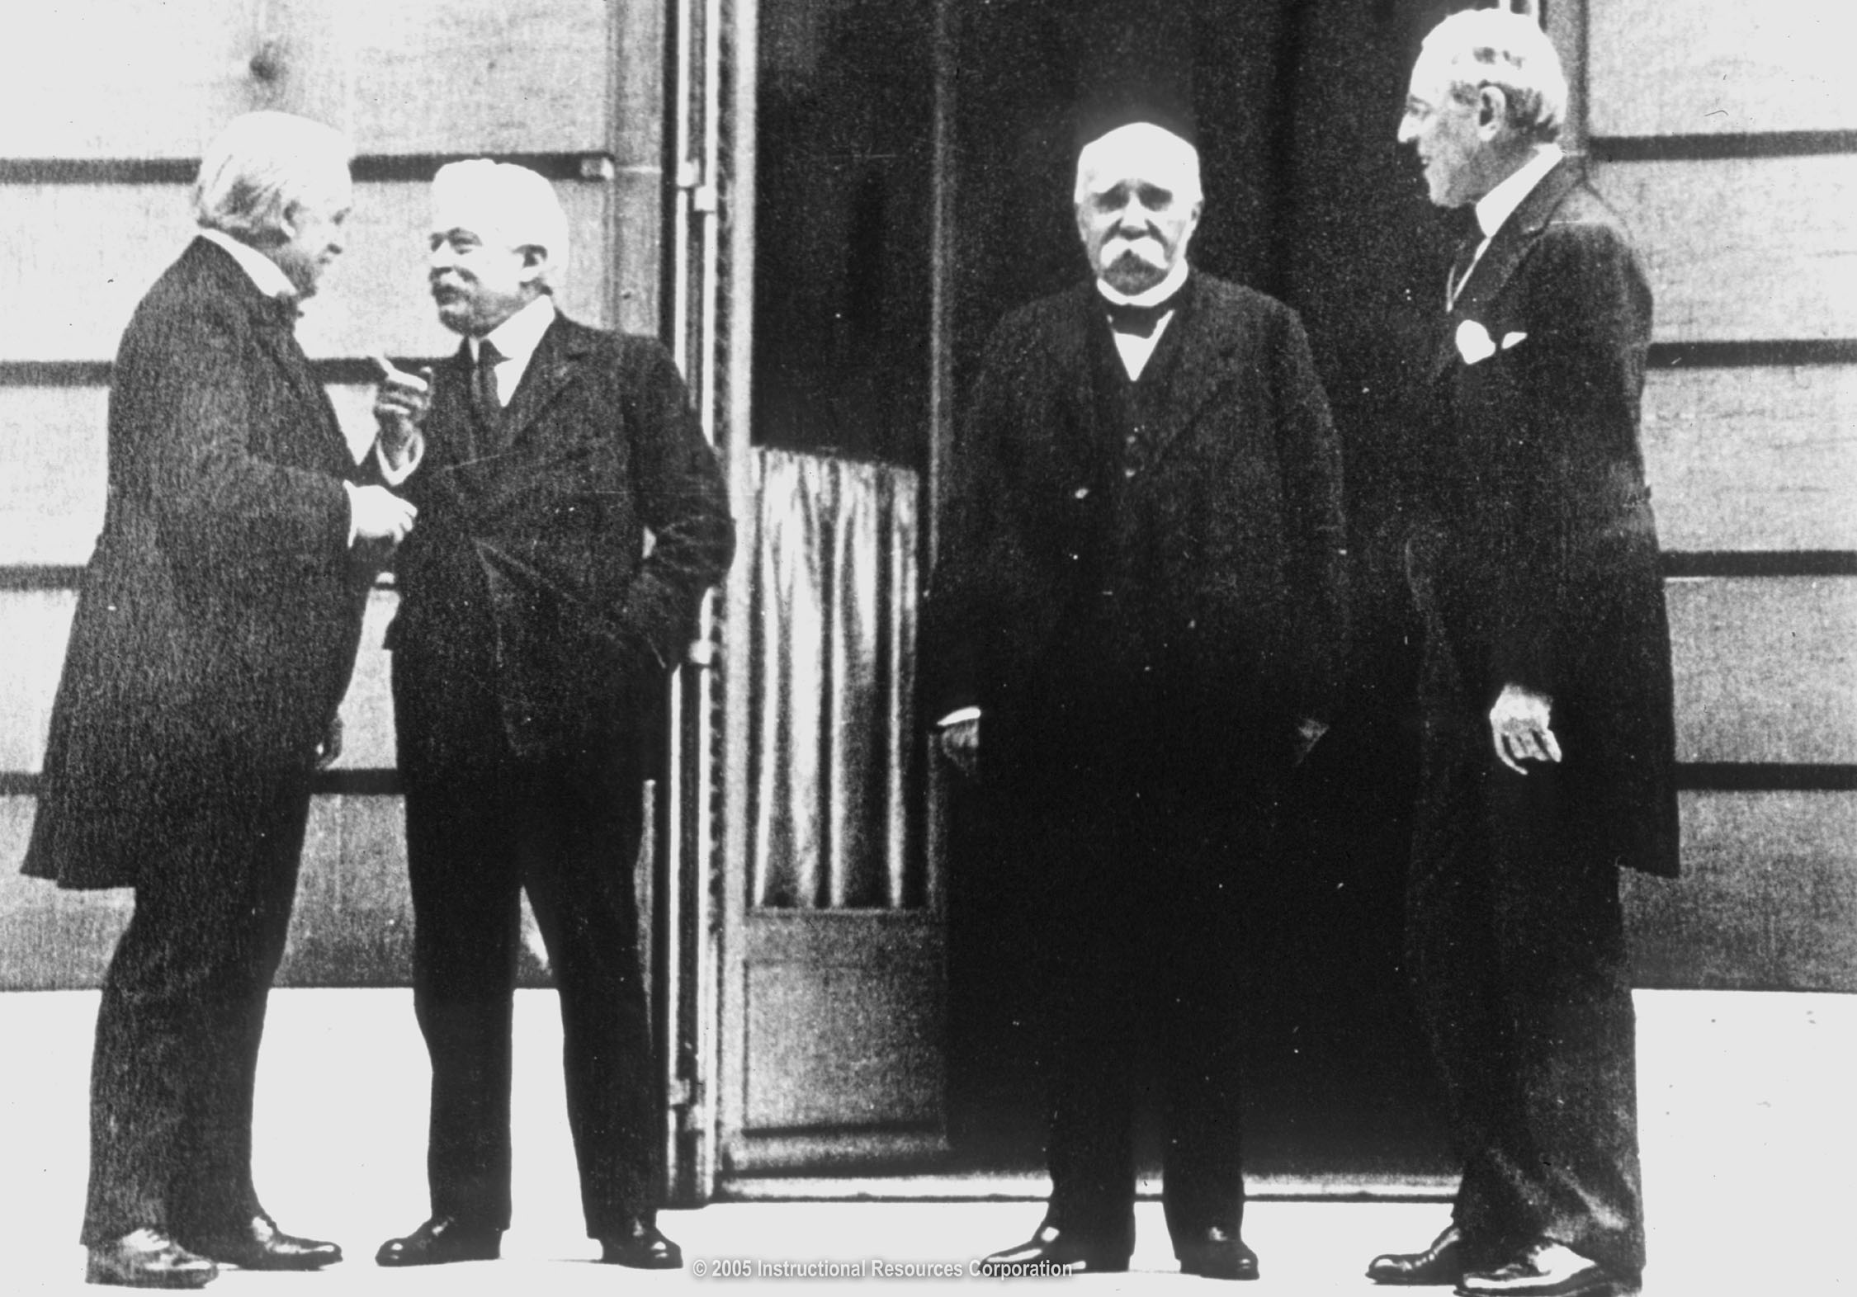
World War I
The Versailles Peace Conference was led by the Council of Four nicknamed the “Big Four”:
American President, Woodrow Wilson
British Prime Minister, David Lloyd George
French Premier, George Clemenceau
Italian Prime Minister, Vittorio Orlando

Slide 38
After months of debates and a speaking tour of the US by Wilson, the Senate will vote against the treaty three times (this kills it)
Wilson has a stroke during the tour and will become ineffective and stubborn
The US will sign a separate agreement with Germany declaring the War over in the 1920s

Slide 39
Ratification of the Treaty of Versailles in the US
Many Americans objected to the Treaty because it contained the League of Nations
They did not want to have our foreign policy dependent on an international organization

