Slide 1
SOL VUS 7
Civil War and Reconstruction

Slide 2
Leading up to the Civil War….
Many Southerners were afraid of slave revolts so what did they do to try and prevent those revolts?

Slide 3
Who were the two most famous men responsible for slave revolts?

Slide 4
What are the names of the three compromise put in place that tried to maintain a balance in Congress (especially the Senate) between free and slave states?

Slide 5
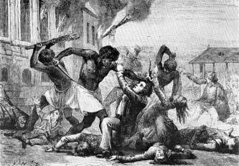
Slave Revolts

Slide 6
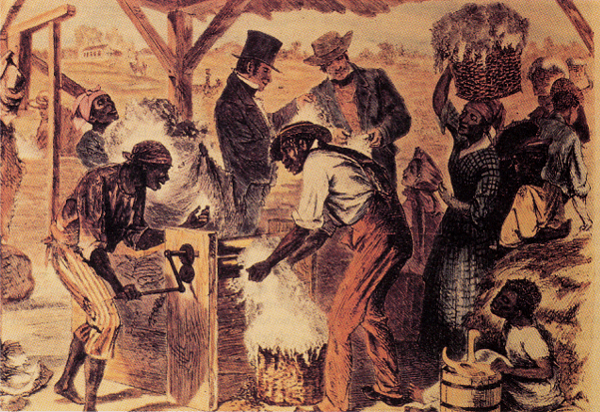

Slide 7
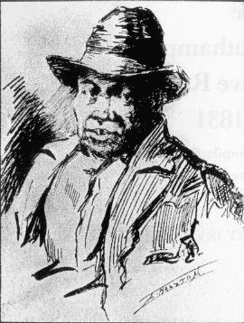
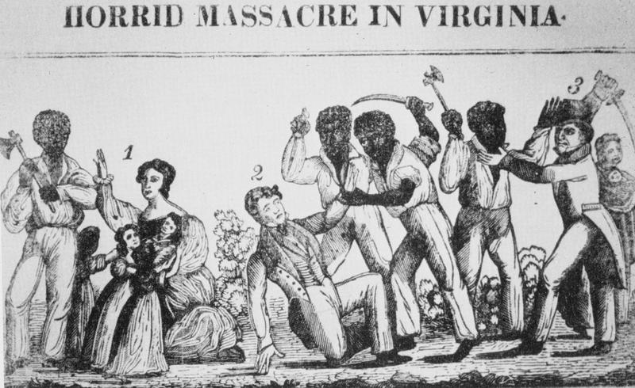
Slave Rebellions in the Antebellum South: Nat Turner, 1831

Slide 8
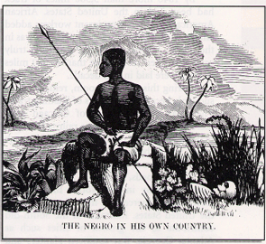
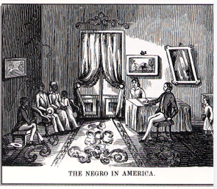
Southern Pro-Slavery Propaganda

Slide 9
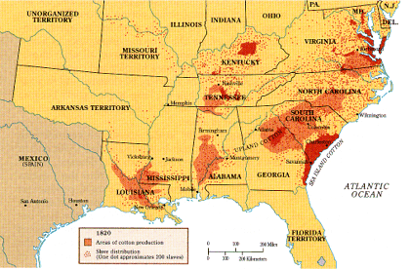
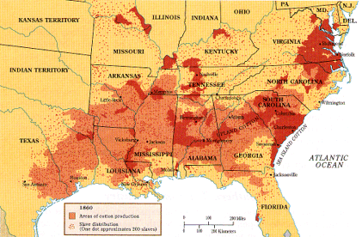
Changes in Cotton Production
1820
1860

Slide 10
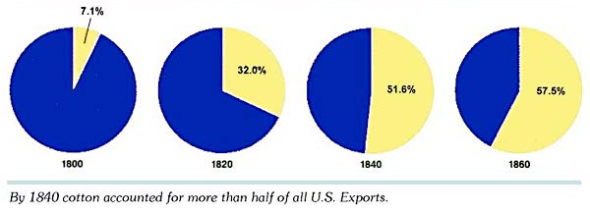
Value of Cotton Exports As % of All US Exports

Slide 11
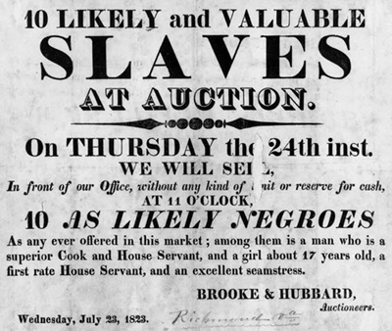
Slave Auction Notice, 1823

Slide 12
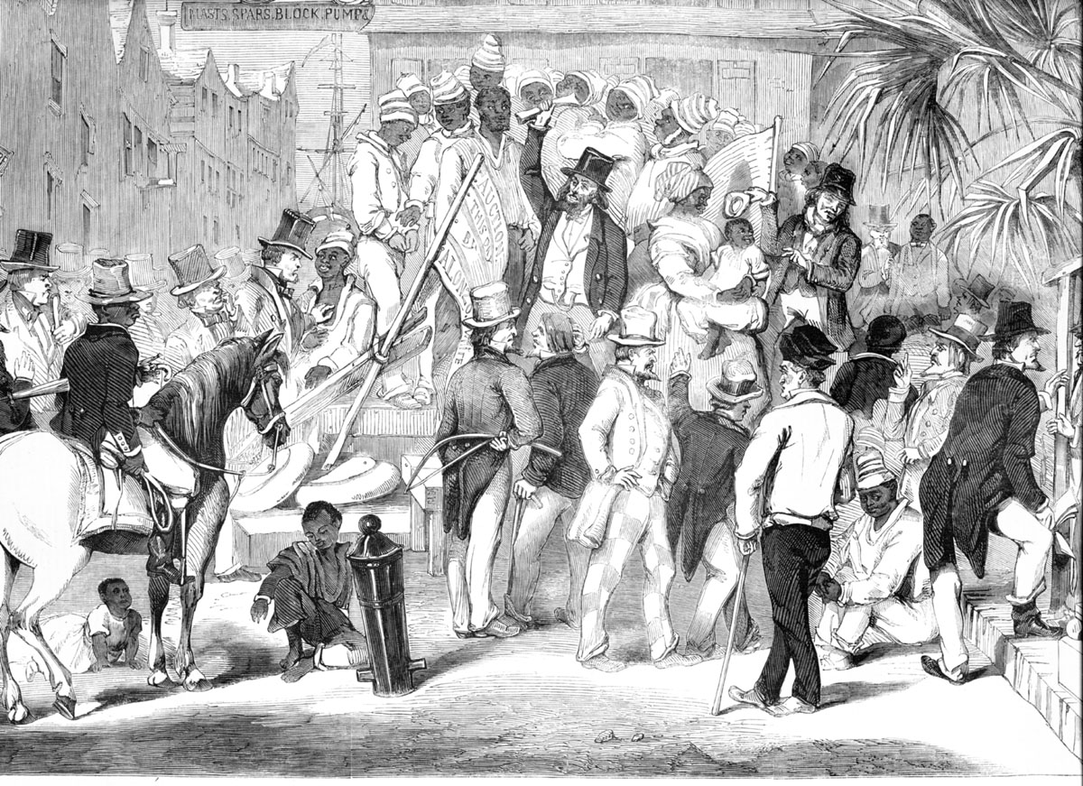
Slave Auction: Charleston, SC-1856

Slide 13
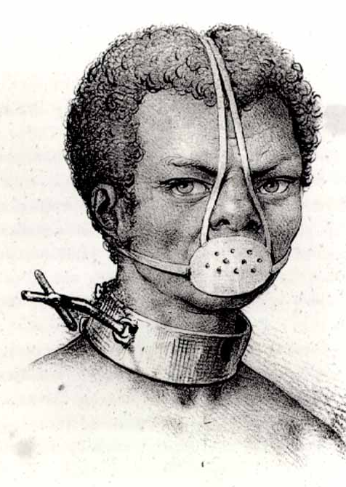
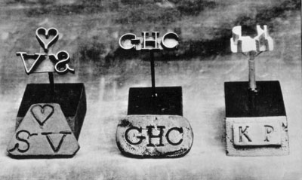
Slave Accoutrements
Slave Master Brands
Slave muzzle

Slide 14
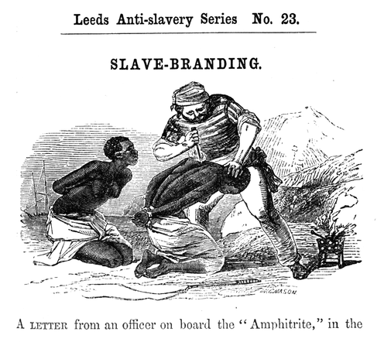
Anti-Slave Pamphlet

Slide 15
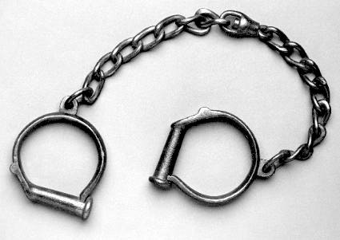
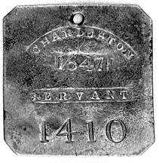
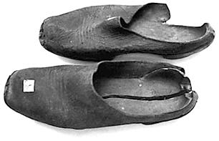
Slave Accoutrements
Slave leg irons
Slave tag, SC
Slave shoes

Slide 16
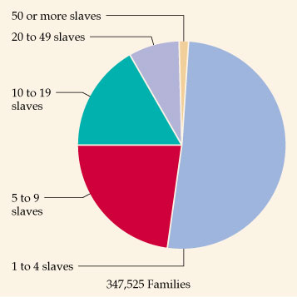
Slave-Owning Population (1850)

Slide 17
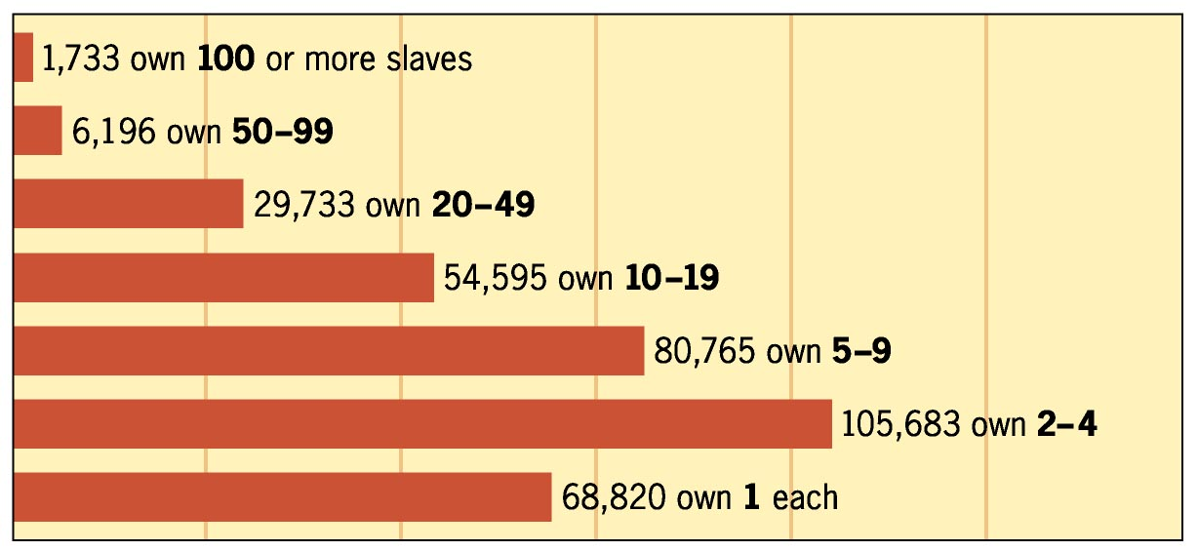
Slave-Owning Families (1850)

Slide 18
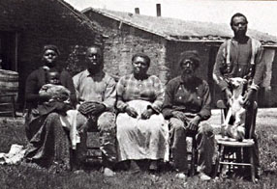
A Slave Family

Slide 19
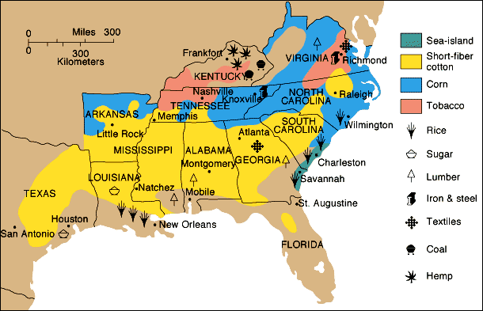
Southern Agriculture

Slide 20
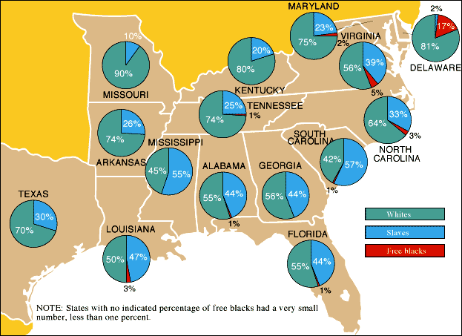
Southern Population

Slide 21
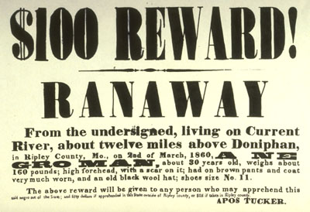
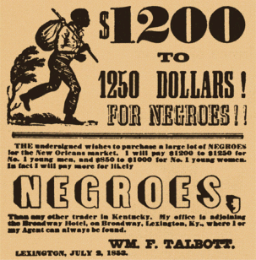
Runaway Slave Ads

Slide 22
Quilt Patterns as Secret Messages
The Monkey Wrench pattern, on the left, alerted escapees to gather up tools and prepare to flee; the Drunkard Path design, on the right, warned escapees not to follow a straight route.

Slide 23
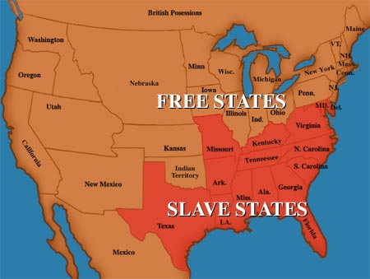
Sectional disagreements and debates over tariffs, extension of slavery in the territories, and the nature of the Union (states’ rights) will led to the Civil War.

Slide 24
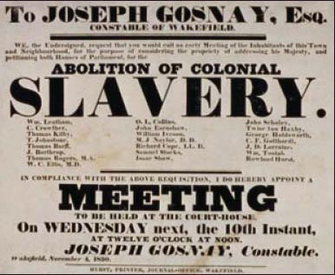
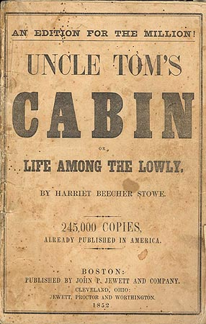
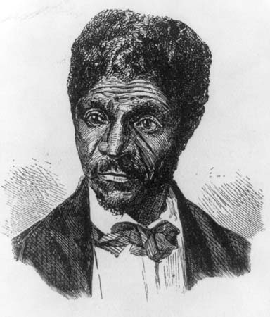
Causes of the Civil War
Northern abolitionists versus Southern defenders of slavery
United States Supreme Court decision in the Dred Scott case
Publication of Uncle Tom’s Cabin by Harriet Beecher Stowe

Slide 25
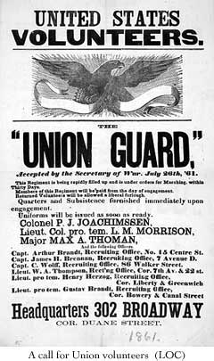
Causes of the Civil War
Ineffective presidential leadership in the 1850s
A series of failed compromises over the expansion of slavery in the territories
President Lincoln’s call for federal troops in 1861

Slide 26
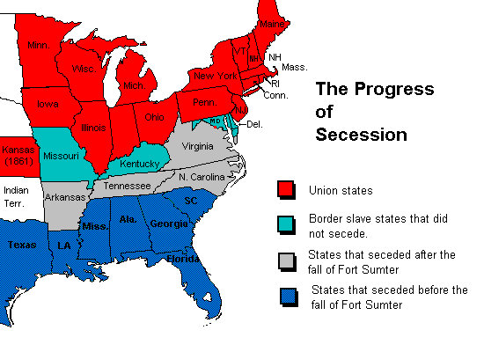
Causes of the Civil War
The secession of Southern states triggered a long and costly war that concluded with a Northern victory and resulted in the restoration of the Union and emancipation of the slaves.

Slide 27
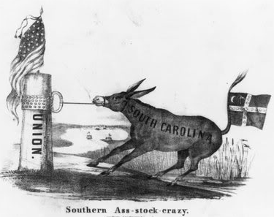
Causes of the Civil War
The Civil War put constitutional government to its most important test as the debate over the power of the federal government versus states’ rights reached a climax.
The survival of the United States as one nation was at risk, and the nation’s ability to bring to reality the ideals of liberty, equality, and justice depended on the outcome of the war.

Slide 28
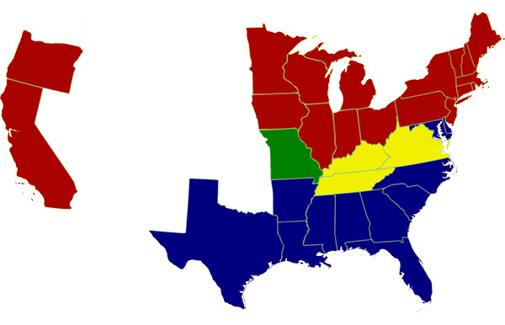
Major events
Election of Lincoln (1860), followed by the secession of several Southern states (South Carolina was first to secede) who feared that Lincoln would try to abolish slavery.

Slide 29
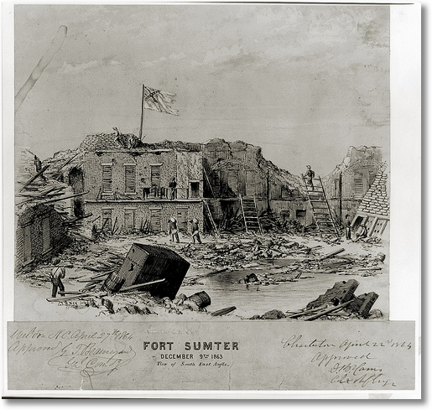
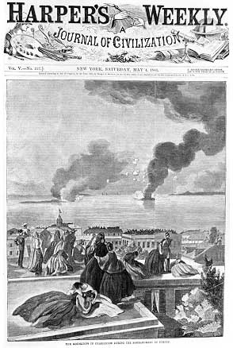
Major events
Fort Sumter: Opening confrontation of the Civil War

Slide 30
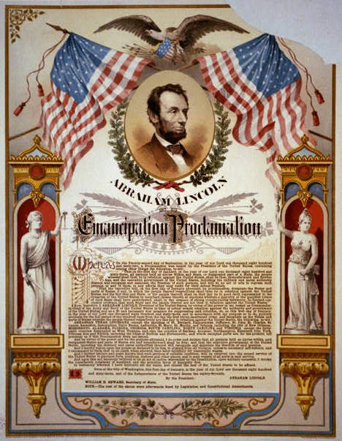
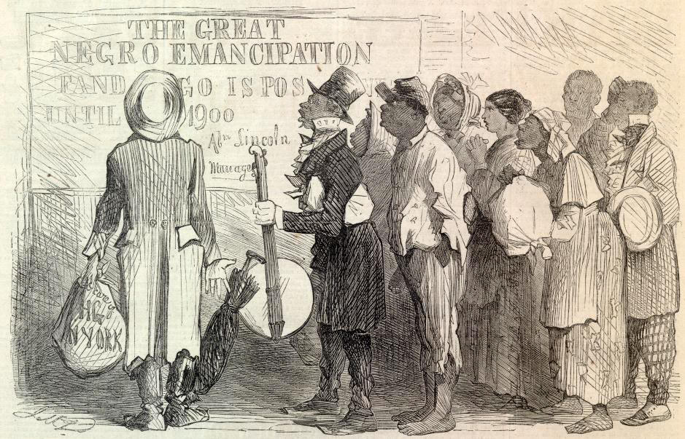
Major events
Emancipation Proclamation issued after the Battle of Antietam

Slide 31
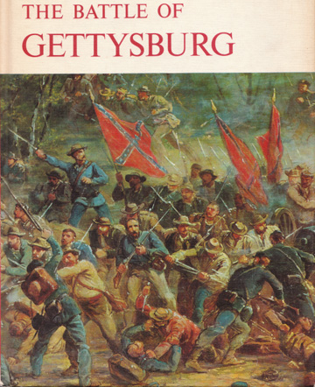
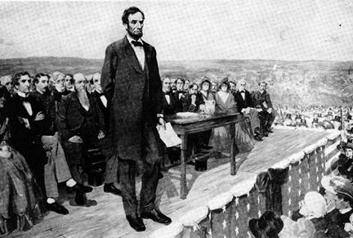
Major events
Gettysburg: Turning point of the Civil War

Slide 32
Gettysburg Address

Slide 33
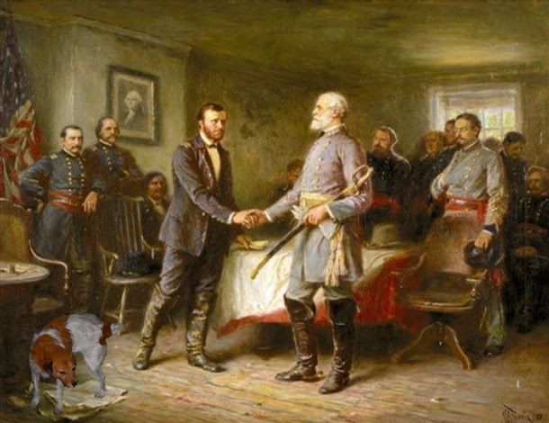
Major events
Appomattox, Virginia: Site of Lee’s surrender to Grant

Slide 34
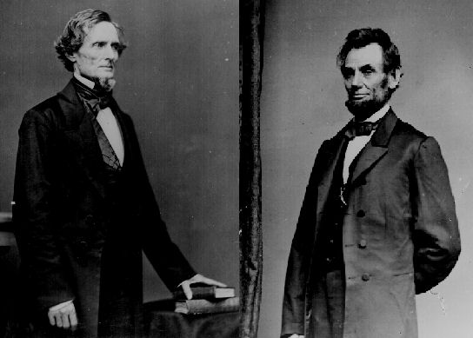
Key leaders and their roles
Abraham Lincoln: President of the United States during the Civil War, who insisted that the Union be held together, by force if necessary
Jefferson Davis: U.S. Senator who became president of the Confederate States of America

Slide 35
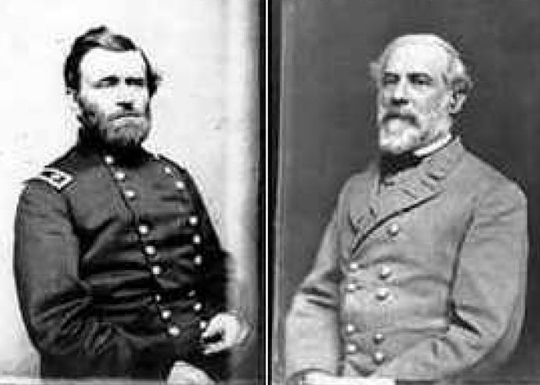
Key leaders and their roles
Ulysses S. Grant: Union military commander, who won victories over the South after several other Union commanders had failed
Robert E. Lee: Confederate general of the Army of Northern Virginia (Lee opposed secession, but did not believe the Union should be held together by force), who urged Southerners to accept defeat and unite as Americans again, when some Southerners wanted to fight on after Appomattox

Slide 36
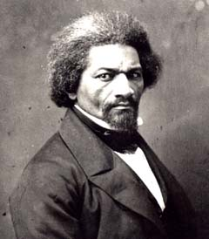
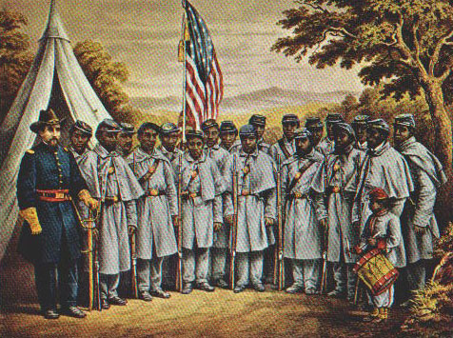
Key leaders and their roles
Frederick Douglass: Former enslaved African American who became a prominent abolitionist and who urged Lincoln to recruit former enslaved African Americans to fight in the Union army

Slide 37
Emancipation Proclamation
Freed those slaves located in the “rebelling” states (Southern states that had seceded)
Made the abolition of slavery a Northern war aim
Discouraged any interference of foreign governments
Allowed for the enlistment of African American soldiers in the Union Army

Slide 38
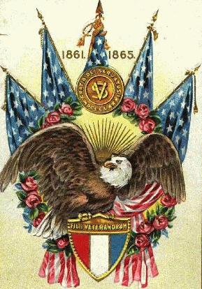
Gettysburg Address
Lincoln described the Civil War as a struggle to preserve a nation that was dedicated to the proposition that “all men are created equal” and that was ruled by a government “of the people, by the people, and for the people.”
Lincoln believed America was “one nation,” not a collection of sovereign states.
Southerners believed that states had freely joined the union and could freely leave.

Slide 39
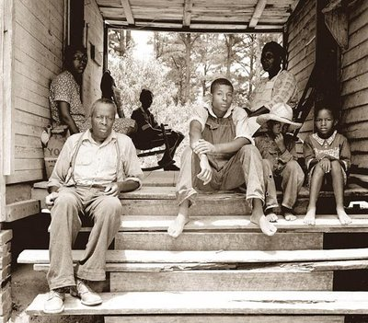
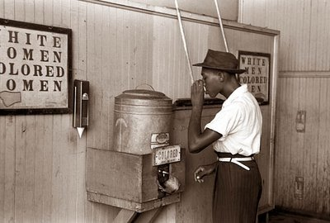
The war and Reconstruction resulted in Southern resentment toward the North and Southern African Americans, and ultimately political, economic, social control of the South returned to whites.

Slide 40
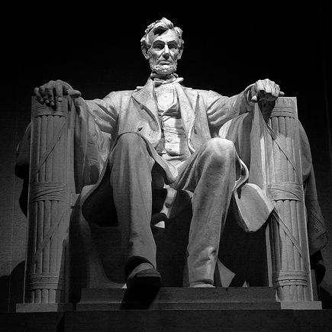
Political effects
Lincoln’s view that the United States was one indivisible nation had prevailed.
Lincoln believed that since secession was illegal, Confederate governments in the Southern states were illegitimate and the states had never really left the Union.
He believed that Reconstruction was a matter of quickly restoring legitimate Southern state governments that were loyal to the Union.
Lincoln also believed that to reunify the nation, the federal government should not punish the South, but act “with malice towards none, with charity for all… to bind up the nation’s wounds….”

Slide 41
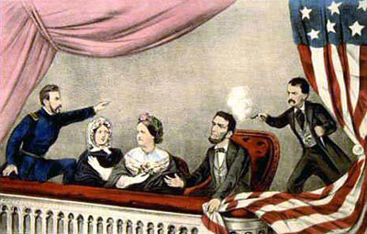
Political effects
The assassination of Lincoln just a few days after Lee’s surrender at Appomattox enabled Radical Republicans to influence the process of Reconstruction in a manner much more punitive towards the former Confederate states.
The states that seceded were not allowed back into the Union immediately, but were put under military occupation.

Slide 42
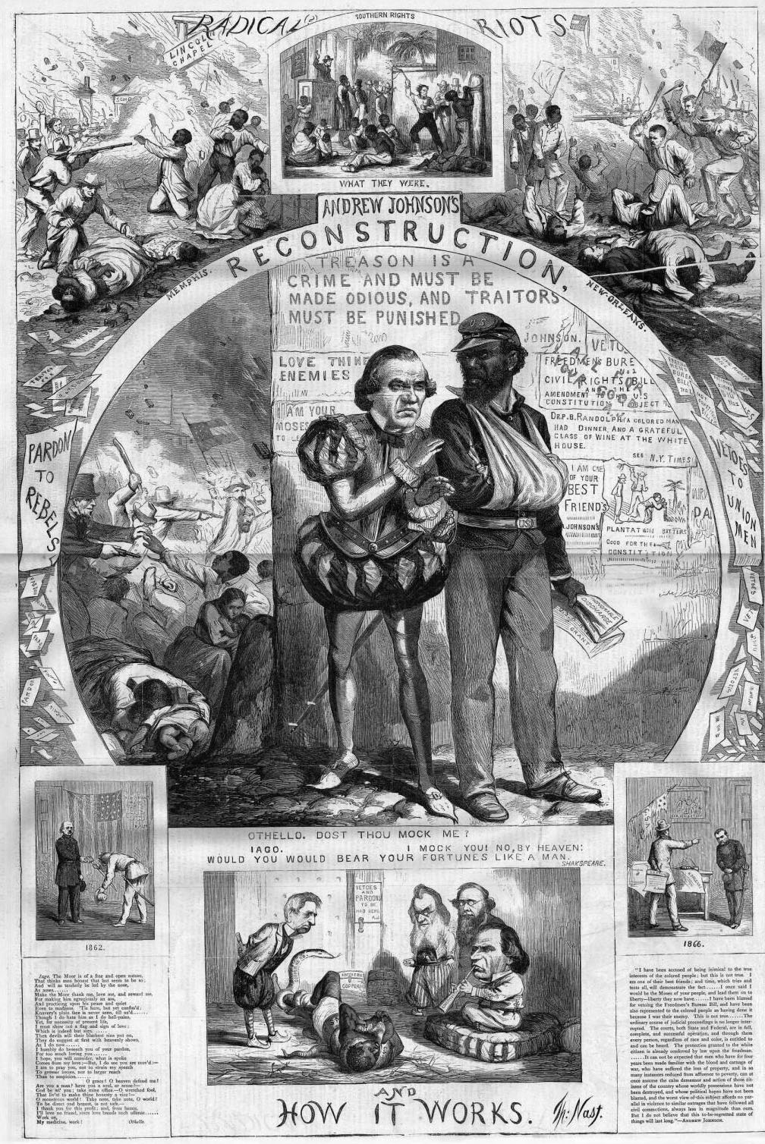
Political effects
Radical Republicans also believed in aggressively guaranteeing voting and other civil rights to African Americans.
They clashed repeatedly with Lincoln’s successor as president, Andrew Johnson, over the issue of civil rights for freed slaves, eventually impeaching him, but failing to remove him from office.

Slide 43
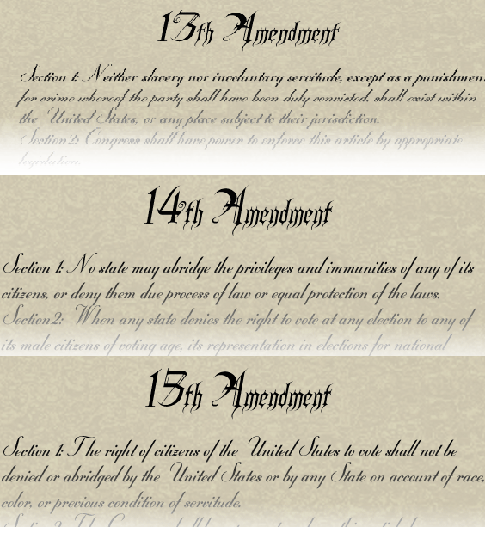
Political effects
The three “Civil War Amendments” to the Constitution were added:
13th Amendment: Slavery was abolished permanently in the United States. (free)
14th Amendment: States were prohibited from denying equal rights under the law to any American. (citizens)
15th Amendment: Voting rights were guaranteed regardless of “race, color, or previous condition of servitude” (vote).

Slide 44
Political effects
The Reconstruction period ended following the extremely close presidential election of 1876.
In return for support from Southern Democrats in the electoral college vote, the Republicans agreed to end the military occupation of the South.

Slide 45
Political effects
Known as the Compromise of 1877, this enabled former Confederates who controlled the Democratic Party to regain power.
It opened the door to the “Jim Crow Era” and began a long period in which African Americans in the South were denied the full rights of American citizenship.

Slide 47
Economic impact of Civil War
The Southern states were left embittered and devastated by the Civil War.
Farms, railroads, and factories had been destroyed through out the South.
Confederate money was worthless.
Many towns and cities such as Richmond and Atlanta lay in ruins, and the source of labor was greatly changed due to the loss of life during the war and the end of slavery.
The South would remain an agriculture-based economy and the poorest section of the nation for many decades afterward.

Slide 48
Economic impact
The North and Midwest emerged with strong and growing industrial economies, laying the foundation for the sweeping industrialization of the nation (other than the South) in the next half- century and the emergence of the United States as a global economic power by the beginning of the twentieth century.

Slide 49
Economic impact
The completion of the Transcontinental Railroad soon after the war ended intensified the westward movement of settlers into the states between the Mississippi River and the Pacific Ocean.

Slide 50
Although slavery ended, African-Americans did not achieve full equality during the next 100 years.
For the common soldier, warfare was brutal and camp life was lonely and boring; many soldiers returned home wounded or disabled.
On the home front, women were required to assume nontraditional roles.
Enslaved African Americans seized the opportunity presented by the approach of Union troops to achieve freedom.

Slide 51
Impact on Common soldiers
Warfare often involved hand-to-hand combat.
Wartime diaries and letters home record this harsh reality.
After the war, especially in the South, soldiers returned home to find destroyed homes and poverty.
Soldiers on both sides lived with permanent disabilities.

Slide 52
Impact on Women
Managed homes and families with scarce resources
Often faced poverty and hunger
Assumed new roles in agriculture, nursing, and war industries

Slide 53
Ulysses S. Grant
Urged Radical Republicans not to be harsh with former Confederates
Elected president and served during most of Reconstruction
Advocated rights for the freedman
Opposed retribution directed at the defeated South

Slide 54
Robert E. Lee
Urged Southerners to reconcile and rejoin the United States
Served as president of Washington College (Washington & Lee University today)
Emphasized the importance of education to the nation’s future

Slide 55
Frederick Douglass
Supported full equality for African Americans
Advocated for the passage of the 14th and 15th Amendments
Encouraged federal government actions to protect the rights of freedmen in the South
Served as ambassador to Haiti and in the civil service

