Slide 1
SOL VUS 6
Last Half of the 18th Century Through the First Half of the 19th Century

Slide 2
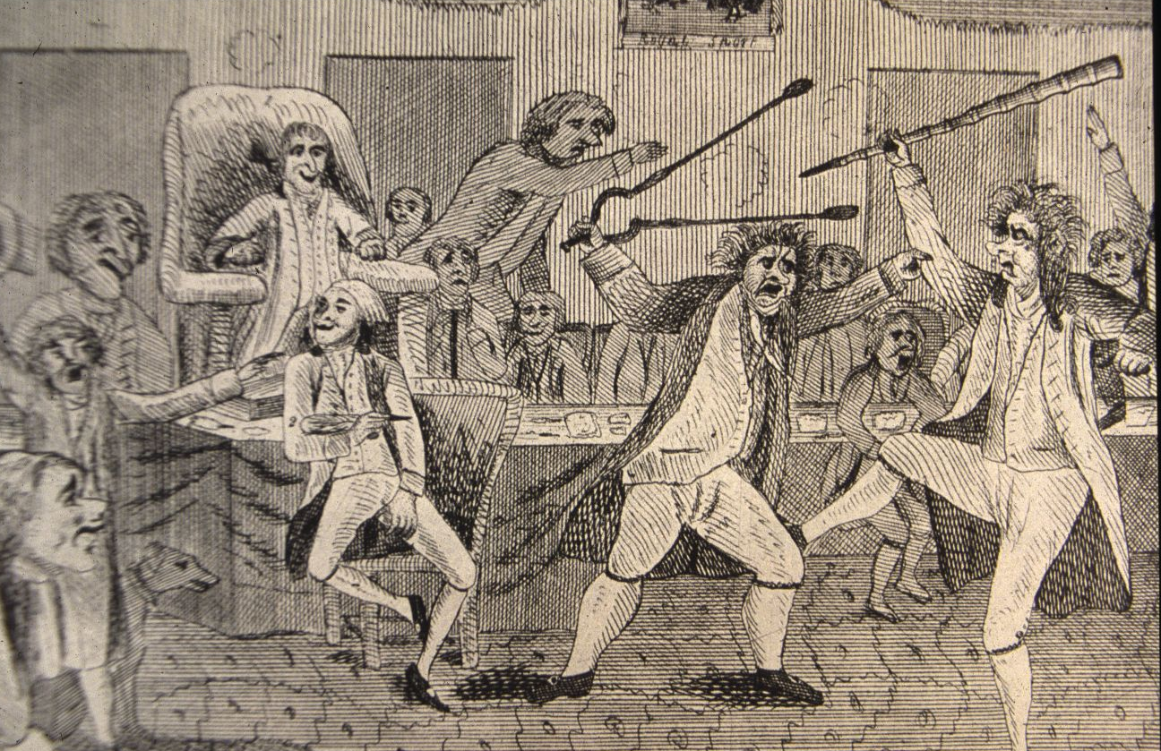
Different views of economic and foreign policy issues led to the development of the first American political parties.

Slide 3
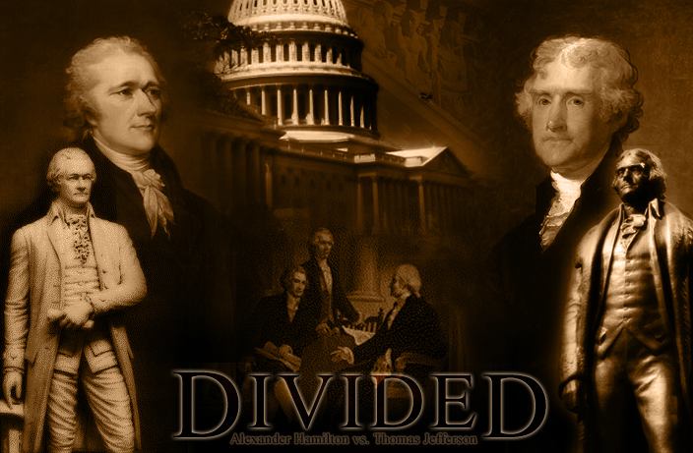
Controversy over the Federalists’ support for the Bank of the United States, the Jay Treaty, and the undeclared war on France contributed to the emergence of an organized opposition party, the Democratic- Republicans, led by Thomas Jefferson and James Madison.

Slide 4
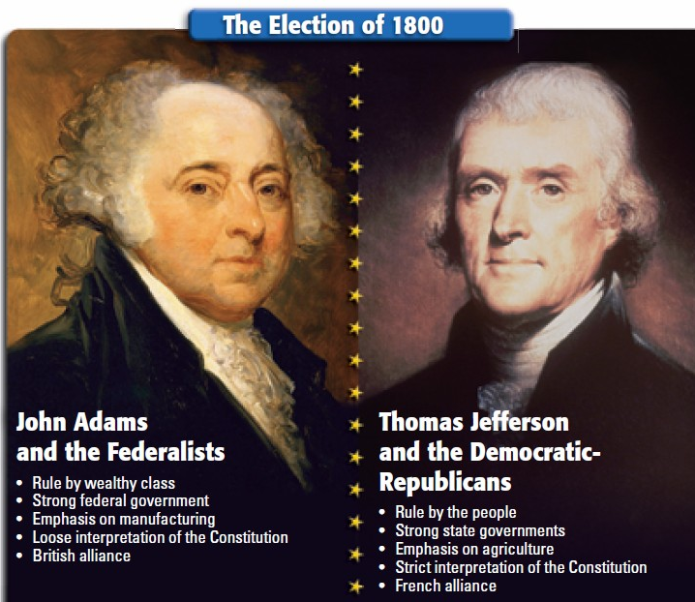
The presidential election of 1800, won by Thomas Jefferson, was the first American presidential election in which power was peacefully transferred from one political party to another.
Democratic-Republican
Federalist

Slide 5
First Political Parties
The Federalists, led by John Adams and Alexander Hamilton, typically believed in a strong national government and commercial economy.
They were supported by bankers and business interests in the Northeast.
The Democratic-Republicans believed in a weak national government and an agricultural economy.
They were supported by farmers, artisans, and frontier settlers in the South.

Slide 6
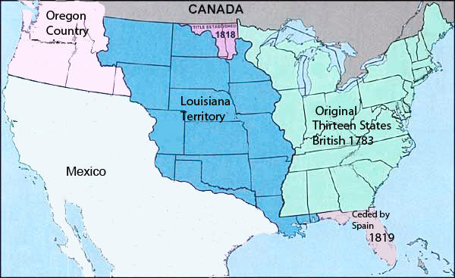
Economic and strategic interests, supported by popular beliefs, led to territorial expansion to the Pacific Ocean.

Slide 7
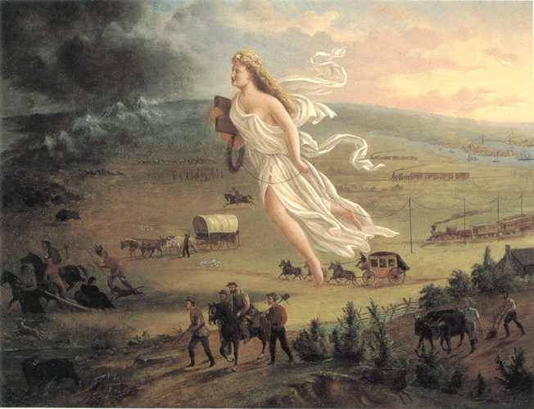
The new American republic prior to the Civil War experienced dramatic territorial expansion, immigration, economic growth, and industrialization. Americans, stirred by their hunger for land and the ideology of “Manifest Destiny,” flocked to new frontiers.

Slide 8
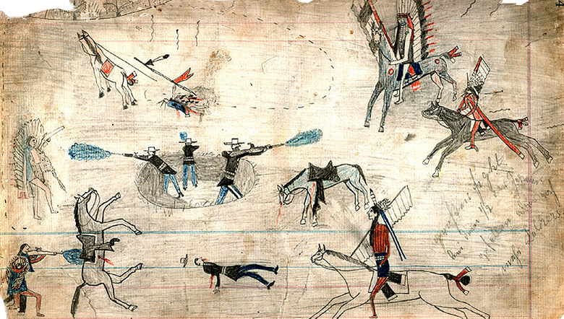
Conflicts between American settlers and Indian nations in the Southeast and the old Northwest resulted in the relocation of many Indians to reservations.

Slide 9
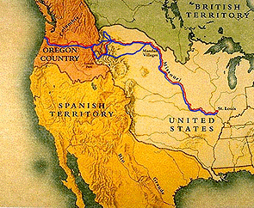
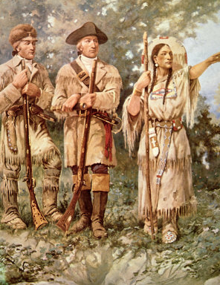
Expansion resulting from the Louisiana Purchase and War of 1812
Thomas Jefferson, as president in 1803, purchased the huge Louisiana Territory from France, which doubled the size of the United States overnight.
He authorized the Lewis and Clark expedition to explore the new territories that lay west of the Mississippi River.
Sacajawea, an American Indian woman, served as their guide and translator.

Slide 10
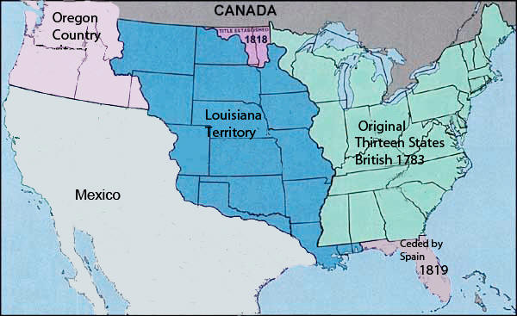
The American victory over the British in the War of 1812 produced an American claim to the Oregon Territory and increased migration of American settlers into Florida, which was later acquired by treaty from Spain.

Slide 11
The Monroe Doctrine (1823) stated the following:
The American continents should not be considered for future colonization by any European powers.
Nations in the Western Hemisphere were inherently different from those of Europe—i.e., they were republics by nature rather than monarchies.
The United States would regard as a threat to its own peace and safety any attempt by European powers to impose their system on any independent state in the Western Hemisphere.
The United States would not interfere in European affairs.

Slide 12
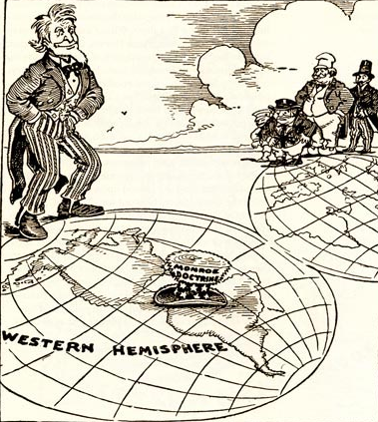

Slide 13
The westward movement and economic development
American settlers streamed westward from the coastal states into the Midwest, Southwest, and Texas, seeking economic opportunity in the form of land to own and farm.
The growth of railroads and canals helped the growth of an industrial economy and supported the westward movement of settlers.
Eli Whitney’s invention of the cotton gin led to the spread of the slavery-based “cotton kingdom” in the Deep South.

Slide 14
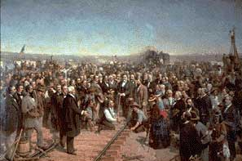
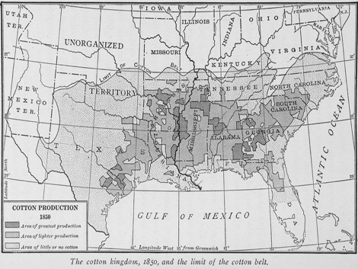
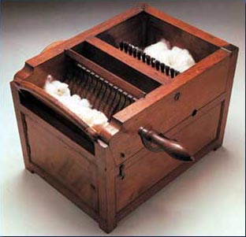
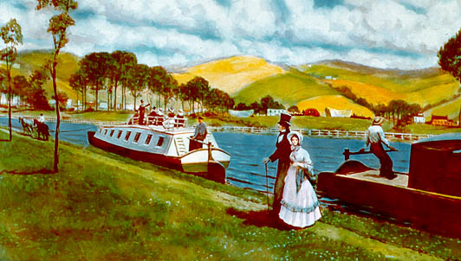

Slide 15
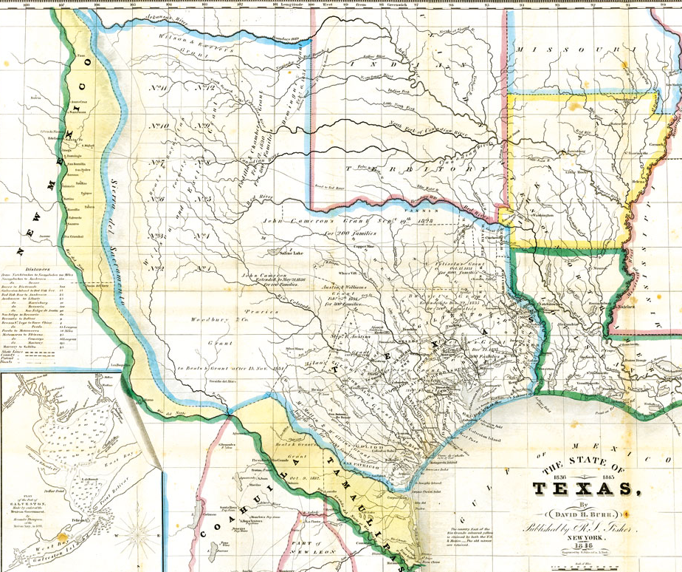
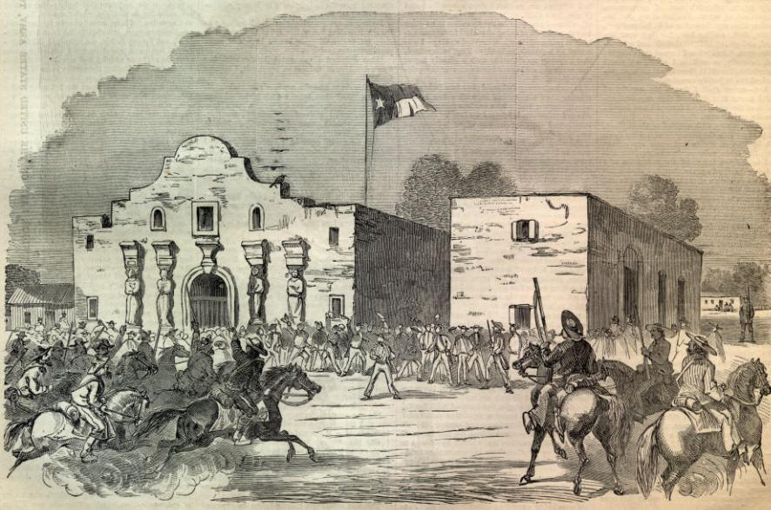
The westward movement and economic development
American migration into Texas led to an armed revolt against Mexican rule and a famous battle at the Alamo, in which a band of Texans fought to the last man against a vastly superior force.
The Texans’ eventual victory over Mexican forces subsequently brought Texas into the United States.

Slide 16
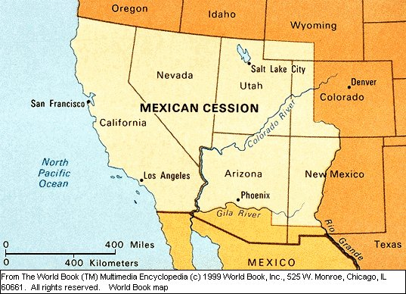
The westward movement and economic development
The American victory in the Mexican War during the 1840s led to the acquisition of an enormous territory that included the present-day states of California, Nevada, Utah, Arizona, and parts of Colorado and New Mexico.

Slide 17
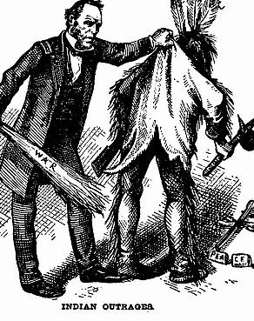
Impact on the American Indians
The belief that it was America’s “Manifest Destiny” to stretch from the Atlantic to the Pacific provided political support for territorial expansion.
During this period of westward migration, American Indians were repeatedly defeated in violent conflicts with settlers and soldiers and forcibly removed from their ancestral homelands.

Slide 18
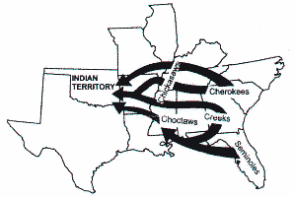
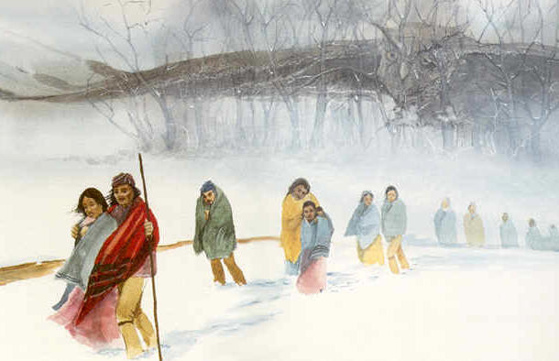
Impact on the American Indians
They were either forced to march far away from their homes (the “Trail of Tears,” when several tribes were relocated from Atlantic Coastal states to Oklahoma) or confined to reservations.

Slide 19
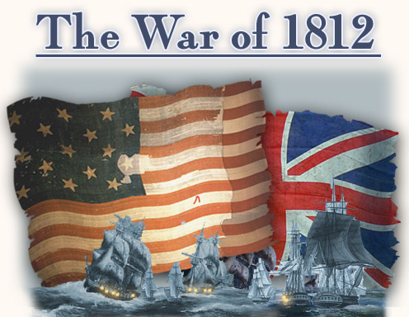
British interference with American shipping and western expansionism fueled the call for a declaration of war.
Federalists opposed Madison’s war resolution and talked of secession and proposed constitutional amendments, which were not acted upon.

Slide 20
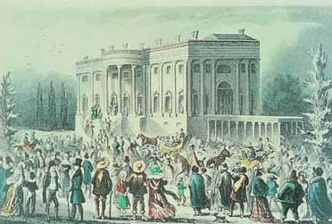
An extension of the franchise, westward expansion, and the rise of sectional interests prompted increased participation in state and national politics.
The changing character of American politics in “the age of the common man” was characterized by
heightened emphasis on equality in the political process for adult white males
the rise of interest group politics and sectional issues
a changing style of campaigning
increased voter participation.

Slide 21
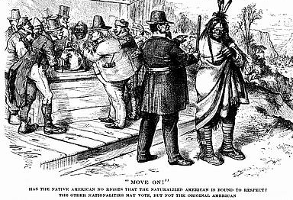

Slide 22
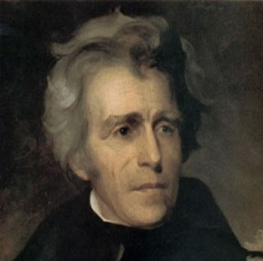
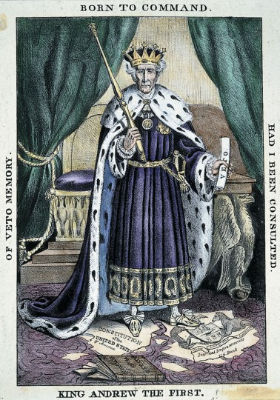
Andrew Jackson personified the “democratic spirit” of the age by challenging the economic elite and rewarding campaign supporters with public office (Spoils System).
The Federalist Party disappeared, and new political parties, the Whigs and Know-Nothings, were organized in opposition to the Democratic Party.

Slide 23
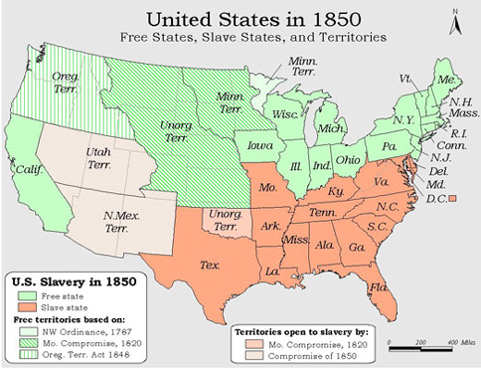
The nation struggled to resolve sectional issues, producing a series of crises and compromises.
These crises took place over the admission of new states to the Union during the decades before the Civil War.
The issue was whether the number of “free states” and “slave states” would remain balanced, thus affecting the distribution of power in the Congress.

Slide 24
Sectional tensions caused by competing economic interests
The industrial North favored high protective tariffs to protect Northern manufactured goods from foreign competition.
The agricultural South opposed high tariffs that made the price of imports more expensive.

Slide 25
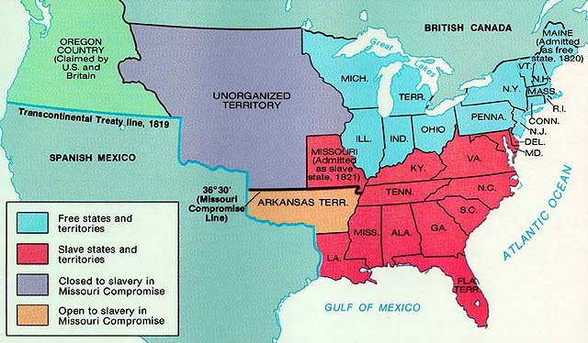
Sectional tensions caused by westward expansion
As new states entered the Union, compromises were reached that maintained the balance of power in Congress between “free” and “slave” states.
The Missouri Compromise (1820) drew an east-west line through the Louisiana Purchase, with slavery prohibited above the line and allowed below, except that slavery was allowed in Missouri, north of the line.

Slide 26
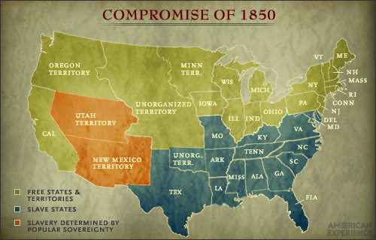
Sectional tensions caused by westward expansion
In the Compromise of 1850, California entered as a free state, while the new Southwestern territories acquired from Mexico would decide on their own (popular sovereignty), and a tougher Fugitive Slave Law/Act.

Slide 27
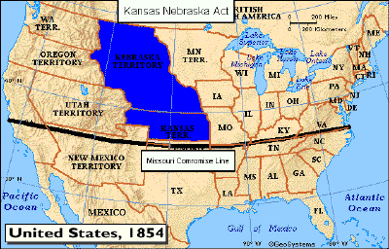
Sectional tensions caused by westward expansion
The Kansas-Nebraska Act of 1854 repealed the Missouri Compromise line, giving people in Kansas and Nebraska the choice whether to allow slavery in their states or not (“popular sovereignty”).

Slide 28
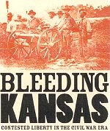
Sectional tensions caused by westward expansion
The Kansas-Nebraska Act produced bloody fighting in Kansas as pro- and anti-slavery forces battled each other. It also led to the birth of the Republican Party that same year to oppose the spread of slavery.

Slide 29
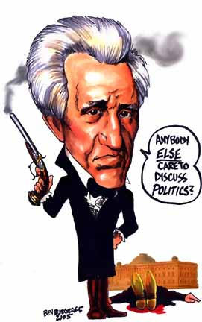
Sectional tensions caused by debates over the nature of the Union
South Carolinians argued that sovereign states could nullify the Tariff of 1832 and other acts of Congress.
A union that allowed state governments to invalidate acts of the national legislature could be dissolved by states seceding from the Union in defense of slavery (Nullification Crisis).
President Jackson threatened to send federal troops to collect the tariff revenues.

Slide 30
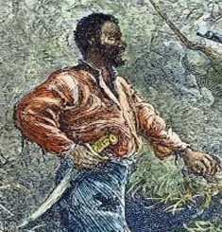
Sectional tensions caused by the institution of slavery
Slave revolts in Virginia, led by Nat Turner and Gabriel Prosser, fed white Southerners’ fears about slave rebellions and led to harsh laws in the South against fugitive slaves.
Southerners who favored abolition were intimidated into silence.

Slide 31
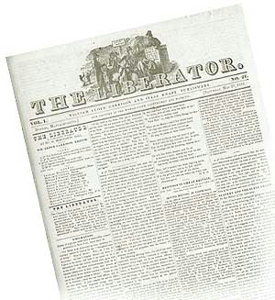
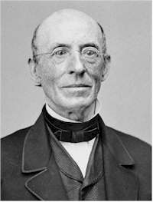
Sectional tensions caused by the institution of slavery
Northerners, led by William Lloyd Garrison, publisher of The Liberator, increasingly viewed the institution of slavery as a violation of Christian principles and argued for its abolition.
Southerners grew alarmed by the growing force of the Northern response to the abolitionists.

Slide 32
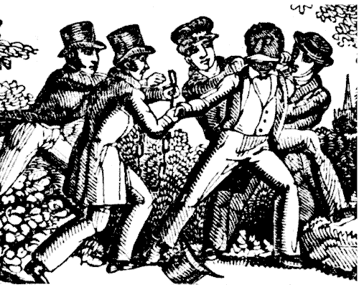
Sectional tensions caused by the institution of slavery
Fugitive slave events pitted Southern slave owners against outraged Northerners who opposed returning escaped slaves to bondage.

Slide 33
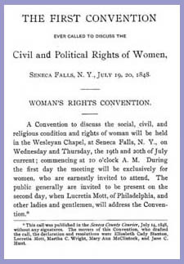
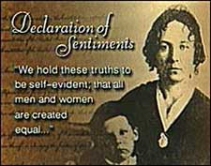
The women’s suffrage movement
At the same time the abolitionist movement grew, another reform movement took root—the movement to give equal rights to women.
Seneca Falls Declaration

Slide 34
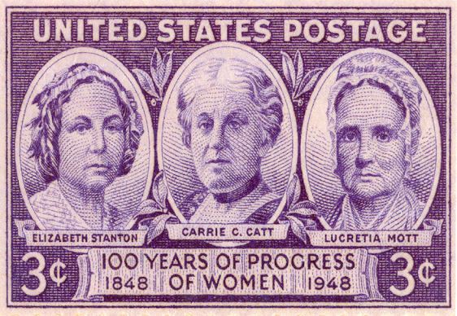
The women’s suffrage movement
Elizabeth Cady Stanton and Susan B. Anthony, became involved in the women’s suffrage movement before the Civil War and continued with the movement after the war

