Slide 1
SOL VUS 5
The New Government – The Constitution of the United States

Slide 2
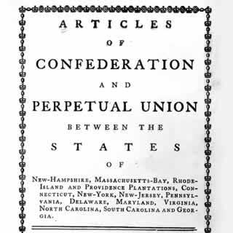
Confederation and Constitution
The Americans made two attempts to establish a workable government based on republican ideals: Articles of Confederation and the Constitution.

Slide 3
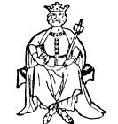
Attempts at a New Government
Fearful of a powerful central government like England’s, America’s political leaders created the Articles of Confederation.

Slide 4
The Articles of Confederation
Provided for a weak national government
Gave Congress no power to tax or regulate commerce (trade) among
the states
Provided for no common currency
Gave each state one vote regardless of size
Provided for no executive or judicial branch

Slide 5
A weak national government
Congress could not tax or regulate commerce among states
No common currency
Just one vote per state, size didn’t matter
No executive or judicial branch
Weaknesses of the Articles of Confederation

Slide 6
The Making of the Constitution
The second government was the Constitution of the United States which established a government that:
Shared power between the national government and state governments = federalism.
Protected the rights of states
Provided a system for orderly change through amendments to the Constitution itself.

Slide 7
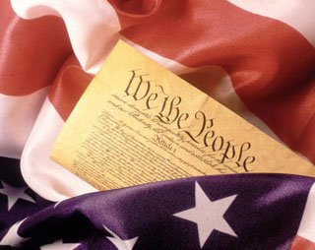
The Making of the Constitution
Key issues and their resolutions
Federal laws are supreme when constitutional but the states have considerable power to govern themselves.
Enumerated, Shared, or Reserved Powers
The power of Congress was limited to those identified in the Constitution =
Enumerated Powers
Collecting taxes
Regulating commerce
Declare war
maintain Army & Navy
Do what is necessary and proper to carry out duties.

Slide 8
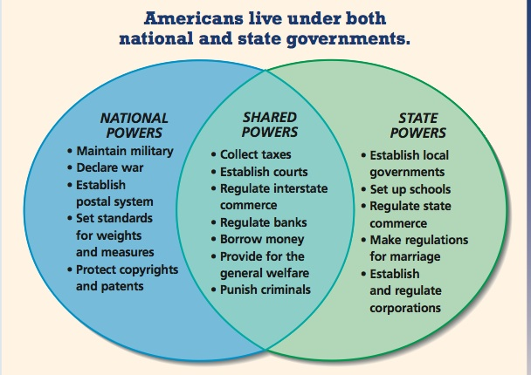

Slide 9
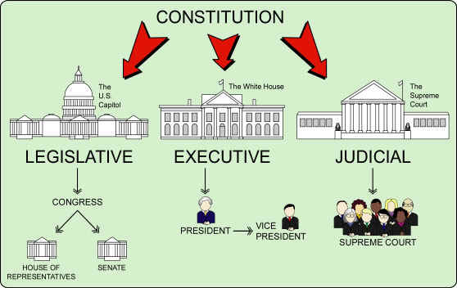
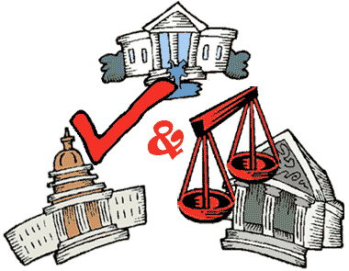
Checks and Balances
Avoided a too-powerful central government by establishing three co-equal branches—legislative, executive, and judicial
With numerous checks and balances among them
Limited the powers of the federal government to those identified in the Constitution

Slide 10
Key Issues → Resolution
Power was balanced between large and small states by creating a Senate with equal representation and a House of Representatives with members based on population
There can be several Representatives from large state
Each state
has 2 Senators

Slide 11
Do Slaves Count in the “Population”?
To please Southern slave-holding states, 3/5 of slaves were able to be
counted when determining the number of Representatives.
= The Three-fifths Compromise

Slide 12
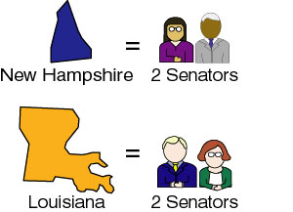
U.S. Constitution

Slide 13
Checks & Balances

Slide 14
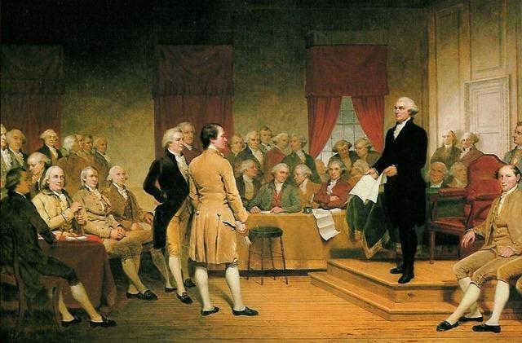
The Making of the Constitution
Key leaders
George Washington, a Virginian, was president of the Convention
He presided at the Convention, and although seldom participating in the debates, lent his enormous prestige to the proceedings.

Slide 15
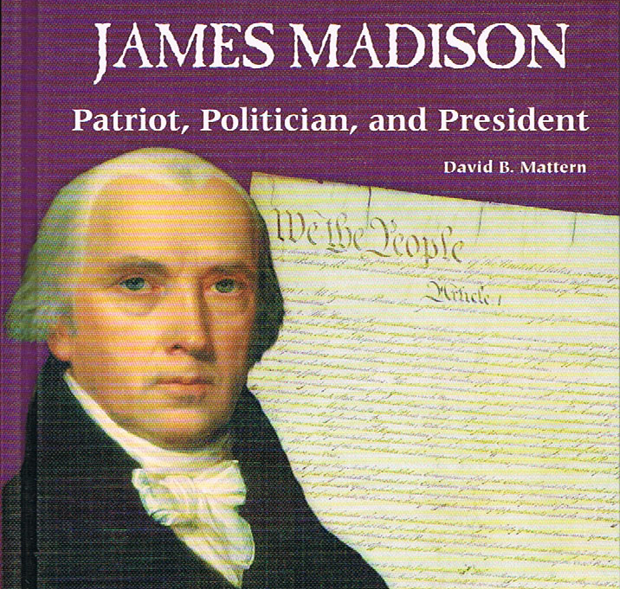
The Making of the Constitution
Key leaders
James Madison, “Father of the Constitution”
Madison, a Virginian and the writer of the “ Virginia Plan,”
kept copious notes of the proceedings.
He wrote the Bill of Rights.

Slide 16
Bill of Rights—Virginia’s Contributions
George Mason wrote the Virginia Declaration of Rights. It held the basic idea that human rights should not be violated by government.
Thomas Jefferson wrote the Virginia Statute for Religious Freedom. It outlawed the “established church” or the support of government for one favored church.

Slide 17
Virginia Statute of Religious Freedom

Slide 18
Principles of the Bill of Rights was based on…
The major principles of the Bill of Rights of the Constitution were based on earlier Virginia statutes.
Virginia Declaration of Rights (George Mason)
Reiterated the notion that basic human rights should not be violated by governments
Virginia Statute for Religious Freedom (Thomas Jefferson)
Outlawed the established church—that is, the practice of government support for one favored church
Sum It Up
James Madison consulted the Virginia Declaration of Rights and the Virginia Statute for Religious Freedom when drafting the amendments that eventually became the United States Bill of Rights.

Slide 19
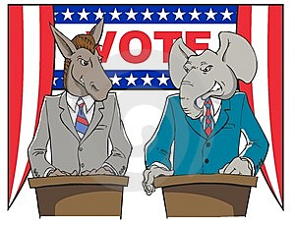
The Constitution was a “bundle of compromises” among the framers who held a variety of political beliefs
Two “sides” emerged from the Convention, those who supported ratification (Federalists) and those opposed (Anti-Federalists)
Elements of Federalist and Anti-Federalist thought are reflected in contemporary political debate on issues such as the size and role of government, federalism, and the protection of individual rights.

Slide 20
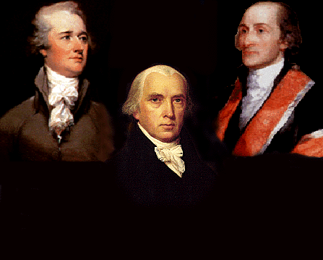
Federalists advocated the importance of a strong central government, especially to promote economic development and public improvements.
Today, those who see a primary role for the federal government in solving national problems are heirs to this tradition.

Slide 21
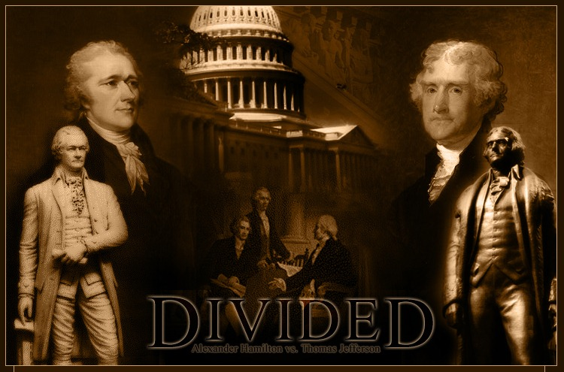
Anti-Federalists feared an overly powerful central government destructive of the rights of individuals and the prerogatives of the states.
Today, the more conservative thinkers echo these concerns and champion liberty, individual initiative, and free markets.

Slide 22
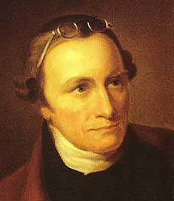
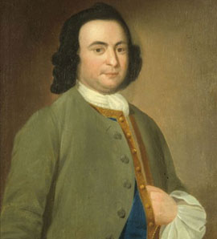
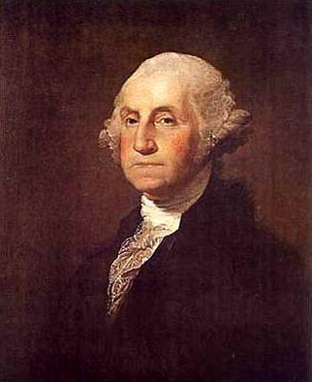
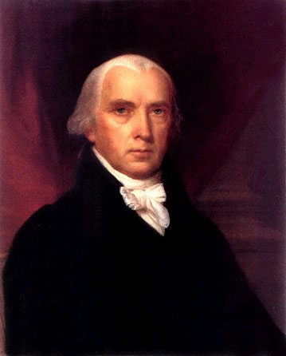
The leading Virginia opponents of ratification were Patrick Henry (“Give me Liberty or Give me Death”) and George Mason
The leading Virginia proponents of ratification were George Washington and James Madison.

Slide 23
Ratification
George Washington
George Mason
James Madison
Patrick Henry

Slide 24
V.

Slide 25
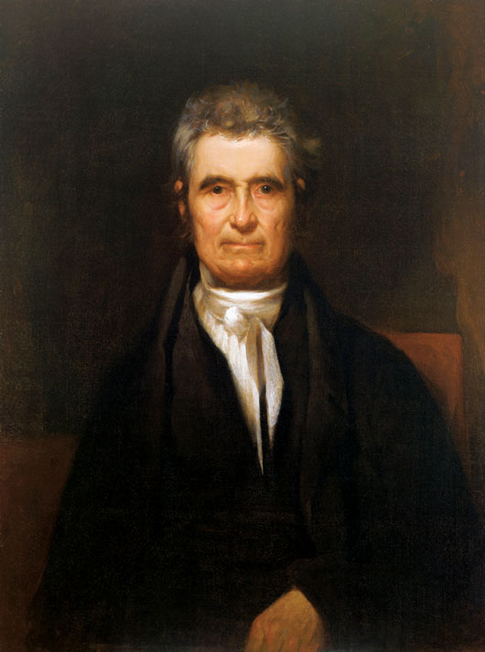
Important legal precedents established by the Marshall Court strengthened the United States Supreme Court as an equal branch of the national government.
The doctrine of judicial review set forth in Marbury v. Madison
The doctrine of implied powers set forth in McCulloch v. Maryland
A broadly national view of economic affairs and interstate commerce set forth in Gibbons v. Ogden
All are the foundation blocks of the Supreme Court’s authority to mediate disagreements between branches of governments, levels of government, and competing business interests.
John Marshall Chief Justice of the Supreme Court

Slide 26
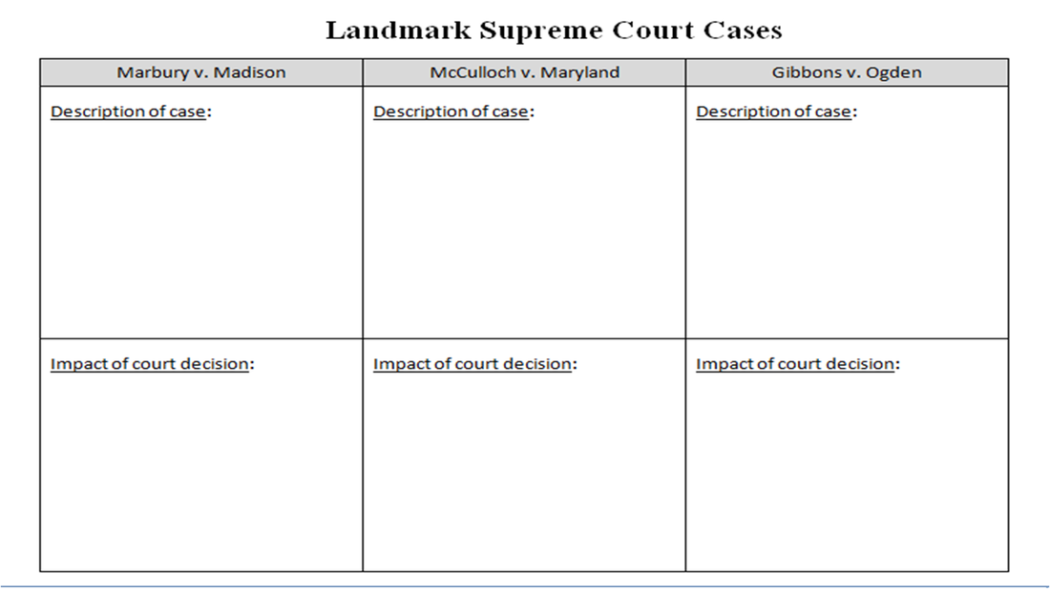
Complete the following:

Slide 27
I. Marbury v Madison 1803
A. Prior to Adams leaving office Congress
(Federalist dominated) tried to assert
power over the Judicial Branch
B. Judiciary Act of 1801
1. Created 16 new federal judgeships
2. Adams approves appointments during
last days as president
3. Became known as the “Midnight Judges”
4. Way Adams (Federalists) could protect
country against Jefferson’s ideals

Slide 28
I. Marbury v Madison 1803 cont
C. William Marbury (“midnight judge”)
D. Appointed by Adams to serve in
Washington, D.C.
E. James Madison the Secretary of
State
1. Refuses to allow Marbury his bench
2. Marbury refuses to step down
3. Madison asks Supreme Court to step in

Slide 29
I. Marbury v Madison 1803 cont
F. John Marshall-Chief Justice (appointed by
Adams)
1. Federalist from VA
2. Acted on over 500 cases
G. Marbury v Madison ruling
1. Marbury had right to judge position
2. Supreme Court could only hear cases on
appeal
3. Declare part of Judiciary Act of 1789
unconstitutional

Slide 30
I. Marbury v Madison 1803 cont
H. Established the principal of judicial
review-federal courts have the
power to declare laws unconstitutional

Slide 31
II. McCulloch v Maryland 1816
A. Court case over the Second
National Bank
1. Maryland tried to destroy the
National Bank by taxing the
National Bank to protect its
states banks
B. National Bank refused to pay taxes
and sued the state of Maryland

Slide 32
II. McCulloch v Maryland 1816 (cont)
C. Supreme Court Issues
1. Was the Bank constitutional?
2. Did Maryland have right to tax National
Bank?
D. Court ruling (Chief Justice Marshall)
1. Bank was constitutional (falls under
“necessary and proper” clause)
2. Maryland (states) could NOT tax
National Bank
a. “Power to tax is the power to
destroy”
b. States could not take away national
powers

Slide 33
“Doctrine of Implied Powers” = “Necessary and Proper” Clause

Slide 34
III. Gibbons v. Ogden, 1824
Called the “Steamboat Case”, this Supreme Court Case was over the state of New York attempting to give a monopoly of water-borne commerce between New York and New Jersey.
Marshall ruled that only Congress and the Federal Government can govern interstate commerce.
This weakened states’ rights and strengthened the powers/rights of the federal government.

Slide 35
Case Foundations Today
Gibbons v. Ogden
Marbury v. Madison
McCulloch v. Maryland
The above three cases laid the foundation for the Court’s authority to mediate disagreements between
--branches of government,
--levels of government and
--competing business interests.

Slide 36
Essential Questions:
How did America’s pre-Revolutionary relationship with England influence the structure of the first national government?
What weaknesses in the Articles of Confederation led to the effort to draft a new constitution?
How did the delegates to the Constitutional Convention balance competing interests?
What were the compromises from the Constitutional Convention?
How was the Bill of Rights influenced by the VA Declaration of Rights and the VA Statute for Religious Freedom?
What were the major arguments for and against the Constitution of 1787 in leading Federalist and Anti-Federalist writings and in the ratification debates?
Who were the leading Federalists and Anti-Federalists in the pivotal ratification debate in Virginia?
How did Chief Justice John Marshall, a Virginian, contribute to the growth of the US Supreme Court’s importance in relation to other branches of the national government?

