Slide 1
Name the Term

Slide 2
Mayflower Compact

Slide 3
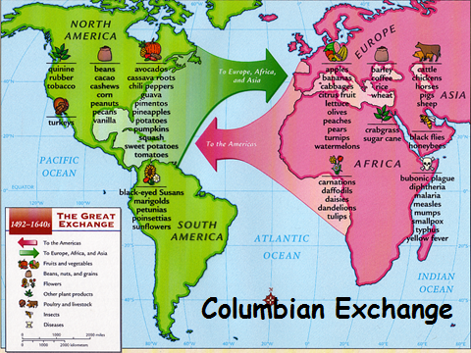
Columbian Exchange

Slide 4
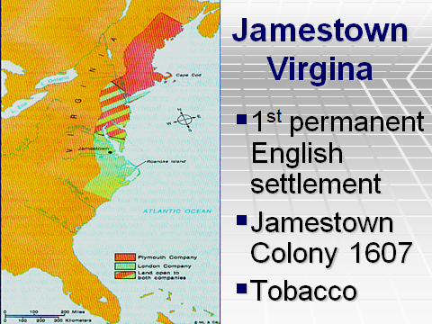
Jamestown

Slide 5
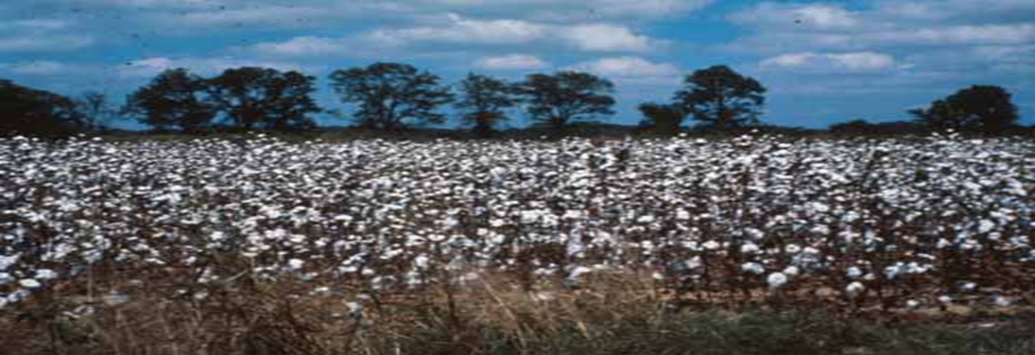
Plantations
Agricultural system in the South. Cash crops like tobacco & cotton fuel slavery.

Slide 6
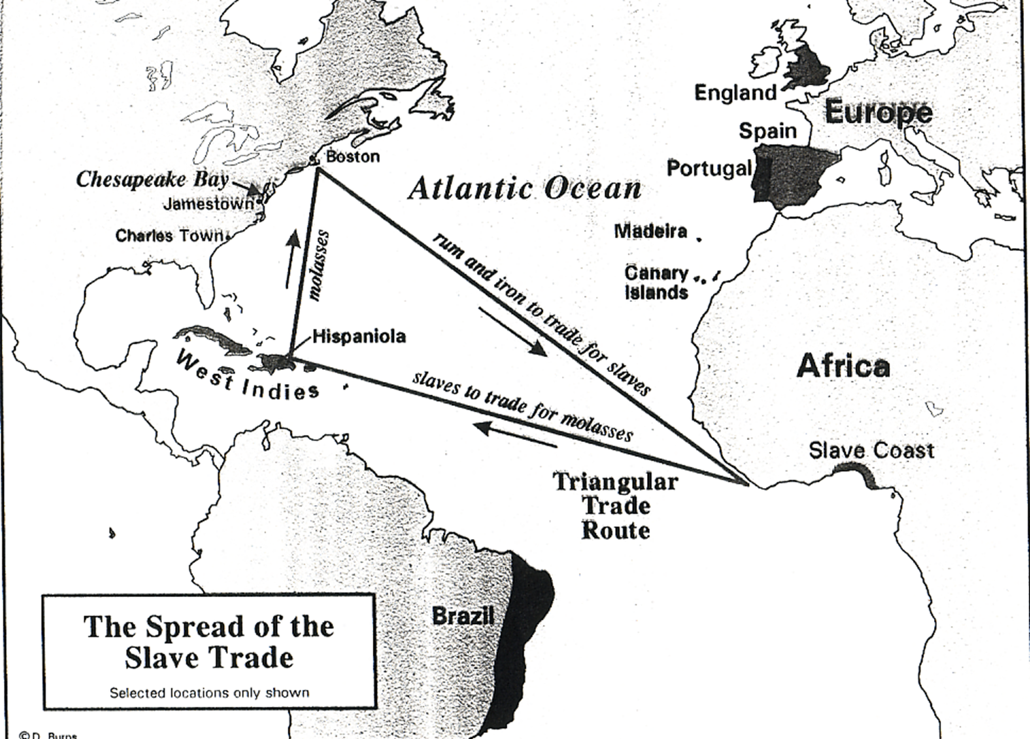
Middle Passage
Part of the Triangular Trade Route. What was the route called that transported slaves from Africa to the West Indies and the Americas?

Slide 7
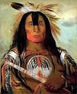
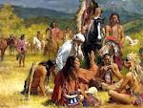
This is another term for the Native Americans, or the first Americans.
Indigenous

Slide 8
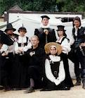
The Massachusetts colony was founded by these people.
Puritans

Slide 9
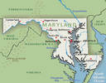
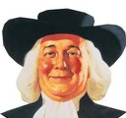
The Maryland Colony was founded by who?
The Pennsylvania Colony was founded by who?
Quakers
Catholics

Slide 10
This is what those were called who left the Massachusetts Colony because they didn’t want to be bound to the religious laws there. Roger Williams led this ground to found the Rhode Island Colony.
Dissenters

Slide 11
The Southern Colonies included what 5 colonies?
Virginia
Maryland
South Carolina
North Carolina
Georgia

Slide 12
Middle Colonies
Include the following:
New Jersey
Delaware
Pennsylvania
New York

Slide 13
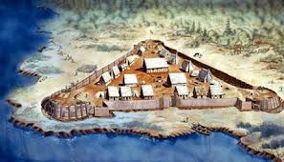
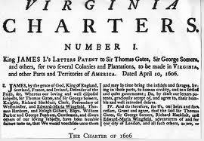
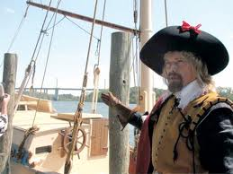
A group of investors who established the Jamestown Colony as a business venture.
Virginia
Company of
london

Slide 14
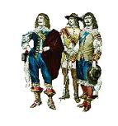
These people were wealthy landowners. They were given land grants to go to America and establish plantations to make money for England.
Cavaliers

