Slide 1
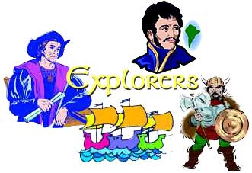

Three Cultures Meet
European Exploration, Settlement, and Colonies

Slide 2
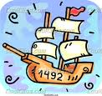
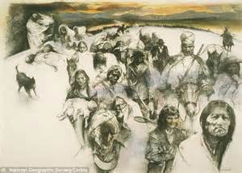
Early Exploration & Colonization→
Redistribution of World’s Peoples
When Christopher Columbus first arrived in the New World, the movement of peoples and cultural interactions began.
American Indians the indigenous peoples were moved from their lands to accommodate the new European arrivals.

Slide 3
When Columbus landed he wrote n the following in his journal:
They…brought us parrots and balls of cotton and spears and many other things, which they exchanged for the glass beads and hawks’ bells. They willingly traded everything they owned….They were well-built, with good bodies and handsome features…They do not bear arms, and do not know them, for I showed them a sword, they took it by the edge and cut themselves out of ignorance.

Slide 4
They have no iron. Their spears are made of cane….They would make fine servants…With fifty men we could subjugate them all and make them do whatever we want.

Slide 5
Slavery…
Bartolome de las Casas (the first man to suggest replacing the natives with Africans as slaves thinking they were stronger and would survive but later relented when he saw the effects on the African slaves) said: Endless testimonies…prove the mild and pacific temperament of the natives…But our work was to exasperate, ravage, kill, mangle, and destroy….
Source Howard Zinn

Slide 6
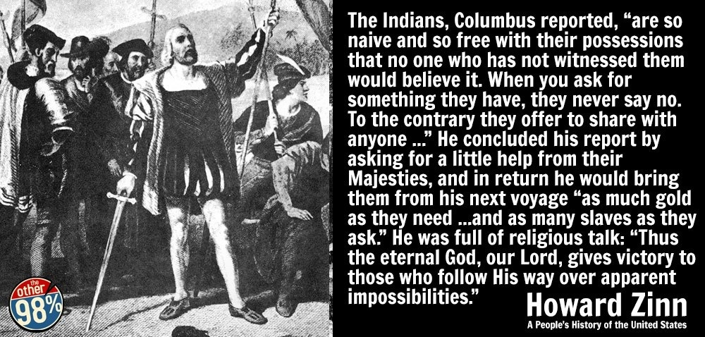

Slide 7
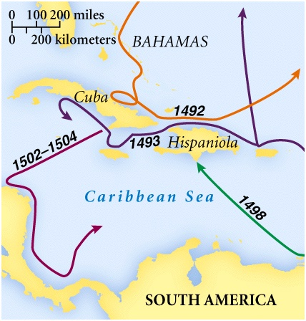
Columbus’ Four Voyages

Slide 8
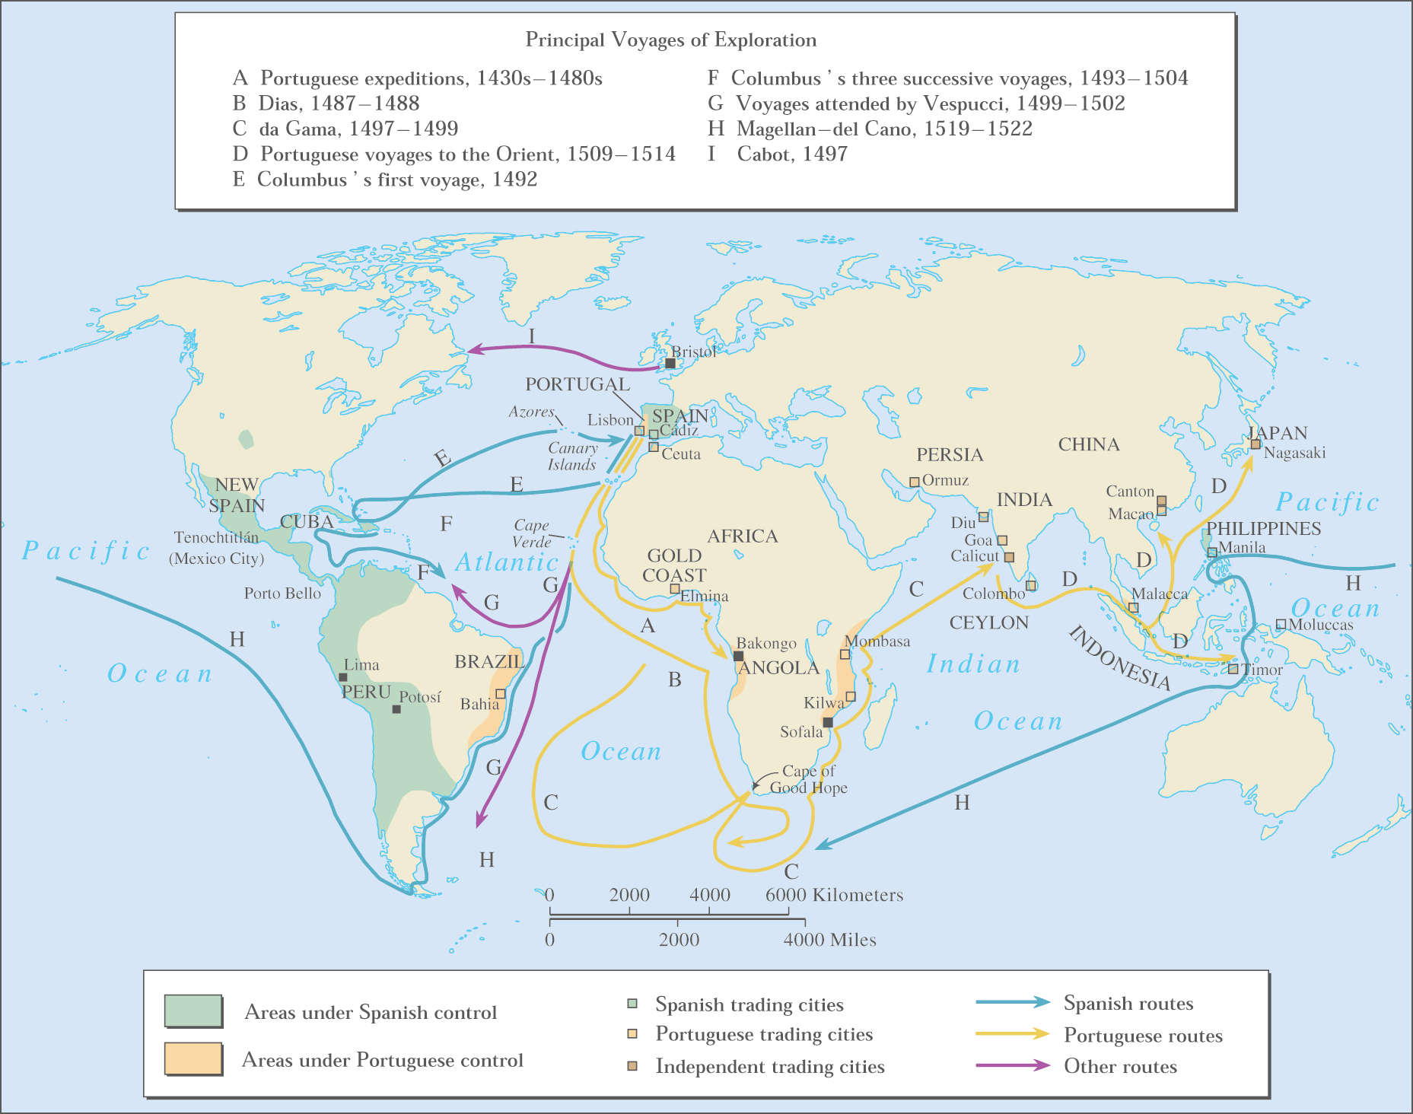
Other Voyages of Exploration

Slide 9
Other Voyages of Exploration

Slide 10
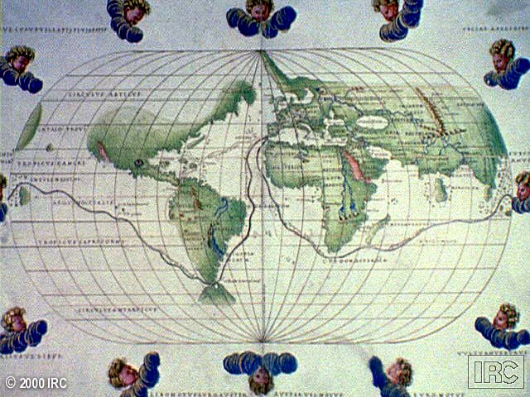
Ferdinand Magellan & the First Circumnavigation of the World:
Early 16^{c}

Slide 11
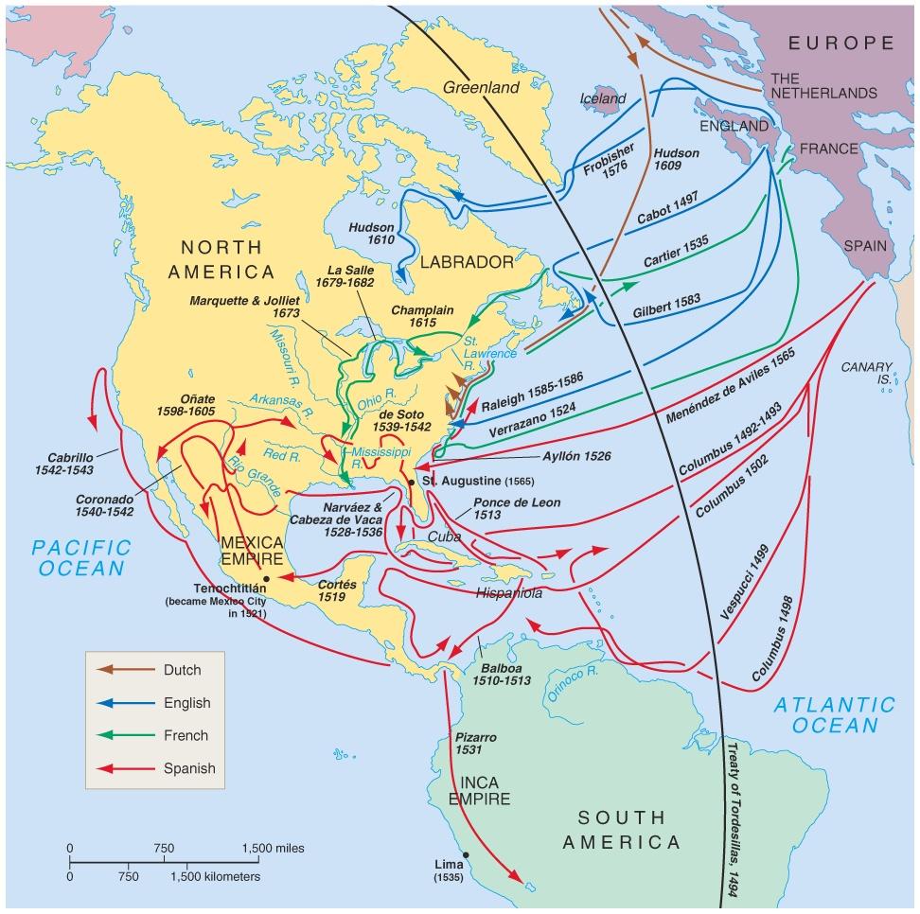
Atlantic Explorations
Looking for “El Dorado”

Slide 12
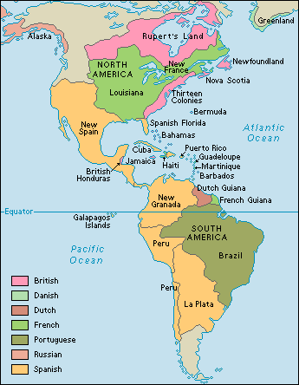
European New World Colonies
Notice the location of the Spanish and Portuguese (gold & olive green colors), French (bright green) and the British (pink).

Slide 13
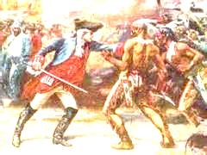
Bad News for Indians
The exploration and settlements of the English in the American colonies and the Spanish in the Caribbean, Central America and South America often led to violent conflicts with the Indians (indigenous people).

Slide 14
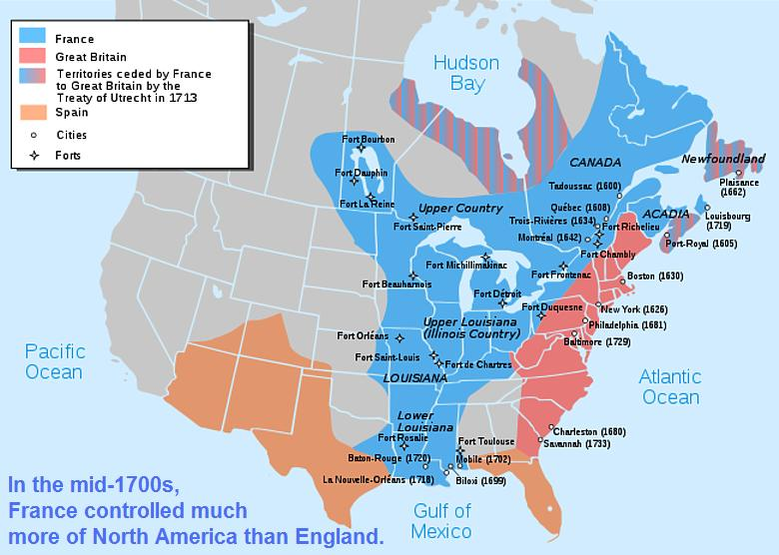
Better News for Indians
In New France (in blue), exploration of Canada did NOT cause a lot of French colonists to settle. French relationships with native Americans were often more cooperative.

Slide 15
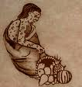
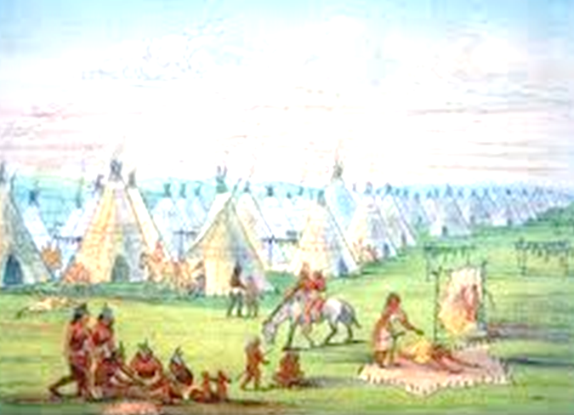
Interactions and consequences of interactions among Europeans, Africans, and American Indians
The Indians lost their traditional territories and fell victim to diseases carried from Europe.

Slide 16
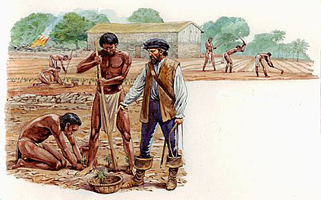
Agricultural Economy
An agricultural economy based on large plantations in the
Southern British colonies and in Latin America led to the introduction of slavery in the
New World with the forced migration of Africans. This was mainly due to the lack of natives to work the land.

Slide 17
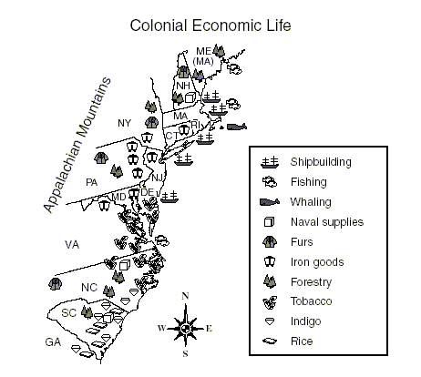
Economic and political institutions in the colonies developed in ways that were either typically European or were distinctively American, as climate, soil conditions, and natural resources shaped regional economic development.

Slide 18
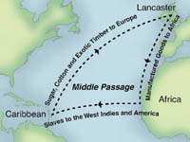
Slave Introduction
This slave journey from west Africa was known as the Middle Passage—part of a link of the Triangular Trade between Europe (manufactured goods),
West Africa (slaves) and the New World sugar, cotton, tobacco and other raw materials.

Slide 19
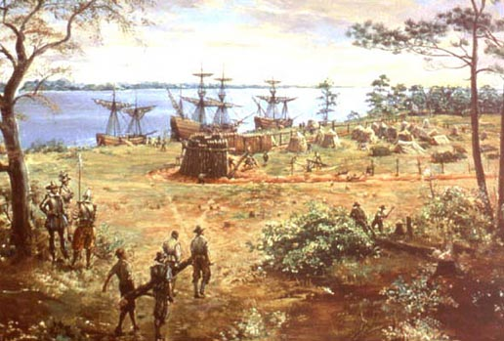
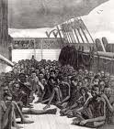
1st American Slaves
The first slaves were brought against their will to Jamestown in 1619 to work on tobacco plantations.

Slide 20
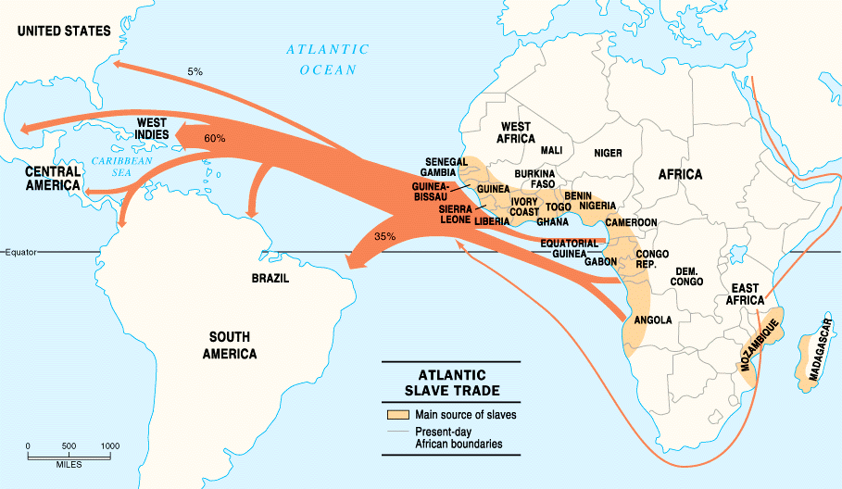

Slide 21
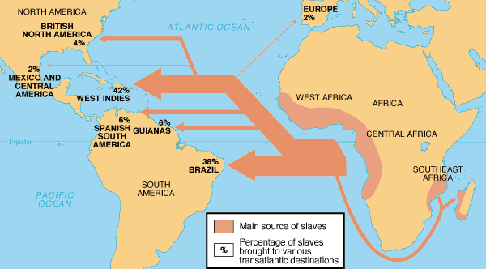
African Slave Trade

Slide 22
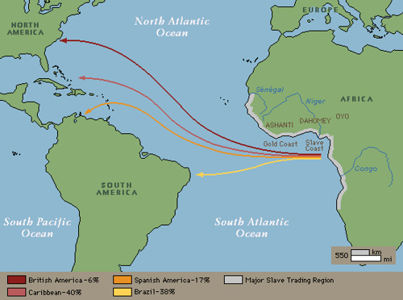
Middle Passage

Slide 23
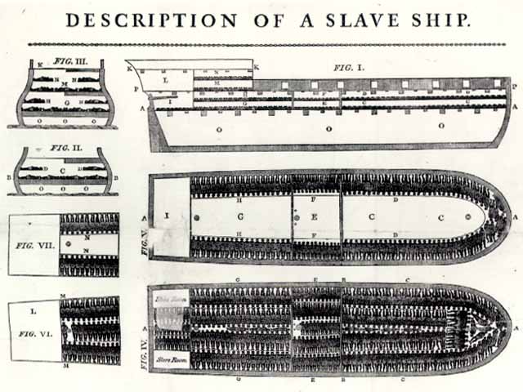
Slave Ship
“Middle Passage”

Slide 24
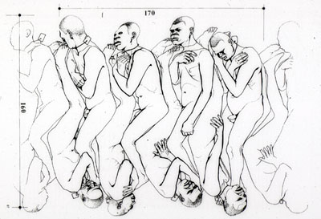

Slide 25
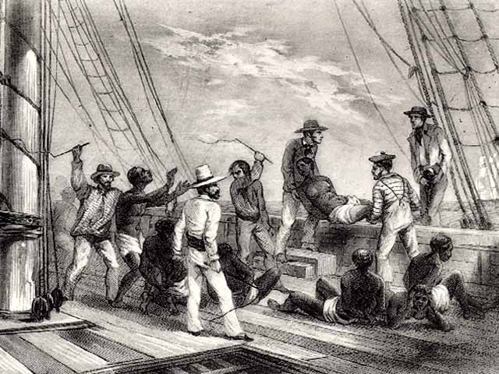
Sharks followed the slave ships!

Slide 26
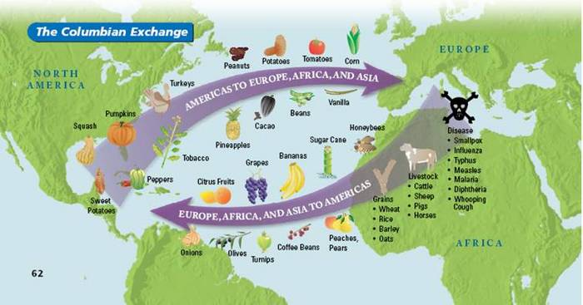
Columbian Exchange
Exploration and colonization began a worldwide commercial expansion as products were exchanged between the Americas and Europe.

Slide 27
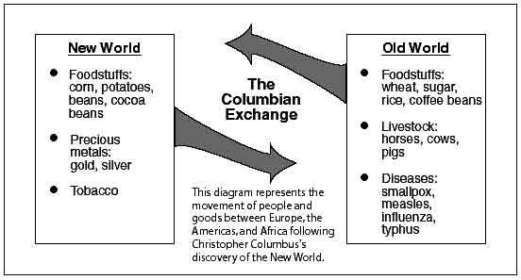
Columbian Exchange

Slide 28
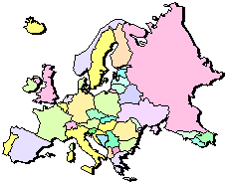
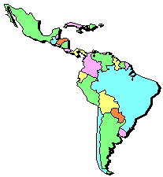
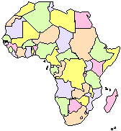
Squash | Avocado | Peppers | Sweet Potatoes
Turkey | Pumpkin | Tobacco | Quinine
Cocoa | Pineapple | Cassava | POTATO
Peanut | TOMATO | Vanilla | MAIZE
 | Syphilis
Trinkets
Liquor
GUNS
Olive | COFFEE BEAN | Banana | Rice
Onion | Turnip | Honeybee | Barley
Grape | Peach | SUGAR CANE | Oats
Citrus Fruits | Pear | Wheat | HORSE
Cattle | Sheep | Pigs | Smallpox
Flu | Typhus | Measles | Malaria
Diptheria | Whooping Cough

Slide 29
Why would the
'Columbian Exchange'
be considered the
tsunami of
unintentional
"bio-terrorism"??

Slide 30
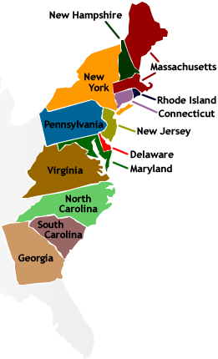
New England Colonies
“Massive Roads Connect New Hampshire”
Massachusetts
Rhode Island
Connecticut
New Hampshire

Slide 31

Motivation → Settlement Patterns and Colonial Structures
New England was settled by Puritans from England seeking religious freedom. They were often intolerant of those not sharing their beliefs.
They formed a “covenant community” based on the Mayflower Compact. → Direct democracy through town meetings.

Slide 32
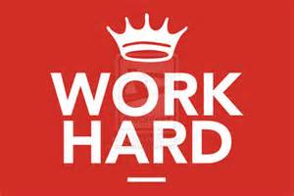
Economic characteristics of the Colonial Period
Why? Poor soil. Rocky areas.
Surrounded by lots of trees.
Settled closer to shore.
Colder climate.
The New England colonies developed an economy based on shipbuilding, fishing, lumbering, small-scale subsistence farming, and eventually, manufacturing.
The colonies prospered, reflecting the Puritans’ strong belief in the values of hard work and thrift.
Why? Based in religious
beliefs. Religion = Puritan faith.

Slide 33
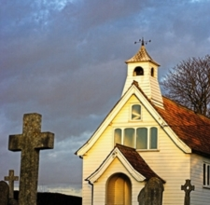
Social characteristics of the colonies
New England’s colonial society was based on religious standing.
The Puritans grew increasingly intolerant of dissenters who challenged the Puritans’ belief in the connection between religion and government.
Rhode Island was founded by dissenters fleeing persecution by Puritans in Massachusetts.

Slide 34
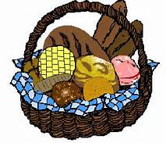
Middle Colonies
“2 New Delaware Pens”
New York
New Jersey
Delaware
Pennsylvania
“the bread basket” colonies

Slide 35


Motivation → Settlement Patterns and Colonial Structures
The diverse Middle Atlantic region was settled chiefly by English, Dutch, and German-speaking immigrants seeking religious freedom AND economic opportunity.

Slide 36
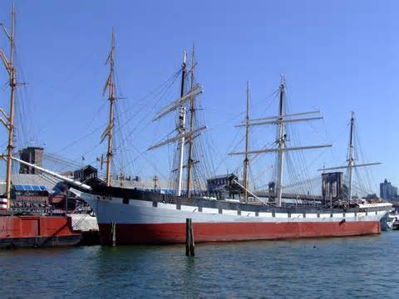

The middle colonies of New York, New Jersey, Pennsylvania, and Delaware developed economies based on shipbuilding, small- scale farming, and trading.
Cities such as New York and Philadelphia began to grow as seaports and/or commercial centers.

Slide 37
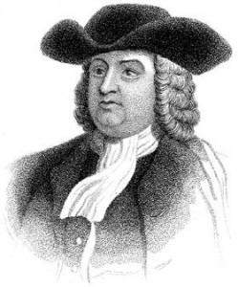
The middle colonies were home to multiple religious groups who generally believed in religious tolerance, including Quakers in Pennsylvania, Huguenots and Jews in New York, and Presbyterians in New Jersey.
These colonies had more flexible social structures and began to develop a middle class of skilled artisans, entrepreneurs (business owners), and small farmers.

Slide 38

Middle Colonies cont’d
They used a number of democratic principles in their political life that were based, in a large part, on rights of Englishmen.
Rights of Englishmen

Slide 39
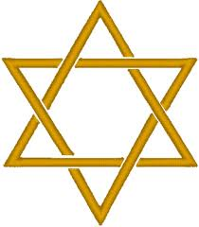

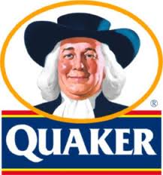
Religious Tolerance
Many Different Religions that get along with each other
Jews = New York
French Protestants = New York
Presbyterians = New Jersey
Quakers = Pennsylvania

Slide 40
Southern Colonies
Virginia Goes 2C Mary.
Virginia
Georgia
North Carolina
South Carolina
Maryland

Slide 41


Motivation → Settlement Patterns and Colonial Structures
Virginia (and other Southern colonies) were settled by people seeking economic opportunity.
Some of the Virginia settlers were cavaliers, nobility given large land grants by the king;
OR poor immigrants who settled in the Shenandoah Valley or western Virginia to farm;
OR came as indentured servants to work tobacco fields.

Slide 42
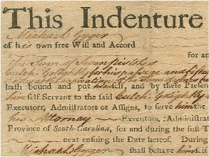
Social Status (Southern Colonies)
Indentured Servants
  Worked 4-7 years in exchange for paid passage to the New World
  Received up to 25 acres of land, tools, pig/cow, and year supply of corn when finish contract

Slide 43
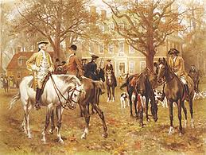

Large landowners in the eastern lowlands dominated colonial government and society and maintained an allegiance to the Church of England and closer social ties to Britain than did those in the other colonies.

Slide 44
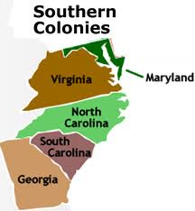
Southern colonies developed economies in the
eastern coastal lowlands based
on large plantations that grew
“cash crops” such as tobacco, rice,
and indigo for export to Europe.
Farther inland, however, in the mountains and valleys of the Appalachian foothills, the economy was based on small-scale subsistence farming, hunting, and trading by settlers of Scots-Irish and English descent.

Slide 45
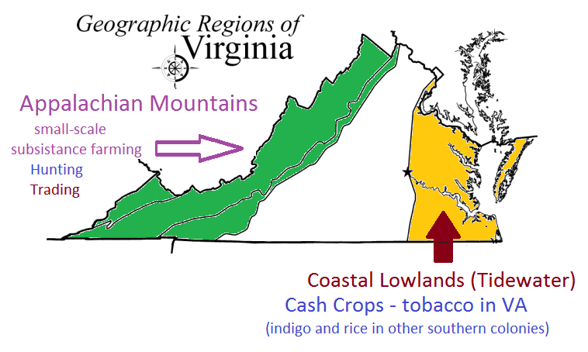

Slide 46
Cavaliers – Received land grants from King

Slide 47
English & Scots-Irish Settlers

Slide 48

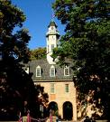
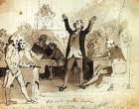
Southern Colonies
Jamestown was the first permanent settlement in North America. It was created by the London Company as a business venture.
1607
The House of Burgesses established by the 1640s was the New World’s first elected assembly. Today it is known as the General Assembly of Virginia
1640s

Slide 49
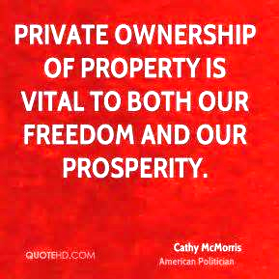

A strong belief in private ownership of property and free enterprise characterized colonial life everywhere.

Slide 50
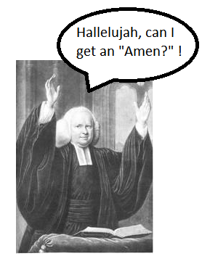
The “Great Awakening” was a religious movement that swept both Europe and the colonies during the mid-1700s.
It led to the rapid growth of evangelical religions, such as Methodist and Baptist, and challenged the established religious and governmental orders.
It laid one of the social foundations for the American Revolution.

Slide 51
 | New England Colonies | Middle Colonies | Southern Colonies
Group/People Responsible for Colony | Puritans seeking freedom from religious persecution in Europe | English, Dutch, German speaking immigrants | “Cavaliers” - English nobility “Indentured Servants” – poor whites
Reason for Settlement | Seeking freedom from religious persecution in Europe | Seeking freedom from religious persecution in Europe and economic opportunities | Seeking economic opportunities
Impact on Government | “Athenian” direct democracy through town meetings. They formed a “covenant community” based on the principles of the Mayflower Compact. | Incorporated a number of democratic principles that reflected the basic rights of Englishmen | Maintained stronger ties to Britain, with plantation owners playing leading roles in representative colonial legislatures. House of Burgesses – VA colony
Economic Activities | Shipbuilding, trading, fishing, lumbering, manufacturing, small-scale subsistence farming. Boston – commercial center | Shipbuilding, trading, small-scale subsistence farming. New York and Philadelphia – commercial centers | Farming, large plantations – along the coastline – grew “cash crops” Small-scale subsistence farming in the Appalachian Mts.
Social Characteristics | Very religious Intolerant of religious dissenters | Very diverse Granted religious tolerance Flexible social structure Quakers, Huguenots, Jews, Presbyterians Development of the middle class | Based on family status and ownership of land Close ties to the Church of England Maintained more allegiance to Britain than to the other colonies.

Slide 52
Essential Questions:
Why did Europeans settle in the English colonies?
How did their motivations influence their settlement patterns and colony structures?
In what ways did the cultures of Europe, Africa, and the Americas interact?
What were the consequences of the interactions of European, African, and American cultures?

