Slide 1
SOL VUS 15
Recent Decades

Slide 2
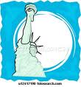
Developments of Recent Decades
Economic, social, cultural and political developments in recent decades have resulted from Supreme Court decisions, immigration, scientific and technological developments, the role of government, and the confrontation with terrorism.

Slide 3
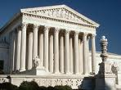
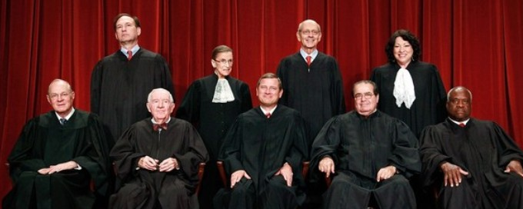
Supreme Court Makeup
The membership of the US Supreme Court has changed over time to include women and minorities. The first women were Sandra Day O’Connor and Ruth Bader Ginsburg. Clarence Thomas is an African American serving currently on the Court.

Slide 4
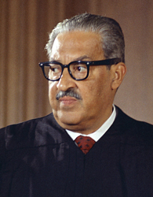
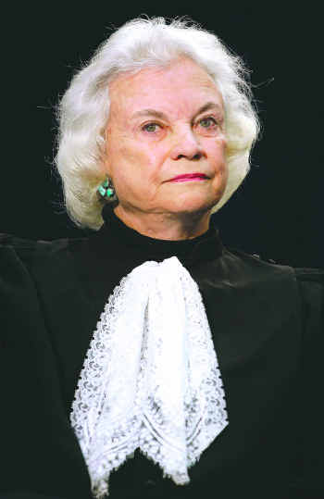
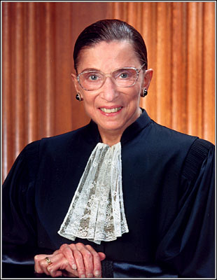
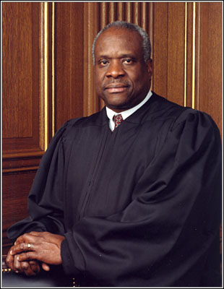
Thurgood Marshall, Sandra Day O’Connor, Ruth Bader Ginsburg, Clarence Thomas, and most recently Sonia Sotomayor.

Slide 5
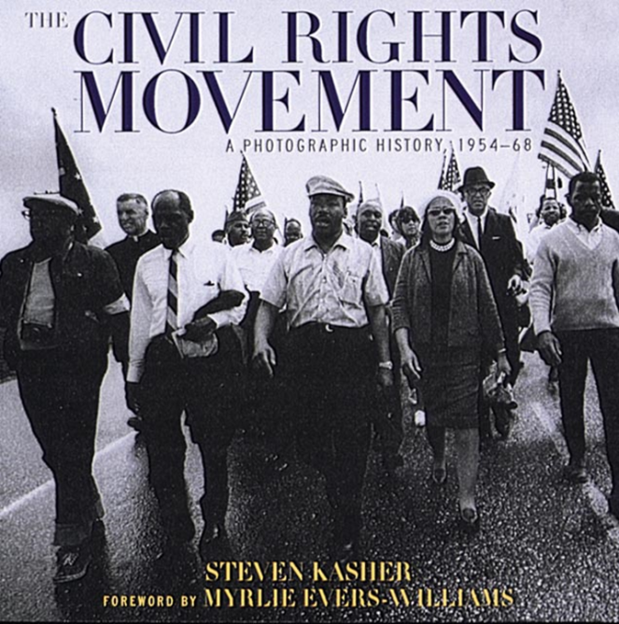
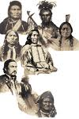
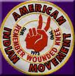
Supreme Court Decisions
The decisions of the Supreme Court have promoted equality and extended civil liberties. The civil rights movement of the 1940s, 1950s, and 1960s provided a model that other groups used to extend civil rights and equal justice.

Slide 6
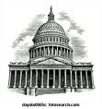
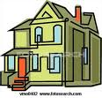
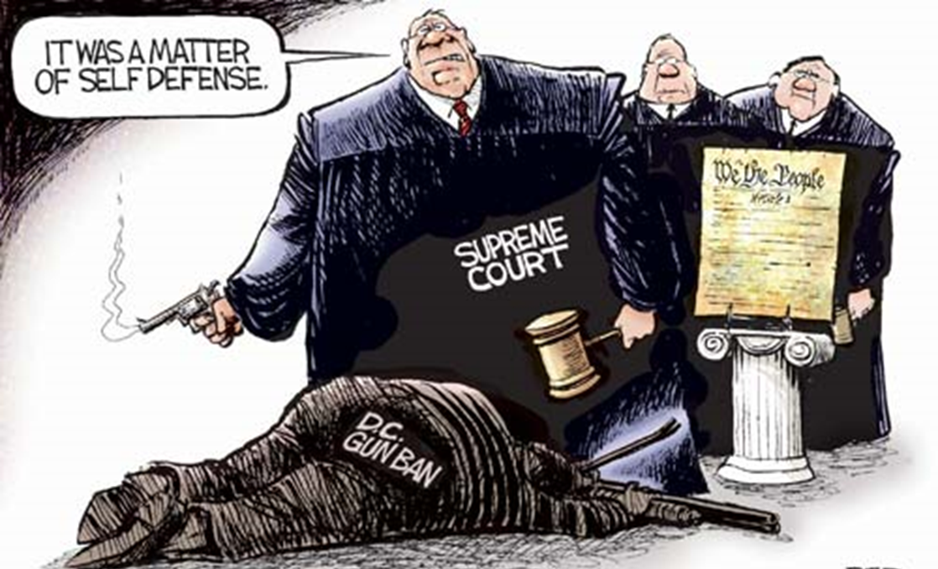
Supreme Court Decisions
The Court identified a constitutional right to privacy that is protected from government interference.
The Court invalidates executive actions and legislative acts that the justices feel exceed authority granted by the Constitution.

Slide 7
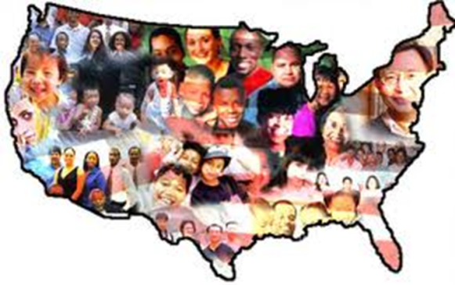
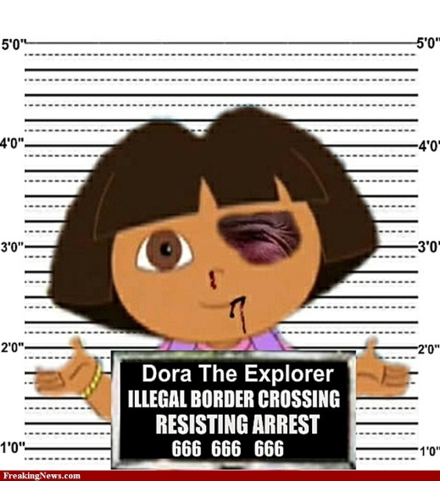
Immigration Changes and Debate
Rising immigration has increased American diversity and redefined American identity. The new immigration has been coming
from many diverse countries, especially in Asia and Latin America.
The main reasons are much the same: political freedom and economic opportunity. But there are new issues related to immigration policy.

Slide 8
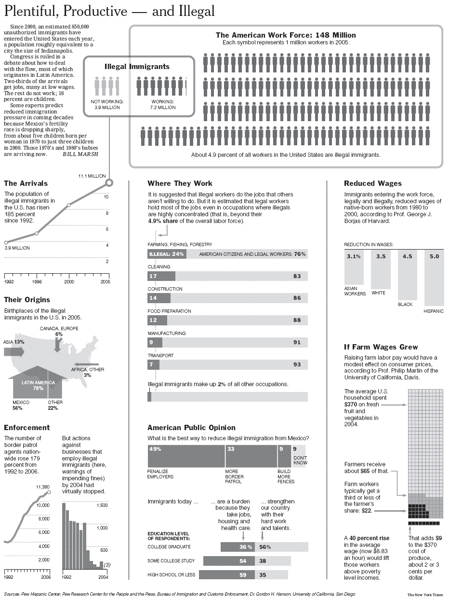
I
mmigra
t
ion

Slide 9
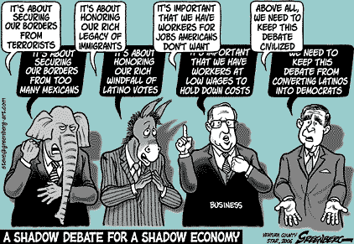
Immigration Changes and Debate
Strain on government services
Filling low-paying jobs
Pathway to citizenship
Border issues
Bilingual education
Increasing cultural
diversity

Slide 10
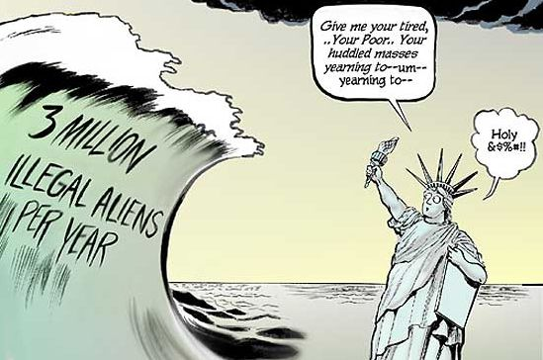

Slide 11
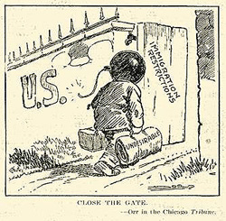
Remember this cartoon? What is it trying to say? What does the open door signify?

Slide 12
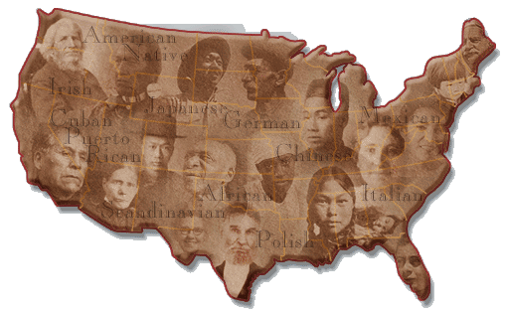
Immigration Contributions
Immigrants have contributed diversity in music, the arts and literature. They play a significant role in the labor force and are
an expanded source of scientists and engineers.

Slide 13
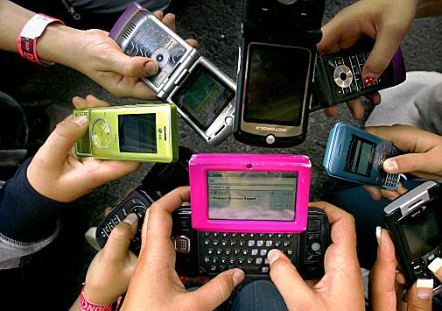
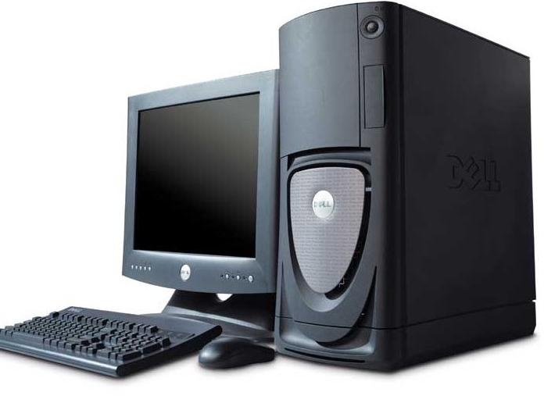
Dramatic advances in technology have affected life in America in many significant areas.
The American space program was a triumph of American technological prowess.
Technology can make communication and information more accessible.

Slide 14
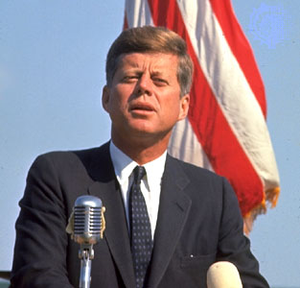
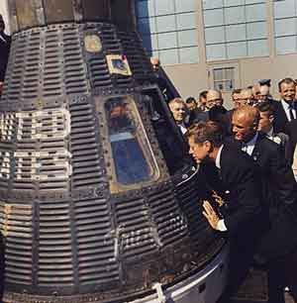
In the early 1960s, President Kennedy pledged increased support for the American space program.
The race to the moon continued through the 1960s.
U.S. astronaut John Glenn was the first American to orbit the Earth.

Slide 15
Space Race competition
Russians get TO space first with Sputnik I.
US is the first to land on the moon with the Apollo 11.
Competition leads to increased spending for both countries and programs such as NASA and Russia’s Roscosmos. Also led to increased spending on science education and spin-off technologies.

Slide 16
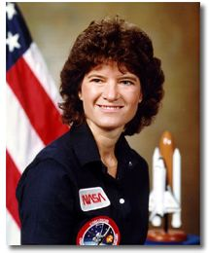
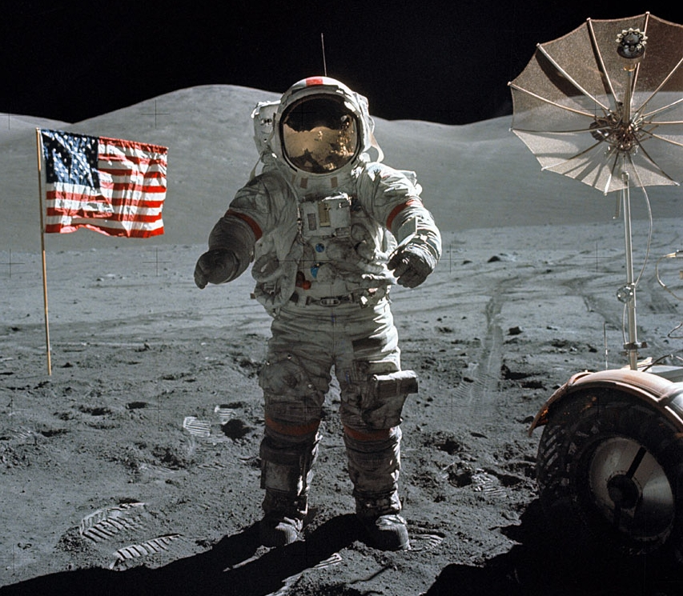
In 1969, American astronaut Neil Armstrong was the first person to step onto the moon’s surface.
He proclaimed, “That’s one small step for a man; one giant leap for mankind.”
Sally Ride was the first female American astronaut.

Slide 17
Image OF the Hubble Telescope
The Hubble Space Telescope's launch in 1990 sped humanity to one of its greatest advances in that journey. Hubble is a telescope that orbits Earth. Its position above the atmosphere, which distorts and blocks the light that reaches our planet, gives it a view of the universe that typically far surpasses that of ground-based telescopes.
Hubble is one of NASA's most successful and long-lasting science missions. It has beamed hundreds of thousands of images back to Earth, shedding light on many of the great mysteries of astronomy. Its gaze has helped determine the age of the universe, the identity of quasars, and the existence of dark energy.
from: http://hubblesite.org/the_telescope/hubble_essentials/

Slide 18
Images FROM the Hubble Telescope

Slide 19
Which would you see from the Hubble Telescope?

Slide 20
Information Technology
In the past three decades, technology and media have brought better access to communication and information for rural areas, businesses and individual consumers.
Many more Americans have access to global information and viewpoints.
Telecommuting, distance learning, and outsourcing have all been made possible through technology.

Slide 21
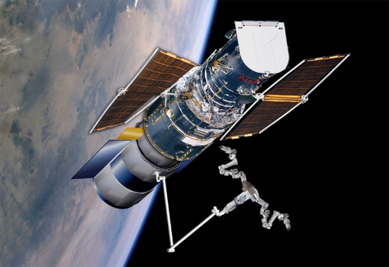
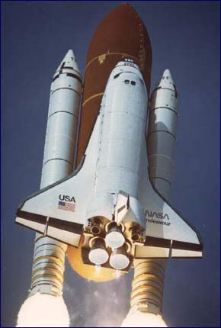
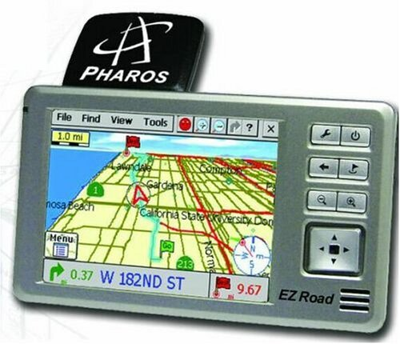
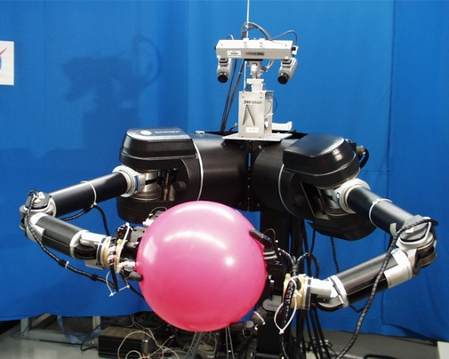
Examples of technological advances
Space exploration
Space shuttle
Mars rover
Voyager missions
Hubble telescope
Communications
Satellite
Global positioning system (GPS)
Personal communications devices
Robotics

Slide 22
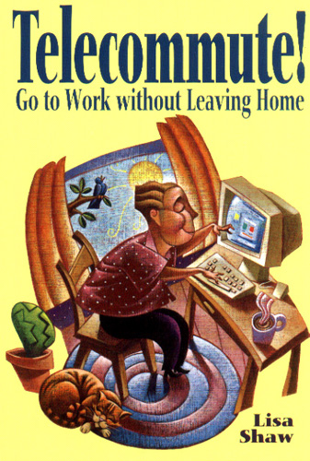
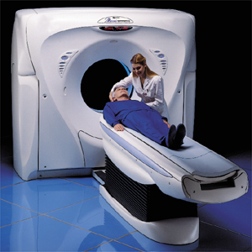
Changes in work, school, and health care in recent decades
Telecommuting
On-line course work
Growth of service industries
Breakthroughs in medical research, including improved medical diagnostic and imagining technologies
Outsourcing and off-shoring

Slide 23
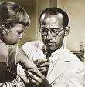
Medical Breakthroughs
In 1952, Dr. Jonas Salk developed a vaccine to prevent polio, a muscle-wasting disease that could cause paralysis or even death.
President Franklin Roosevelt had gotten polio as an adult and was seriously handicapped by the disease.

Slide 24
Polio FYI…
Definition
Polio is a contagious viral illness that in its most severe form causes paralysis, difficulty breathing and sometimes death.
In the U.S., the last case of naturally occurring polio happened in 1979. Today, despite a concerted global eradication campaign, poliovirus continues to affect children and adults in Afghanistan, India, Nigeria and Pakistan.
Resource: http://www.bing.com/health/article/mayo-MADS00572/Polio?q=polio&qpvt=polio&adlt=strict

Slide 25
Polio FYI…
Polio (also called poliomyelitis) is a contagious, historically devastating disease that was virtually eliminated from the Western hemisphere in the second half of the 20th century. Although polio has plagued humans since ancient times, its most extensive outbreak occurred in the first half of the 1900s before the vaccination created by Jonas Salk became widely available in 1955.
At the height of the polio epidemic in 1952, nearly 60,000 cases with more than 3,000 deaths were reported in the United States alone. However, with widespread vaccination, wild-type polio, or polio occurring through natural infection, was eliminated from the United States by 1979 and the Western hemisphere by 1991
Resource: http://kidshealth.org/parent/infections/bacterial_viral/polio.html

Slide 30
Carter’s Crisis of Confidence--FYI
President Carter struggled with inflation, high unemployment, and soaring energy costs.
Carter's approval rating plummeted.
The president was criticized for "blaming" the American people and offering few solutions.

Slide 31
Gas lines during the energy crisis--FYI
Gas lines during the energy crisis

Slide 32
Iran Hostage Crisis Discredits Carter--FYI
After US-backed Shah of Iran was deposed in January 1979, the most westernized country in the Middle East transitioned to an Islamic fundamentalist regime led by Ayatollah Ruholla Khomeini.
When President Carter allowed the Shah into the United States for cancer treatment, a student group stormed the US embassy in Iran and took 53 staff members hostage.
Public support for Carter quickly waned as the months dragged on with no progress.

Slide 33
Iran Hostage Crisis Discredits Carter--FYI
After months of abortive efforts to forge a diplomatic solution, the President ordered a secret military rescue operation in April 1980.
The operation ended in disaster before getting close to the embassy when two helicopters malfunctioned and another collided with a cargo plane, killing eight service members.
Iranians displayed the burned corpses before television cameras.
The Iran Hostage Crisis became symbol of the decline of US prestige in the world and the President was criticized for incompetence.
After 444 days of captivity, the hostages were released immediately after Reagan's inauguration in January 1981.
Wreckage of Operation Eagle Claw

Slide 34
Roe v. Wade Mobilizes Conservatives--FYI
In Roe v. Wade (1973), the Supreme Court ruled that state laws restricting abortion violated a woman's constitutional right to privacy.
The issue of legalized abortion helped galvanize the rise of the Christian Right in the 1970's and 1980's.
In the wake of the sexual revolution and the women's liberation movement, many conservatives sought to restore "traditional family values".
Roe v. Wade catalyzed the formation of a number of enduring political organizations.

Slide 35
The Christian Right--FYI
The growth of evangelical Christianity in the 1970's reflects the concern for what many perceived as a decline in traditional moral values.
By 1978, 40% of Americans described themselves as "born again," including President Carter.
The divisive issues pervading American politics, including abortion and women's rights, contributed to the proliferation of evangelical political organizations.

Slide 36
Televangelism--FYI
Evangelical television progamming enjoyed a rising level of influence and viewership throughout the 1970's and 1980's.
Charismatic "televangelists" like Jerry Falwell, Jim Bakker, Jimmy Swaggert, and Pat Robertson delivered rousing sermons that resonated with disaffected evangelicals and translated into political action.
Jim and Tammy Faye Bakker

Slide 37
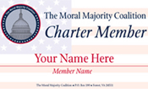
Political Influence of the Christian Right--FYI
Groups like the National Conservative Political Action Committee and Reverend Jerry Falwell's Moral Majority pioneered the use of sophisticated campaigning and fundraising techniques such as direct mail. The influence and campaign tactics of Christian Right delivered a critical proportion of votes to Ronald Reagan in 1980.
Rev. Jerry Falwall

Slide 38
Reagan Revolution
Impact on federalism, the role of gov’t, and state and national elections since 1988.

Slide 39
Reagan Landslide--FYI
The election ended in a landslide victory of Ronald Reagan and the first Republican majority in the Senate since 1952.
Dismal voter turnout suggested disaffection and apathy toward the political process as the 1970's came to an end and the "Reagan Revolution" began.

Slide 40
Election of 1980

Slide 41
The Reagan Revolution Begins--FYI
Following his overwhelming victory Reagan and his political allies began an effort to reverse the political legacy of the New Deal and Great Society.
In addition to delivering a clear, concise agenda, Reagan conveyed a sense of optimism and accessibility that earned him the title "The Great Communicator."

Slide 42
A Dramatic Start to the Reagan Presidency--FYI
In 1981, Reagan enjoyed high public approval and success in implementing his campaign promises.
Immediately following his inauguration, Iranian terrorists released the American hostages after 444 days of captivity.
Congress enacted legislation to reduce tax rates by 25% over three years, cut social spending, and advance the goal of a balanced budget by 1984.

Slide 43
A Dramatic Start to the Reagan Presidency--FYI
On March 30, 1981, Reagan survived an assassination attempt by John Hinkley Jr, who shot the president in an effort to impress actress Jodie Foster. Reagan was more badly injured than the administration reported, but he remained optimistic and his approval rating reached 73%.

Slide 44
A Dramatic Start to the Reagan Presidency--FYI
In 1981, Reagan appointed the first female Supreme Court Justice Sandra Day O'Connor. Although she identified herself as a moderate Republican, foes of abortion and the ERA condemned her appointment to the bench.

Slide 45
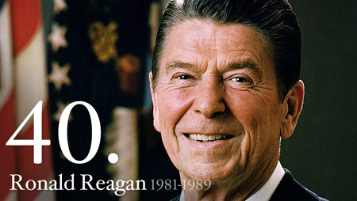
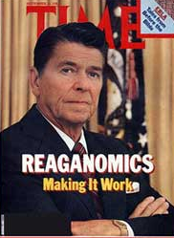
Ronald Reagan’s policies had an impact on the relationship between the federal and state governments.
The conservative political philosophy of President Reagan prompted a re-evaluation of the size and role of government in the economy and society of contemporary America.

Slide 46
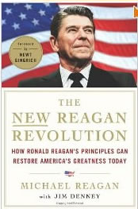
President Reagan and conservative Republicans advocated for
tax cuts
transfer of responsibilities to state governments
appointment of judges/justices who exercised “judicial restraint”
reduction in the number and scope of government programs and regulations
strengthening of the American military <- write in !!!

Slide 47
Questions to ponder….
How do tax cuts effect the economy?
Do you think they would improve the economy or make it worse (since the gov’t will have less money to spend on programs geared to help the poor)?
If you agree with this policy then you’re probably a conservative.
What is a conservative?

Slide 48
Questions to ponder….
How did the transfer of gov’t responsibilities from the federal government to the state governments effect federalism?
If you believed in states’ rights, would you approve or disapprove of this Reagan policy?

Slide 49
Questions to ponder….
Reagan sought to reduce the size and scope of the gov’t. Do you think the Federalists would approve of him? Or do you think the Anti-Federalists would have liked him better?

Slide 50
Questions to ponder….
Well, Reagan also dramatically increased the defense budget. Do you think Federalists or Anti-Federalists would have approved of this?

Slide 51
Questions to ponder….
What is Judicial Restraint? It was the idea that the Supreme Court Justices shouldn’t allow their personal opinions to influence their decisions but should follow the lead of Congress and the President. Therefore, if Congress passes a particular law then the Supreme Court shouldn’t rule it unconstitutional unless they have a really, really good reason to do so.
Do you think the John Marshall Supreme Court operated with Judicial Restraint or Judicial Activism? How about the Warren Court (ruled over Brown v. Board of Education)?
Which do you agree with?

Slide 53
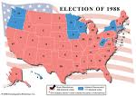
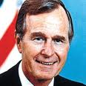
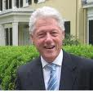
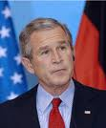
Reagan’s Continued Influence
Reagan’s “revolution” extended beyond his tenure in office to the election of his vice-
president George H. W. Bush. His term was followed by a centrist Democrat, William Clinton. In the 1990s, Republicans swept mid-term congressional and state house offices.
The election of George W.
Bush was also part of
Reagan’s impact.

Slide 54
Current candidate’s platform. How does it reflect Reagan’s influence?

Slide 55
Make a 3 column chart with the following headers:
George H.W. Bush “41” | Bill Clinton “42” | George W. Bush “43”

Slide 56
II. George H. W. Bush, 1989-1993
Impact:
Had to deal with the fall of communism in Eastern Europe
a. Reunification of Germany
Collapse of Yugoslavia
Breakup of the Soviet states
Persian Gulf War 1990-1991
First war where American women served in combat role
Also called Operation Desert Storm

Slide 57
The Persian Gulf War--FYI
Saddam Hussein, dictator of Iraq
Iraq invaded its wealthy neighbor Kuwait on August 2, 1990 because of an oil dispute.
The U.S. dispatched troops to Saudi Arabia to prevent Iraq expansion.
Desert Shield
The U.N. authorized the use of force to dislodge Iraq from Kuwait.
By January 1991, George Bush had put together a 28 nation coalition

Slide 58
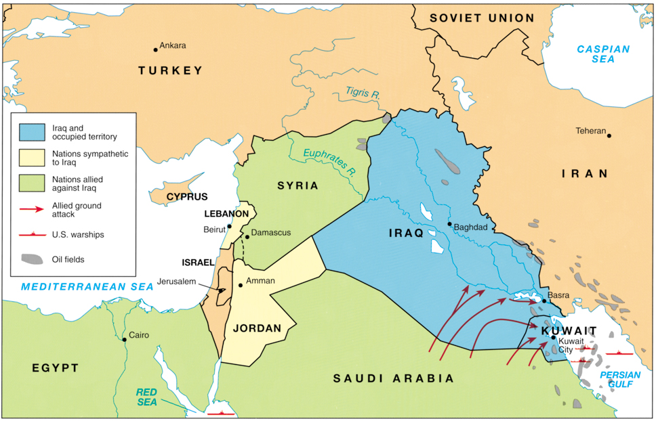

Slide 59
The Gulf War--FYI
Operation Desert Storm
Air attack began on January 17 against Baghdad
Ground attack began on February 24 and lasted only 4 days
Cease fire on February 28
Saddam Hussein remained in power.
Continued economic sanctions

Slide 60
Recession and Downsizing--FYI
The former Cold War Rivals began the process of downsizing the military.
Private businesses also began “restructuring” and “downsizing”
Economic recession
Increased inflation and unemployment and decreased production.
The recession would be short and self-correcting.
“Peace dividend”
The economic situation improved by 1996.

Slide 61
III. William J. Clinton, 1993-2001
Impact:
North American Free Trade Agreement (NAFTA)
Full diplomatic relations with Vietnam
Lifted economic sanctions against South Africa when its government ended the policy of apartheid
NATO action in former Yugoslavia

Slide 62
Yugoslavian Turmoil (The Balkans)--FYI
Ethnic and religious conflicts in Bosnia and Croatia
Orthodox Serbs, Catholic Croats, and Bosnian or Albanian Muslims
“Ethnic Cleansing”
Dayton Accord (1995)
NATO and Peacekeeping mission.
Intervention in Kosovo
Muslim Albanians outnumbered Serbs.
Yugoslav President Slobodan Milosevic asserted Serbian control through martial law.
NATO launched air strikes in 1999.
Milosevic resigned in 2000.

Slide 63
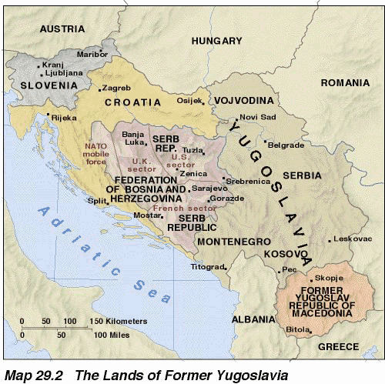

Slide 64
IV. George W. Bush, 2001-2009
Impact:
Terrorists attacks on US soil (9/11/2001)
War in Afghanistan
War in Iraq
FYI Review: US responses to terrorism
Heightened security at home (Patriot Act)
Diplomatic and military initiatives

Slide 65
WHICH PRESIDENT WAS INVOLVED WITH OPERATION DESERT STORM/PERSIAN GULF WAR?
George H.W. Bush

Slide 66
WHO DID NAFTA AND NATO INVOLVEMENT IN YUGOSLAVIA?
William “Bill”
Clinton

Slide 67
9/11, AFGHANISTAN, IRAQ, PATRIOT ACT?
George W. Bush

Slide 68
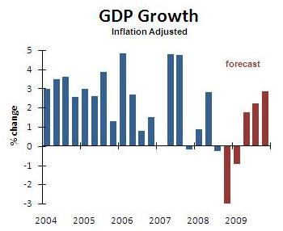
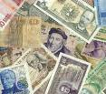
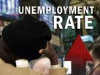
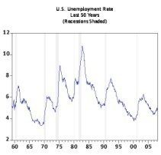
Government in the Economy
Using indicators like Gross Domestic Product figures, inflation rates, currency exchange rates and unemployment statistics, the government tries to
promote a healthy economy.
The tools it uses are monetary policy and the Federal Reserve to control the supply of money plus fiscal policy decisions of taxing and spending plans by the government.

Slide 69
Fiscal policy is set by the government (legislative and executive branch) by the decision to raise and decrease taxes or raise and decrease federal spending. Monetary policy is set by the Federal Reserve or other central banks when they decide to raise, lower, or maintain interest rates.

Slide 70
As the central bank of the United States, the Federal Reserve System has the duty to maintain the value of the national currency (the dollar). It regulates banks to ensure the soundness of the banking system and the safety of deposits. It manages the amount of money in the economy to try to keep inflation low and stable. It acts as the federal government's bank.
Government tax increases reduce the funds available for individual & business spending; tax decreases increase funds for individual and business spending.
Increased government borrowing reduces funds available for borrowing by individuals and businesses; decreased government borrowing increases funds available for borrowing by individuals and businesses.
Increased government spending increases demands, which may increase employment and production; decreased government spending reduces demand, which may result in a slowing of the economy.
Increased government spending may result in higher taxes; decreased government spending may result in lower taxes.

Slide 71
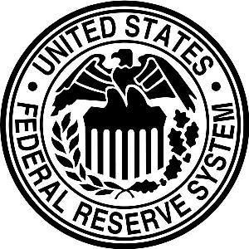
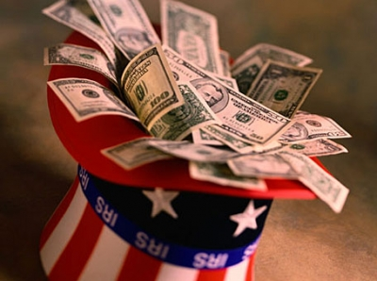
The Federal government has the ability to influence the United States economy.
It bases its decisions on economic indicators such as Gross Domestic Product (GDP), exchange rates, rate of inflation, and unemployment rate.

Slide 72
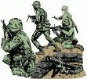
The US Against Terrorism
The US formulates domestic and international policy in an effort to confront terrorism (the use of violence and intimidation in the pursuit of political aims).
Security at home has been heightened
with the Patriot Act and worldwide
with diplomatic and military initiatives abroad.

Slide 73
What do you think about the Patriot Act?

Slide 74
Essential Questions:
How has the membership of the US Supreme Court changed over time?
How have the decisions of the US Supreme Court promoted equality and extended civil liberties?
What factors have drawn immigrants to the United States?
What immigrant groups account for the bulk of immigration?
What issues are currently being debated related to immigration to the US?
What are some contributions made by immigrants?
How has the accessibility to improved technology and communications affected American culture?
What was the impact of the “Reagan Revolution” on federalism, the role of government, and state and national elections since 1988?
What are the roles that government plays in the US economy?
What role has the US played in a world confronted by international terrorism?

