Slide 1
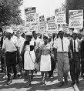
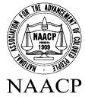
Civil Rights Movements of 1950s and 1960s
African Americans, working through the court system with the NAACP and mass protest, reshaped public opinion and secured the passage of civil rights legislation.

Slide 2
Separate but Equal
What does Separate but Equal mean?
Can society be separate AND equal?
What does separate mean?
What does equal mean?

Slide 3
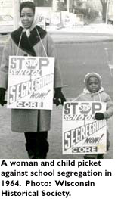
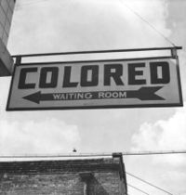
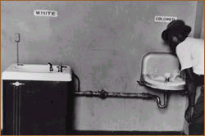
What were some effects of segregation?
There were separate schools and resources
There were separate public facilities
There was social isolation of the races

Slide 4
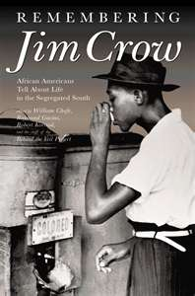
Jim Crow Laws

Slide 5
Jim Crow Laws
Jim Crow laws were laws during the late 19th century and early 20th century, which discriminated against minorities especially black people.
These laws were mainly implemented in the South.
Some example:
No person or corporation shall require any white female nurse to nurse in wards or rooms in hospitals, either public or private, in which negro men are placed.
It shall be unlawful for a negro and white person to play together or in company with each other at any game of pool or billiards.
The marriage of a white person with a negro or mulatto or person who shall have one-eighth or more of negro blood, shall be unlawful and void

Slide 6
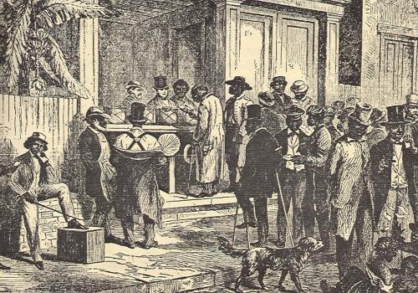
Voter Discrimination, Literacy Tests, Poll Taxes

Slide 7
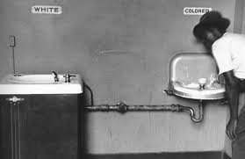
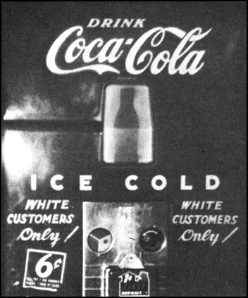
Examples of Jim Crow Laws

Slide 8
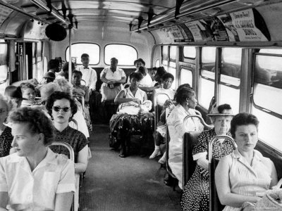
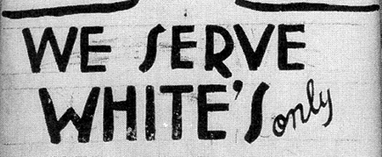
Segregation = Separation
Discrimination

Slide 9
Side Note
The name Jim Crow comes from a song written by Thomas Dartmouth Rice, who was a struggling actor and musician.
In 1828, Rice appeared in a short skit as a man named Jim Crow, who was the stereotypical black person.
He was one of the first actors to do skits in “Black Face” which is when a white person paints their face black.

Slide 10
Stereotypes of Black People Presented in the Book Uncle Tom ‘s Cabin the persisted during the Jim Crow Era
Black children are considered unruly and hyper (Topsy)
The “Happy Darky" = lazy, carefree(Sam)
Mulatto slaves where more desiriable to masters (Eliza)
Dark-skinned female who cooks and cleans (Mammy)
A black man who is eager to please white people (Uncle Tom)

Slide 11
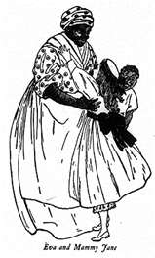
Examples

Slide 12
Lynchings
The act of lynching is considered an extreme mean of execution by either hanging or shooting the victim.
It was created by white people to punish colored people, mainly blacks.
Lynchings occurred mainly in the south.
Lynchings became basically a way for white people to vent their anger against blacks.
Between the years 1882-1968 almost 3,446 black people were lynched.

Slide 13
Lynching Statistics
Between the years of 1882-1968 Mississippi had the highest number of lynchings – 581
Georgia was 2nd with 531
Texas was 3rd with 493

Slide 14
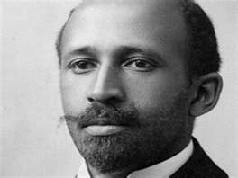
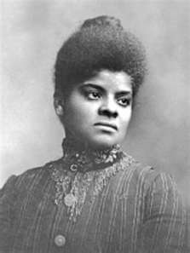
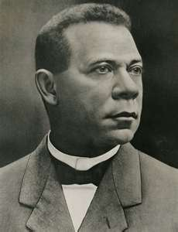
African American Voice

Slide 15
1896
Court Cases
1954
Plessy
v. Fergusson
Ruled that “separate but equal” was legal.
This became the law of the land for over 50 years!
Brown v. Board of Education
Ruled that “separate but equal” was illegal.
This desegregated the schools.

Slide 16
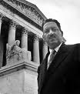
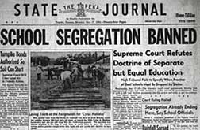
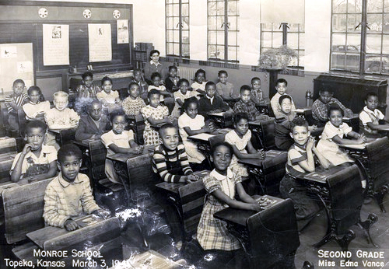
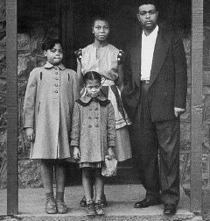
Brown v. Board of Education
In the 1954 case of Brown v. Board of Education of Topeka, Kansas, the Supreme Court ruled that segregated schools are unequal and must
desegregate.
Thurgood Marshall
Key People =
--Thurgood Marshall
(NAACP legal defense team)
--Oliver Hill
(NAACP legal defense team in Virginia)
Oliver Hill
Brown Family

Slide 17
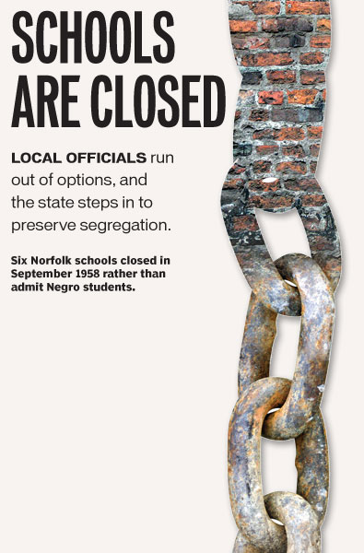
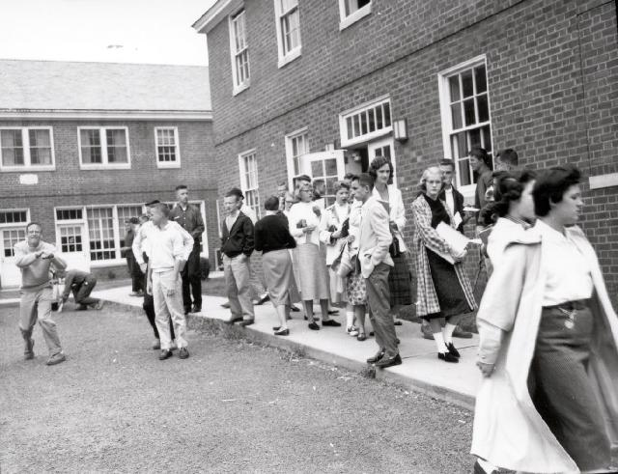
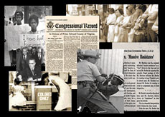
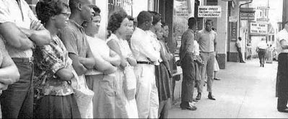
Virginia Response
Virginia’s response to the Court’s desegregation ruling was to close some public schools—Massive Resistance.
--Private academies were opened for whites.
--“White flight” from urban
school systems
occurred.

Slide 18
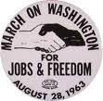
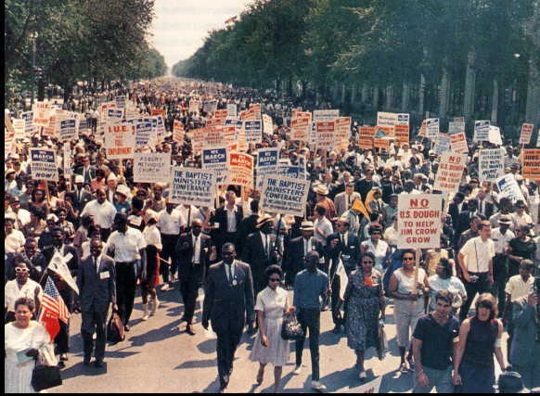
1963 March on Washington
Martin Luther King, Jr. inspired participants in the 1963 March on
Washington with his “I Have a
Dream” speech.
The march had a great influence on public opinion to support civil
rights legislation. It demonstrated the power of non-violent, mass protest.

Slide 21
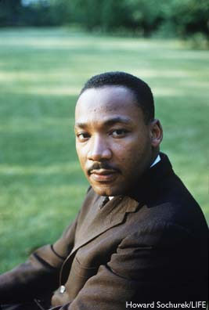
Martin Luther King, Jr.
Leader of the Civil Rights Movement.
Believed in Passive Resistance.

Slide 22
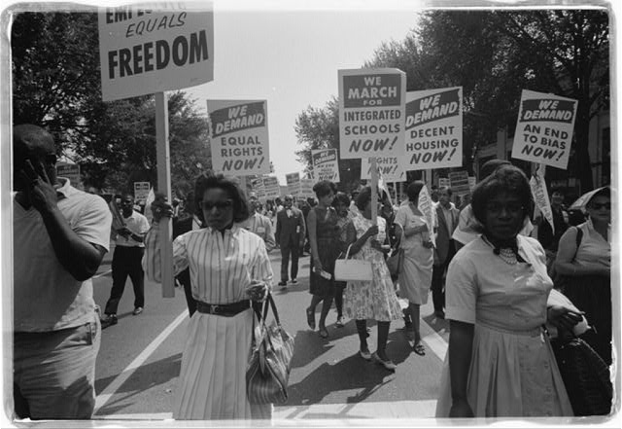
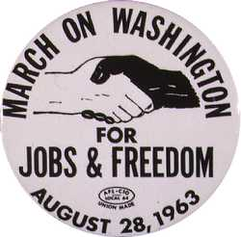
March to Washington D.C.

Slide 23
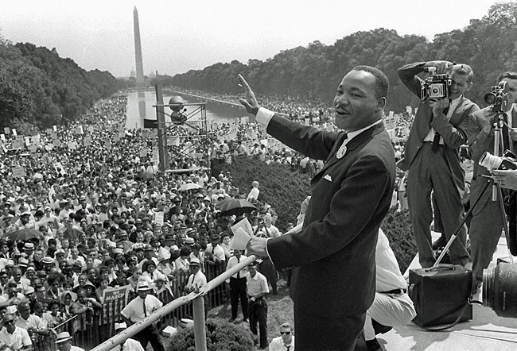
250,000 protesters

Slide 24
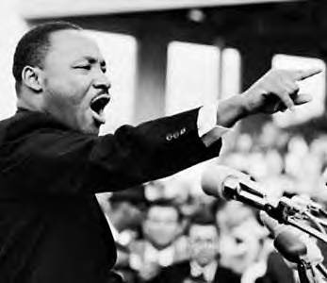
I Have A Dream Speech

Slide 25
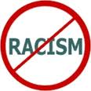
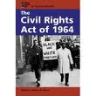
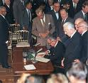
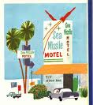
Civil Rights Act of 1964
President Lyndon Johnson played an important role in the passage of the Civil Rights Act of 1964.
It prohibited discrimination based on race, religion, national origin and gender.
It also desegregated public accommodations.

Slide 26
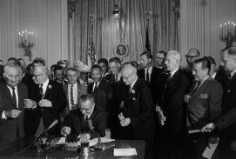
Civil Rights Act of 1964
Made discrimination based on race, national origin, gender or religion illegal.
This one piece of legislation transformed American society.

Slide 27
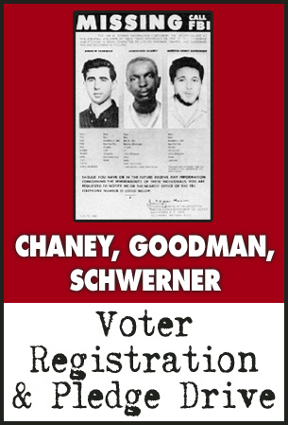
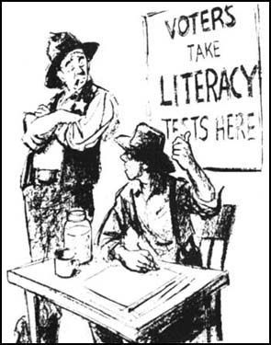
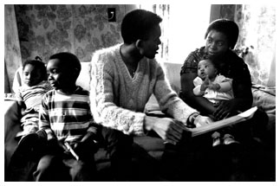
Voting Rights Act of 1965
The Voting Rights Act outlawed literacy tests. Federal registrars were sent to the South to register voters. (President Johnson played an important role again in this act’s passage.)
The act led to increased violence against African American voters.

Slide 28
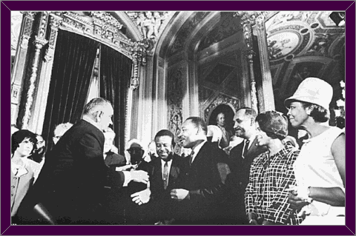
Voting Rights Act of 1965
Made it illegal to require voting tests or poll taxes for voting rights.

Slide 29
Martin Luther King Jr, assassinated on April 4, 1968. Here he is shown at the March on Washington.

Slide 30
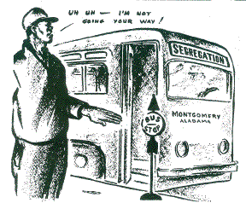
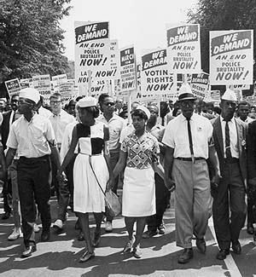
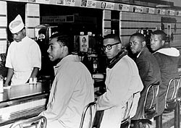
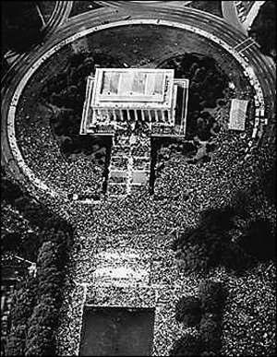
Examples of passive resistance
Boycotts
Sit-ins
Marches
Peaceful
Resistance
Freedom
Rides

Slide 31
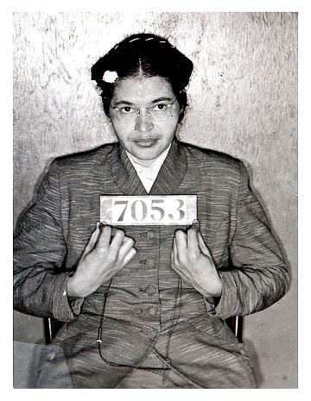
When did the Civil Rights Movement Begin?
December 1, 1955
Rosa Parks refused to give up her seat to a white man
This started the Montgomery bus boycott

Slide 32
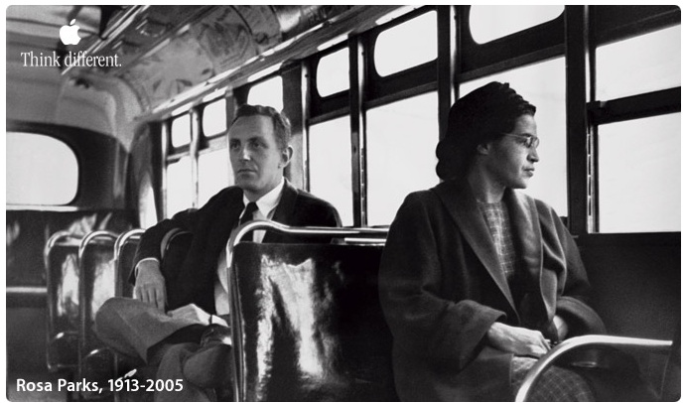
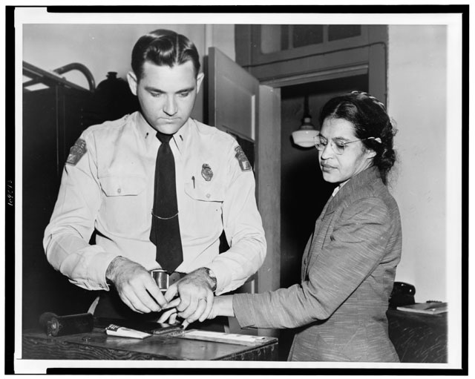

Slide 33
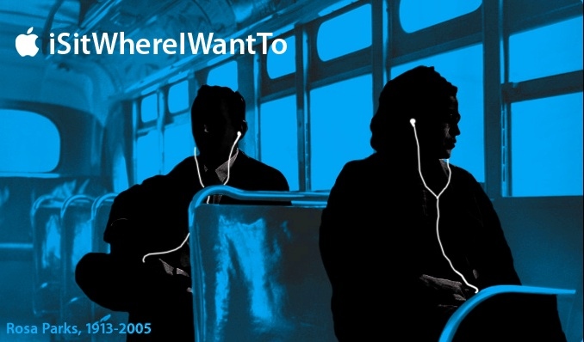

Slide 34
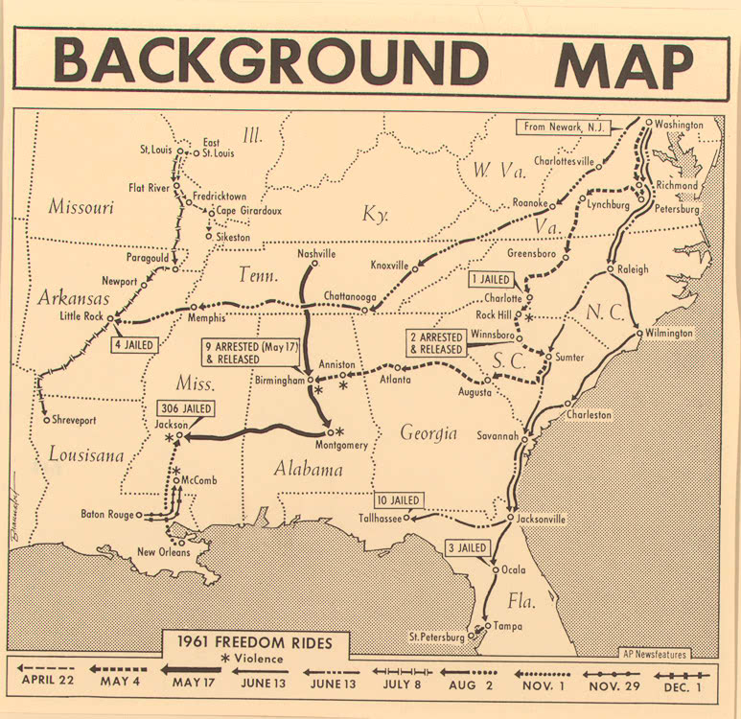
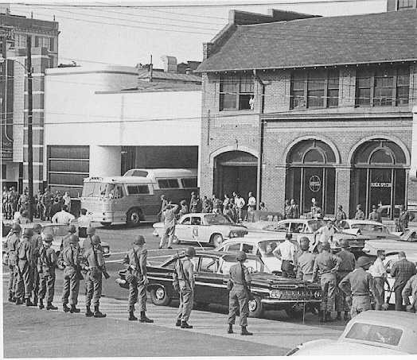
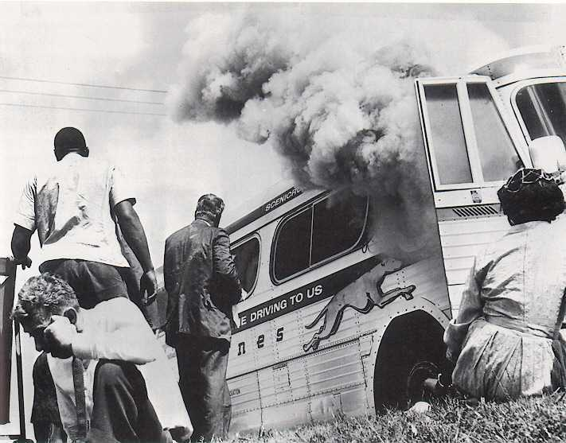
Freedom Rides
Freedom Rides were in 1961.
Bus loads of white and black students traveled cross country
Their goal was to end discrimination at bus terminals
They meet with violence in many areas, but did not give up!

Slide 36
The Little Rock Nine

Slide 37
Governor of Arkansas

Slide 38
Little Rock High School, Arkansas

Slide 40
The President Sends The Federal Army

Slide 41
March Birmingham, Alabama - 1963

Slide 42
March to Birmingham

Slide 51
The Student Nonviolent Coordinating Committee (SNCC)

Slide 59
Called “The Soiling of Old Glory”, Boston 4/5/1976

Slide 64
Essential Questions:
What was the significance of Brown v. Board of Education, and what roles did Thurgood Marshall and Oliver Hill play in the demise of segregated schools?
How did Virginia respond to the Brown decision?
How did the 1963 March on Washington influence public opinion about civil rights?
How did the legislative process advance the cause of civil rights for African Americans?
How did the NAACP advance civil rights for African Americans?

