Slide 1
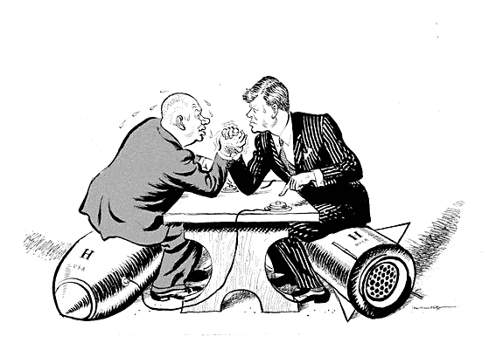
The Cuban Missile Crisis
BEGIN
Letitia Lee and Pritha Sordi (9G)

Slide 2
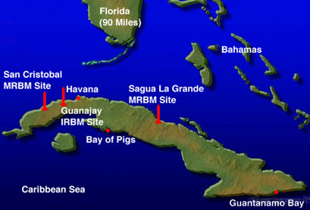
Bay of Pigs
Next

Slide 3
Cuba provided with arms
After the Bay of Pigs fiasco, Soviet arms flooded into Cuba. The Soviet Union publicly announced that it was supplying Cuba with arms in May 1962. By September, Cuba had thousands of Soviet radar vans, missile erectors, jet bombers, jet fighters, tanks, and patrol boats, as well as 5000 Soviet technicians to help maintain the weapons.
Next

Slide 4
So near America?
Whilst conventional arms were being supplied to Cuba, an island next door to the USA, the Americans watched with great alarm, the question being whether the USSR would dare put nuclear missiles on Cuba. On 11 September, Kennedy warned the USSR, and on the same day, the USSR assured the USA that they had no intention of placing nuclear missiles on Cuba.
Next

Slide 5
BUT…
On Sunday, 14 October 1962, an American U-2 spy plane was sent to Cuba, flying over and taking amazingly detailed photographs of missile sites in Cuba. It was obvious to all US military experts that these were nuclear missile sites, and that they were being built by the USSR. Over the next few days, it was confirmed that some sites were already supplied with missiles, and 20 Soviet ships carrying missiles were also on the way to Cuba.
Next

Slide 6
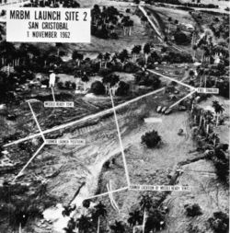
Nuclear launch sites in Cuba, 1962
Next

Slide 7
What should America do?
As both the USA and USSR were now in possession of many nuclear weapons, Kennedy had five main choices, put forward by his advisors. What should he do?
Click on each of the choices for the pros and cons of each choice.
Do nothing
Surgical attack
Invasion
Diplomatic pressures
Blockade

Slide 8
Do nothing
PROS
The Americans knew that their nuclear power was much greater than the Soviet Union
The USA could still destroy the USSR, and the USSR knew this, meaning that the USSR would never use the missiles
The biggest danger to world peace would be to overreact to the discovery of the missiles on Cuba
CONS
The USSR had lied about the missiles in Cuba, and Kennedy had already issued a warning to the USSR
Doing nothing could be, and would be, interpreted as a sign of weakness by other countries
Back
Confirm this choice

Slide 9
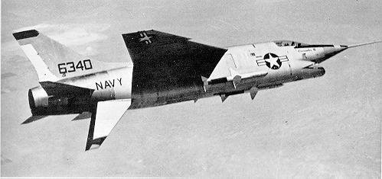
Attack from air
Next

Slide 10
Surgical air attack
PROS
It would destroy the missiles on Cuba before they were ready to use
CONS
The destruction of all the sites could not be guaranteed, and if even only one site was left undamaged, the USSR would be able to launch a counterattack against the USA
The attack would kill Soviet soldiers, causing the Soviet Union to retaliate at once
The attack would be seen as immoral
Back
Confirm this choice

Slide 11
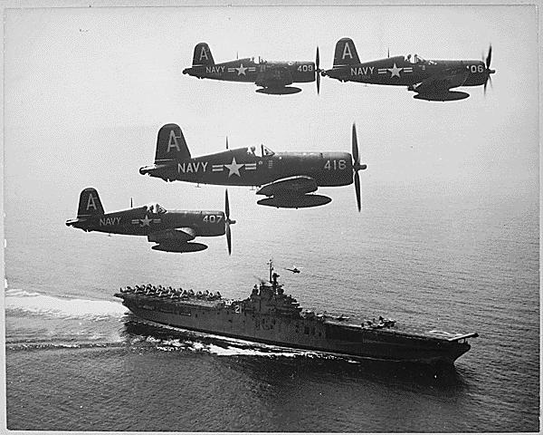
All-out invasion by air and sea
Next

Slide 12
Invasion
PROS
An all-out invasion of Cuba by both air and sea would get rid of both the missiles and Castro
The American forces were already trained and available to carry out the invasion
CONS
The USSR would either respond immediately to protect Cuba, or would respond within the Soviet sphere of influence, with a possible take-over of Berlin
Back
Confirm this choice

Slide 13
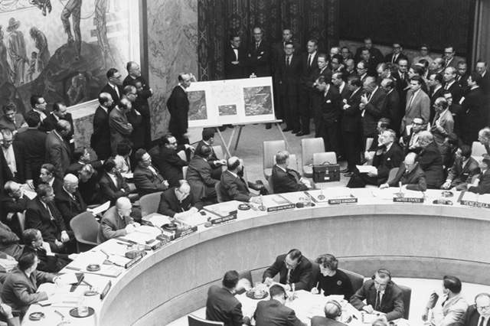
United Nations meeting to discuss Cuba
Next

Slide 14
Diplomatic pressures
PROS
By getting the United Nations or other countries to intervene, or negotiate, it would avoid conflict
CONS
If the USA was forced to back down, it would be interpreted as a sign of weakness by other countries
Back
Confirm this choice

Slide 15
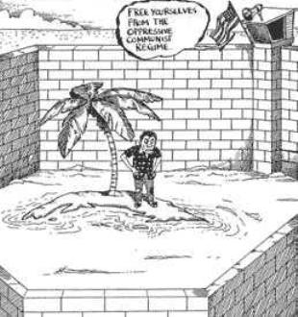
American blockade
Next

Slide 16
Blockade
PROS
Banning the Soviet Union from bringing in any further military supplies to Cuba by using the US navy to stop and search Soviet ships would show that the USA was serious, without using a direct act of war
Blockading the Soviet ships going to Cuba would put the burden on Khrushchev
If this option did not work out, even though the USA had a strong navy, they could still take other options
CONS
A blockade would not solve the main problem as the missiles were already on Cuba, and could be used within one week
The USSR may choose to retaliate by blockading Berlin, as it had already done so before in 1948
Back
Confirm this choice

Slide 17
Weak America
The USSR have not used the missiles, but America is now seen as a weak country, and Kennedy is seen as a pushover, and America is therefore more vulnerable.
Next

Slide 18
Soviet Retaliation
It was inevitable that at least one of the nuclear bases would be missed. However, America now has to face the consequences of its actions. The Soviet Union retaliate at once as America’s attack without advance warning is seen as immoral, and this may be the very beginning of World War III.
Next

Slide 19
Defense and retaliation
The USSR respond immediately to the all-out invasion on Cuba, to protect it, and also take over Berlin. Numerous lives are lost on both sides. Both the USSR and USA are still in possession of nuclear missiles, and are ready to fire them at each other.
Should the USA fire?
Click on each of the choices for the pros and cons of each choice.
No
Yes

Slide 20
The USA do not fire
PROS
The potential World War is avoided for now.
Neither America, the Soviet Union, nor other countries are reduced to almost nothing by nuclear missiles.
CONS
The USSR may see the USA doing nothing about it (not firing their weapons) as a weak thing to do.
Back
Confirm this choice

Slide 21
The USA fires
PROS
This will show the Soviet Union the extremities that the USA are willing to go to in order to have the USSR remove the nuclear weapons from Cuba, and may threaten the USSR.
CONS
World War III can no longer be avoided.
Many innocent lives are taken, and many once lively places destroyed.
The USSR will no doubt retaliate by firing their own missiles even before the American nuclear missiles have reached the USSR, causing further damage.
Back
Confirm this choice

Slide 22
World War III avoided
World War III is avoided as the nuclear weapons are not fired, and there is no mass waste of life, time, and effort. However, lives are still being lost because of the take-over of Berlin, and the original invasion of Cuba.
Next

Slide 23
All is lost
All hope is lost, and so are numerous amounts of lives, as soon as the USA press the buttons and fire their nuclear missiles at the USSR. The two countries, America and the Soviet Union, will soon be reduced to almost nothing, and other countries will get involved, making this World War III.
Next

Slide 24
The United Nations
As a well respected member, your choice will make a great deal of difference for America. Your choice will influence that of many others.
The United Nations can either intervene or negotiate, or force the USA to back down.
What is your choice?
Click on each of the choices for the pros and cons of each choice.
Intervene
Back down

Slide 25
Intervene
PROS
Can help to avoid conflict.
There may be no more needless loss of lives.
CONS
The United Nations’ intervention could anger the USSR.
In the event that intervention and negotiation are not a success, more lives may be lost.
Back
Confirm this choice

Slide 26
Back down
PROS
Conflict could be avoided.
USSR would not be angered.
No further lives would be lost.
CONS
The USA would be seen as a weak country as being forced to back down would be interpreted as a sign of weakness by other countries.
Back
Confirm this choice

Slide 27
Angered USSR
The intervention has angered the USSR, and more innocent lives are gone to waste, and lost. As the USSR and USA still have nuclear weapons in their possession, and the Soviet Union is angered, there may still be a chance of a nuclear war.
Next

Slide 28
No loss
By forcing the USA to back down, the USSR has not been angered, and are therefore not likely to unleash their nuclear missiles, and whilst the United Nations has power over the USA, their missiles will not be used either. Conflict has been avoided.
Next

Slide 29
Still advancing
The US Navy have blockaded Cuba, posted around the island to search any ships going in or out from Cuba, ensuring that no military supplies will reach Cuba. However, although the burden is now on Krushchev, Soviet ships carrying military supplies, still advancing to Cuba, are spotted.
Next

Slide 30
Soviet ships
America now has yet another decision to make. America can either assume that Krushchev is ignoring the blockade, and attempting to get the military supplies through all the same, or that message has not traveled to the ships yet, and they are soon to turn back. If it is decided that Krushchev is purposely ignoring the blockade, action will have to be taken.
Click on each of the choices for the pros and cons of each choice.
Ignoring
Turning back

Slide 31
Ignoring
PROS
America may use Krushchev’s ignorance as a point in their desperate promotion of Capitalism.
CONS
More lives may be lost due to the actions to be taken against Krushchev and the advancing Soviet ships.
Back
Confirm this choice

Slide 32
Turning back
PROS
If the Soviet ships receive the message to turn back, all conflict will be avoided.
CONS
It is a risk to believe that the Soviet ships will turn back as the USSR had once lied about the missiles on Cuba.
Back
Confirm this choice

Slide 33
Action
By deciding that Krushchev is purposely ignoring the blockade, countries now see Kennedy as a pushover, and America as weak. In taking action to prevent Krushchev from ignoring the blockade, more lives are lost.
Next

Slide 34
Turning point
The Soviet ships have indeed turned back after much patient waiting on the part of the Americans, and the nuclear missile sites on Cuba were later dismantled and taken away. World War III has been avoided, and so has further loss of life, and waste of time.
Next

Slide 35
CONGRATULATIONS
You have successfully avoided all conflict, and war throughout the crisis of missiles, that belonged to the Communist Soviet Union, being found on Cuba.
Play again

Slide 36
GAME OVER
You have made the wrong choice and caused World War III to begin, or caused numerous lives to be lost, and a countless amount of time and effort to be wasted. Had you made better decisions, this could have been avoided. Better luck next time.
Play again

Slide 37
GAME OVER
Bad luck! You were close! Think over your decisions again. Could they have been better?
Better luck next time.
Play again

Slide 38
CONGRATULATIONS
Whilst this is not the best possible set of decisions there are, they have still avoided conflict!
Perhaps after thinking over it, you will realize the better solution. Going to take up on the challenge?
Play again

Slide 39
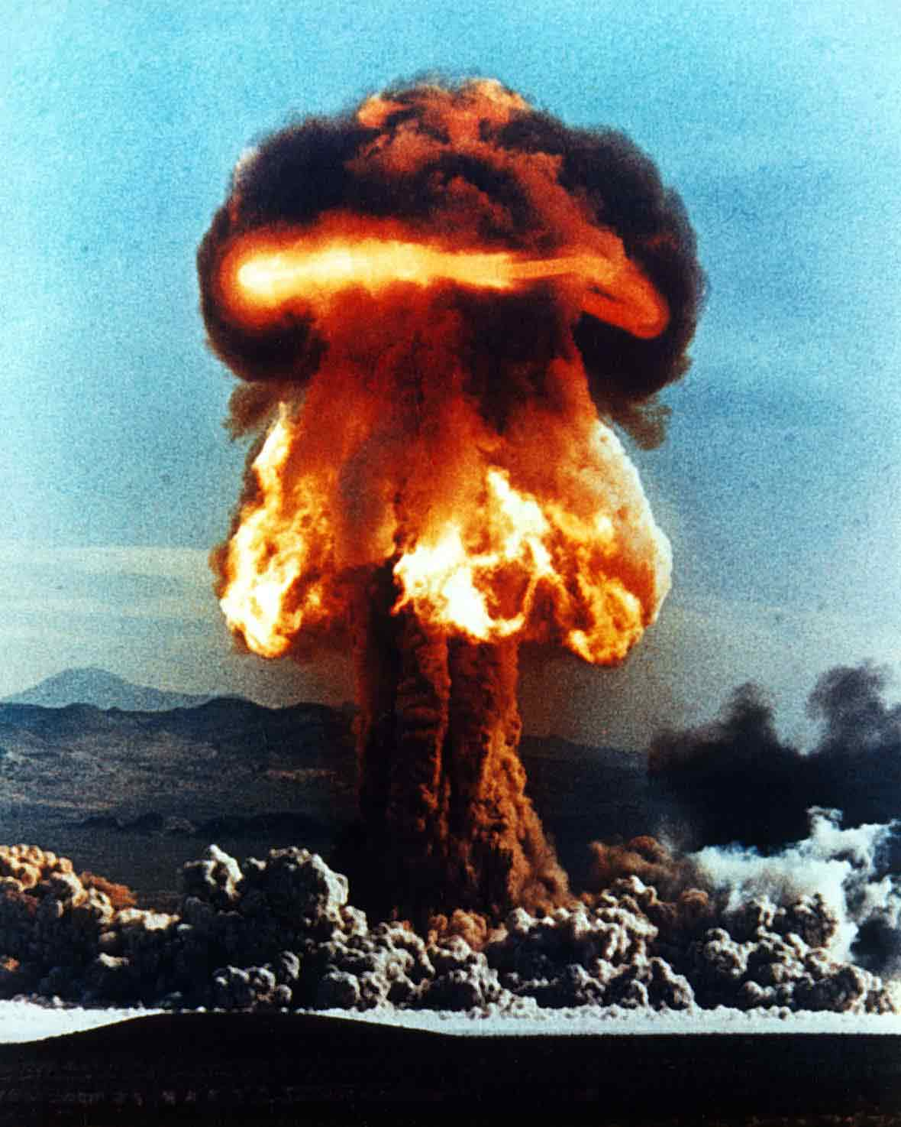
Next

Slide 40
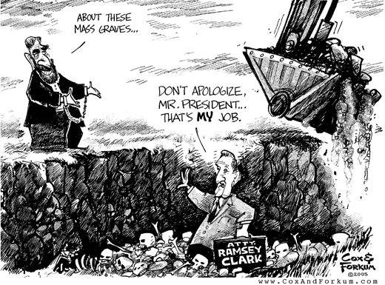
Next

