Slide 1
VUS.10 Key Domestic Events of the Twenties and Thirties

Slide 2
The 20’s is The Jazz Age
Radio, movies, newspapers and magazines created a new popular culture for the times.
Radio broadcast jazz music and Franklin D. Roosevelt’s fireside chats.
Newspapers and magazines shaped cultural norms and sparked fads. Movies provided escape from depression-era realities.

Slide 3
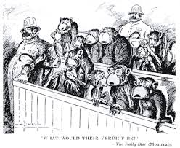
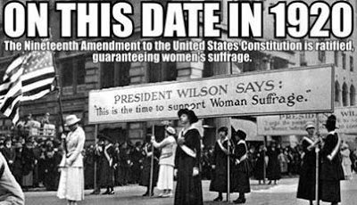
The 1920’s Challenged Tradition
Traditional religion was challenged by Darwin’s Theory of Evolution, and the
Scopes “Monkey Trial”
The traditional role of women was challenged by the “Flappers” symbolizing the New Woman and the 19th Amendment , guaranteeing ….women’s right to vote (suffrage)

Slide 4
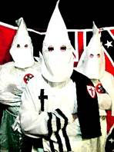
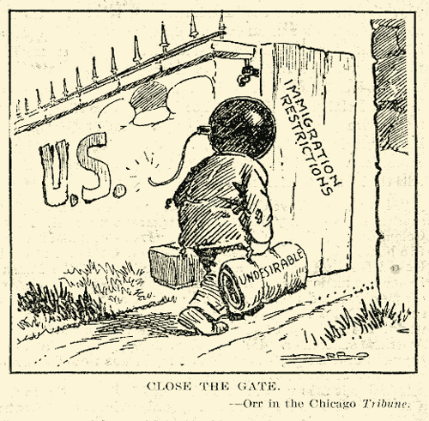
Immigration was again open, which resulted in many
fearing that American values were threatened
by those immigrants coming into the U.S. Due to this
“threat” to traditional values, there was a new uprising
of the Ku Klux Klan.

Slide 5
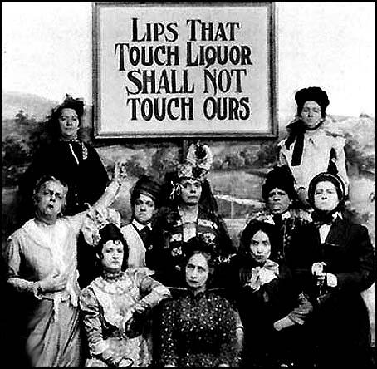
in the meantime…
The 18th Amendment provided for Prohibition (outlawing the manufacture and sale of alcohol). Americans smuggled alcohol and went to “Speakeasies” to get around it.

Slide 6
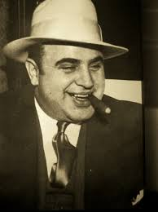
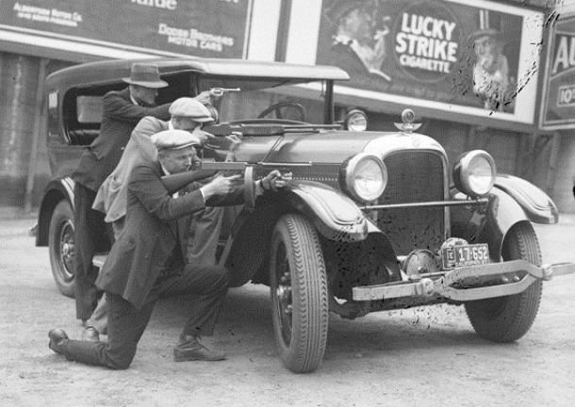
Did the 18th Amendment usher in criminal activities?

Slide 7
America emerged from WWI as a global power. The stock market boom and optimism of the 1920s were due to:
Investments made with borrowed money (over speculation, also called buying on margin)
When businesses failed, the stocks lost their value, prices fell, production slowed, banks collapsed, and unemployment became widespread.

Slide 8
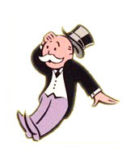
Business was booming, but investments were made with borrowed money. There was an excessive expansion of credit…easy loans for businesses and individuals. Business failures led to bankruptcies. Bank deposits were invested in the market.
When the market collapsed, banks had no money to repay people wanting their money.
In addition to the stock market collapse, the
Federal Reserve Bank failed to prevent the widespread collapse of the nation’s banking system. It caused a severe contraction in the supply of money.
High protective tariffs of 1930, called the
Hawley-Smoot Act, caused Europe to retaliate, strangling
world trade.

Slide 9
Causes of the Stock Market Crash
Excessive expansion of credit
Business failures led to bankruptcies
When the market collapsed, the banks had no money
Bank deposits were invested in the market
Overspeculation

Slide 10
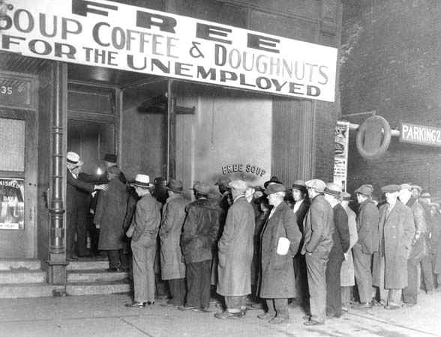
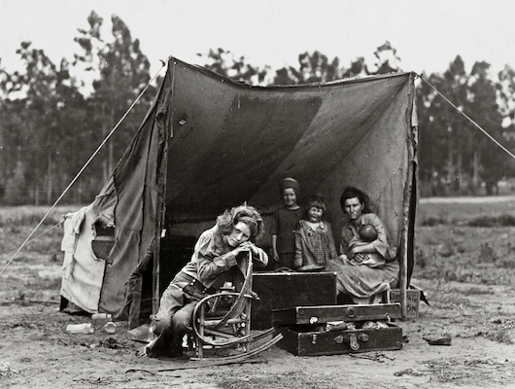
The Great Depression…caused widespread hardships. Hardships such as unemployment and homelessness.
Unemployment and homelessness resulted in reduced demand for consumer goods

Slide 11
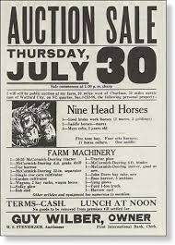
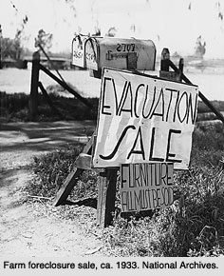
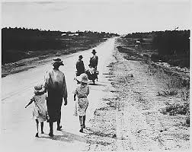
Additional impacts:
Collapse of the financial system and banks closings, political unrest and growing militancy of unions, also farm foreclosures and the migration of people farther West or cities

Slide 12
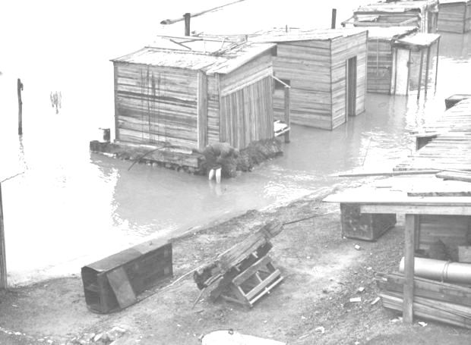
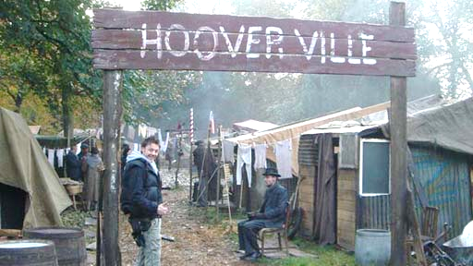
At the beginning of the Great Depression, Herbert Hoover was President. American people blamed him for the hardships. People who became homeless built shacks from any materials they could find.
These homeless communities became known as “Hoovervilles”

Slide 13
Causes of the great depression
Stock Market crashed in 1929 and stock prices collapsed
Federal Reserve’s failure
High protective tariffs that produced retaliatory tariffs
Great Depression
Widespread hardships

Slide 14
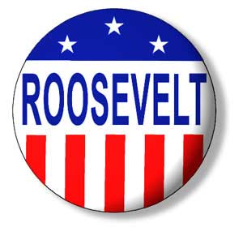
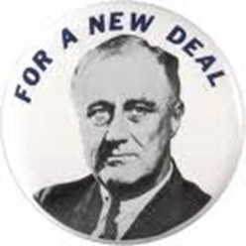
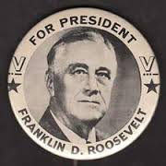
In the election following the Crash, President Hoover was defeated and Franklin Roosevelt was elected. He called his program the New Deal.
“We have nothing to fear, but fear itself.”

Slide 15
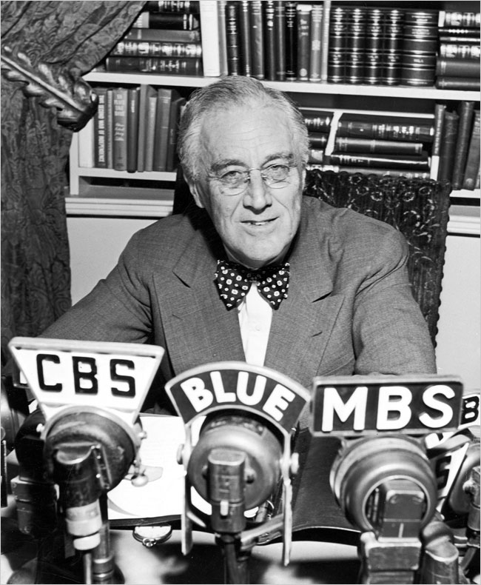
With his New Deal, Franklin Roosevelt attempted to address the causes and effects of the Great Depression. He rallied a frightened nation where one in four workers was unemployed saying,
“We have nothing to fear, but fear itself.”

Slide 16
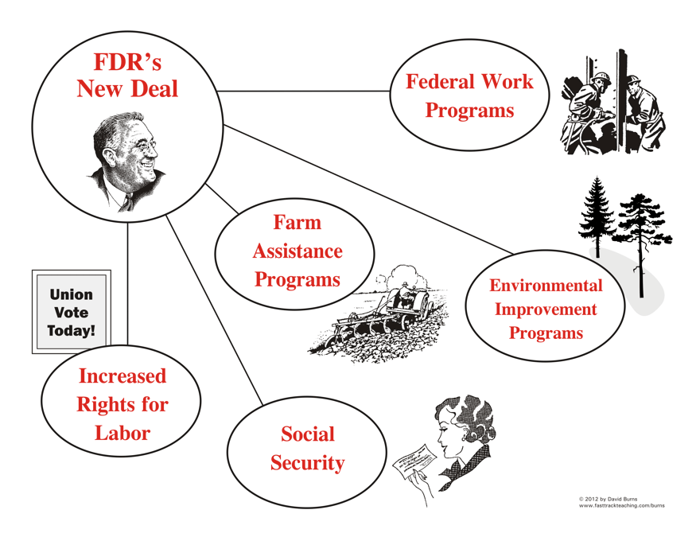

Slide 17
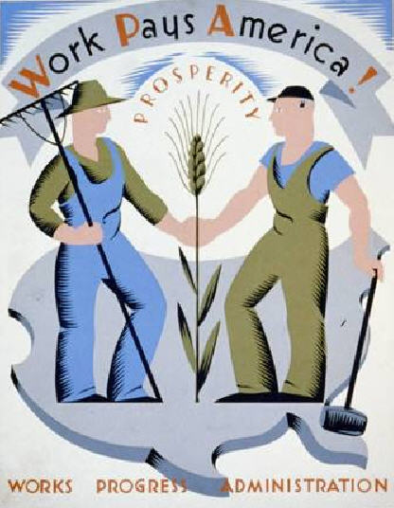
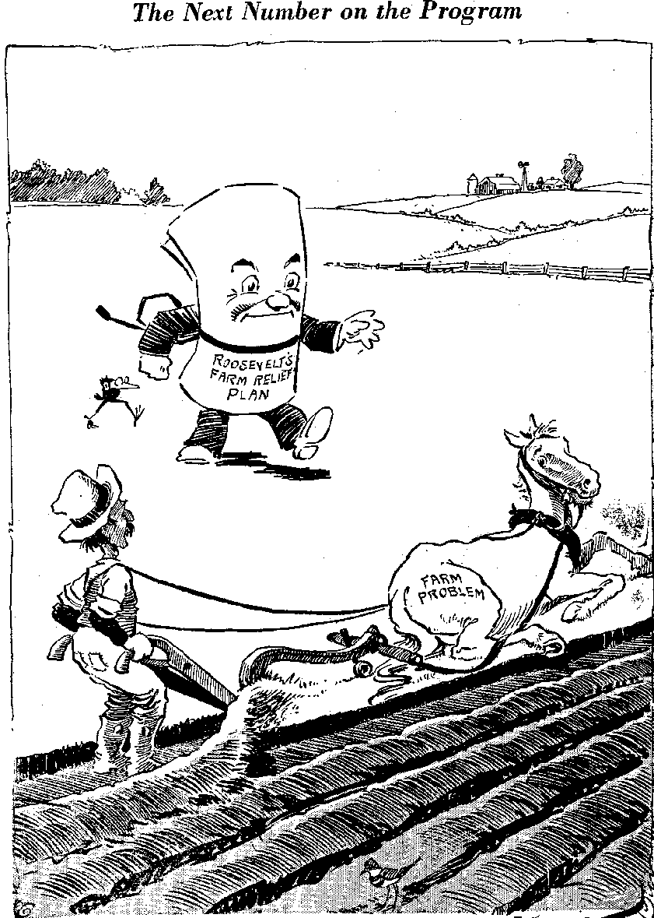
FDR’s New Deal
Relief measures provided direct payment to people for immediate help—example = Works Progress Administration or WPA
Recovery programs were designed to bring the nation out of depression over time.
Example = Agricultural Adjustment Act (AAA) which paid farmers to reduce production to boost prices. The government paid subsidies for acres not plowed.

Slide 18
Reform measures corrected unsound banking and investment practices.
Example = Federal Deposit Insurance Corporation (FDIC) which guaranteed individual bank deposits up to $5000. Today the number is $250,000.

Slide 19
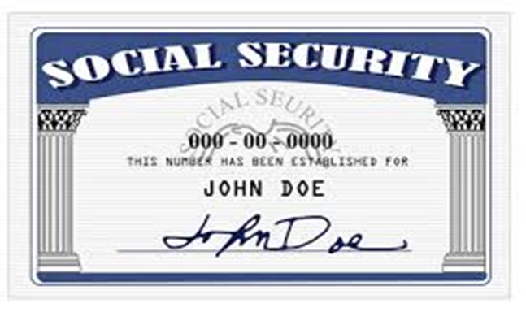
The Social Security Act created a federal insurance program to benefit retired workers over 65, workers who lost jobs (unemployment compensation), persons blind or disabled and mothers with dependent children.

Slide 20
Lasting impact…
The New Deal permanently altered the role of government in the economy. It changed people’s belief in the responsibility of the government to deliver public services, intervene in the economy, and to promote the general welfare.
Organized labor gained new rights and the New Deal set in place legislation that reshaped modern American Capitalism.

