Slide 1
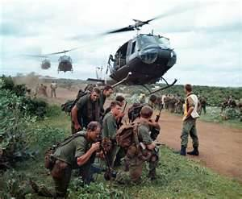
The Vietnam War (1957-1975)
By: Michael Krise

Slide 2
Vietnam War Background
The Vietnam War was the longest war in which the U.S. took part in. It was also the most hated in America, which split the country into Doves who opposed the war and Hawks who supported the fight against communism.
Though it started in 1957, the U.S. didn’t get involved until August 4, 1964 when the North Vietnamese torpedoed the Maddox, an American Destroyer, in the Gulf of Tonkin.

Slide 3
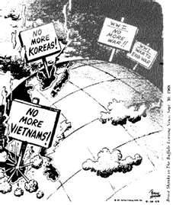
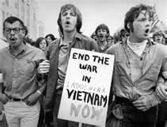
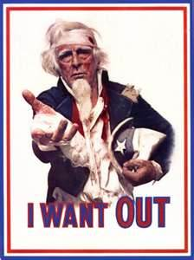

Slide 4
The Viet Cong
The Viet Cong were South Vietnam Guerillas who fought against South Vietnam and the U.S.. They sought to overthrow southern leadership and unite Vietnam.
In attempt to surprise their enemies the Viet Cong would dress like civilians so opposing soldiers couldn’t identify them as the enemy. Also the Viet Cong used an unconventional military style known as guerilla warfare. This method of hit and run slowly wears down the opponent, much like what Americans did during the American Revolution.

Slide 5
Ho Chi Minh
Ho became the head of the Vietnamese government that declared its independence from France. His troops known as the Viet Minh, overthrew the French forces at Dien Bien Phu in 1954. He was a widely popular leader for he had supporters in South and North Vietnam.
Under his leadership, land reforms were enacted and women were given equal legal rights within Vietnam.
However in his attempt to unite Vietnam he succeeded in suppressing non-communist parties, which didn’t play well with the United States.

Slide 6
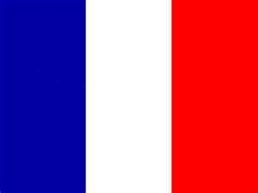
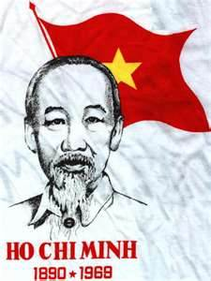
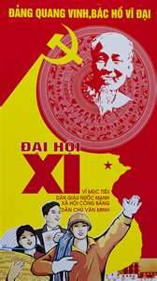
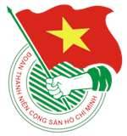

Slide 7
The Tet Offensive
On January 30th, 1968 the Viet Cong launched an unexpected attack known as the Tet Offensive on five of South Vietnam's cities, most of its provincial and district capitals, and about 50 villages.
Though it was not successful it sent a message that the war was no where near over, which demoralized many American soldiers. The offensive also decreased support for the war back in America for they now believed it would be costly with no definite winner.
Later on March 16th 1968, frustrated American soldiers marched into a small community called My Lai 4 and massacred innocent civilians. This became known as the My Lai Massacre.
Though the government attempted to cover it up, the public became aware of it in 1969.

Slide 8
American Tactics
During the Vietnam War one of the most popular approaches to clearing out communist forces was carpet bombing. Cambodia, which was neutral, became a huge target for American bombs because of the Ho Chi Minh Trail that ran through it. A total of 2,756,941 tons were dropped on Cambodia alone. However, some of the bombs dropped were duds and in an attempt to protect their villages, North Vietnamese soldiers used them to create booby traps.
Another tactic used by America was firebombing or better known as Napalm. When used, Napalm clings to anything it touches such as people, houses, crops and other supplies.

Slide 9
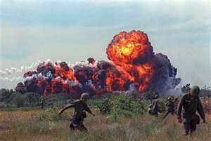
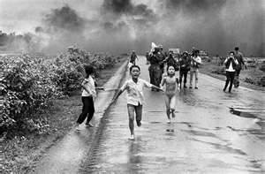
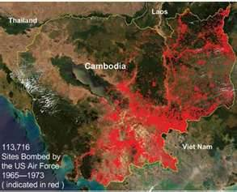

Slide 10
American Tactics (Continued)
In an attempt to reduce and/or destroy enemy food supplies and clear out foliage, American soldiers sprayed Agent Orange, which is a plant killing chemical, on farms and jungles . It caused plants to loose their leaves which helped reveal enemy hiding spots and decimate food crops. It was never meant to directly kill civilians.
However, it’s effects on humans have been studied and it has been confirmed that Agent Orange has caused three kinds of cancer and two skin diseases which have plagued civilians and Vietnam War veterans.

Slide 11
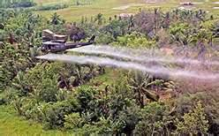
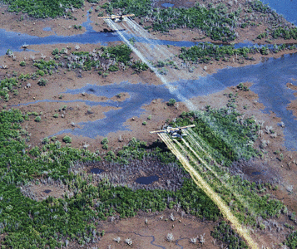
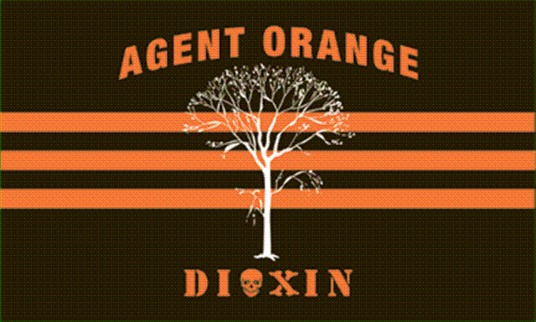

Slide 12
The End of the War
Eventually defeat in Vietnam seemed inevitable, so Congress would only agree to provide $300 million for the evacuation of U.S. troops from Saigon.
The war ended on April 30th, 1975, when North Vietnamese troops entered Saigon and the South Vietnamese government formally surrendered.
In conclusion about 58,000 American military personnel died and about 300,000 others were wounded. A total of $200 billion was put into the first foreign war defeat in American history.

Slide 13
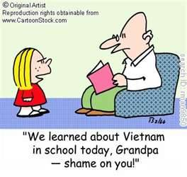
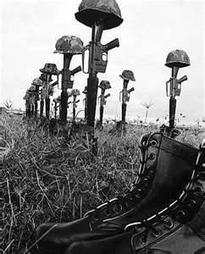
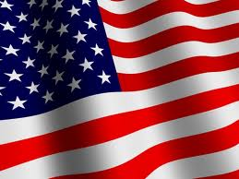
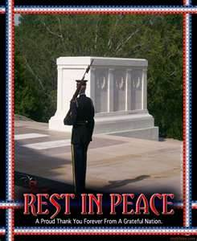
THE END P.S Everything Bad Happens in April

