Slide 1
(1954-1975)

Slide 2
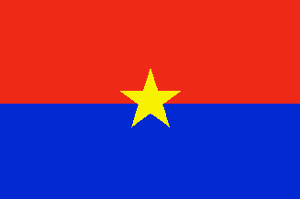
Viet Cong
Was also known as National Liberation Front (NLF)
was a political organization and army in South Vietnam and Cambodia that fought the United States and South Vietnamese governments during the Vietnam War

Slide 3
Viet Minh
was a communist national independence alliance formed at Pac Bo (city in northern Vietnam) on May 19, 1941
The Viet Minh initially formed to seek independence for Vietnam from the French Empire
When the Japanese occupation began, the Viet Minh opposed Japan with backing from the United States and the Republic of China
After World War II, the Viet Minh opposed the re-occupation of Vietnam by France and later opposed South Vietnam and the United States in the Vietnam War

Slide 4
Tet Offensive
was a military campaign during the Vietnam War
was launched on January 30, 1968
It was started by forces of the People's Army of Vietnam (North Vietnam) fighting against the forces of the Republic of Vietnam (South Vietnam), the United States, and their allies
The main purpose of the offensive was to utilize the element of surprise and strike military and civilian command and control centers throughout South Vietnam (during a period when no attacks were supposed to take place)

Slide 5
Gulf of Tonkin
was also known as the USS Maddox Incident
On August 2, 1964, the destroyer USS Maddox, while performing a signals intelligence patrol as part of DESOTO operations, engaged three North Vietnamese Navy torpedo boats of the 135th Torpedo Squadron.
A sea battle resulted, in which the Maddox depleted over two hundred and eighty 3-inch and 5-inch shells, and in which four USN F-8 Crusader jet fighter bombers attacked the torpedo boats.
One US aircraft was damaged, one 14.5 mm round hit the destroyer, three North Vietnamese torpedo boats were damaged, and four North Vietnamese sailors were killed and six were wounded. There were no U.S. casualties.

Slide 7
Ho Chi Minh
was a Vietnamese Marxist-Leninist revolutionary leader who was prime minister (1945–1955) and president (1945–1969) of the Democratic Republic of Vietnam (North Vietnam)
He was a key figure in the foundation of the Democratic Republic of Vietnam in 1945, as well as the People's Army of Vietnam (PAVN) and the Viet Cong (NLF or VC) during the Vietnam War
He led the Viet Minh independence movement from 1941 onward, establishing the communist-governed Democratic Republic of Vietnam in 1945 and defeating the French Union in 1954 at Dien Bien Phu
He officially stepped down from power in 1955 due to health problems, but remained a highly visible figurehead and inspiration for Vietnamese fighting for his cause – a united, independent Vietnam – until his death.
After the war, Saigon, the capital of Republic of Vietnam, was renamed Ho Chi Minh City in his honor.

Slide 8
Guerrilla Warfare
is a form of irregular warfare and refers to conflicts in which a small group of combatants
It normally includes, armed civilians using military tactics, such as ambushes, sabotage, raids, the element of surprise, and extraordinary mobility to harass a larger and less-mobile traditional army, or strike an exposed target, and leave almost immediately

Slide 9
Carpet Bombing

Slide 10
is a large airborne bombing done in a progressive manner to inflict damage in every part of a selected area of land
The phrase suggests the image of explosions completely covering an area, in the same way that a carpet covers a floor
Carpet bombing is usually achieved by dropping many unguided bombs
In contrast to precision bombing, it is not aimed at a small target, such as a bunker, an airfield, or a military unit. One of its uses is the airborne bombing of cities

Slide 11
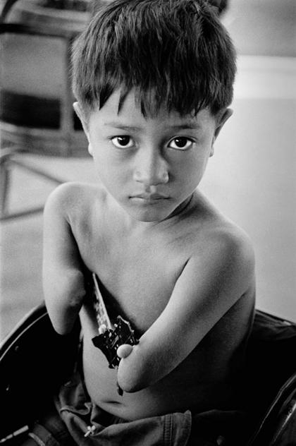
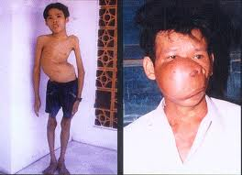
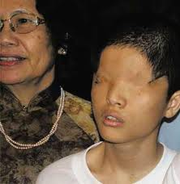
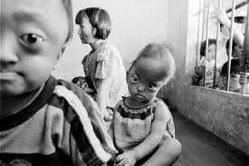
Agent Orange

Slide 12
Napalm
is a thickening or gelling agent generally mixed with petroleum or a similar fuel for use in a flammable device, primarily as an anti-personnel weapon

Slide 13
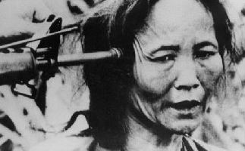
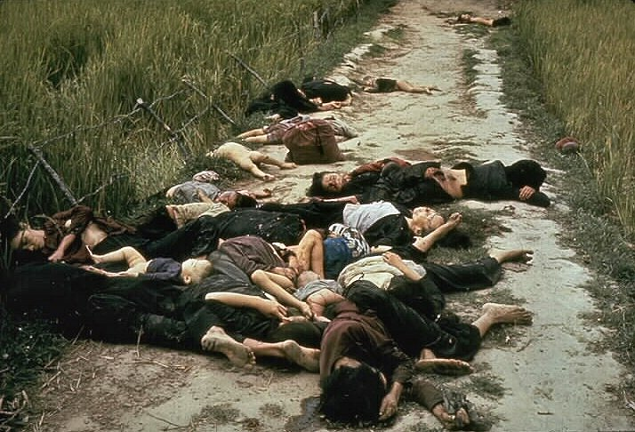
My Lai Massacre
This was the Vietnam War mass murder of between 347 and 504 unarmed civilians in South Vietnam on March 16, 1968, by United States Army soldiers of "Charlie" Company of 1st Battalion, 20th Infantry Regiment, 11th Brigade of the American Division
Most of the victims were women, children, infants, and elderly people. Some of the bodies were later found to be mutilated and many women allegedly raped prior to the killings
While 26 US soldiers were initially charged with criminal offenses for their actions at My Lai, only Second Lieutenant William Calley, a platoon leader in Charlie Company, was convicted
Found guilty of killing 22 villagers, he was originally given a life sentence, but only served three and a half years under house arrest

Slide 14
Resources
http://www.worldbookonline.com/wb/Login?ed=wb
http://www.wikipedia.org/
Google images

Slide 15
By: Alex, James, and Shea

