Slide 1
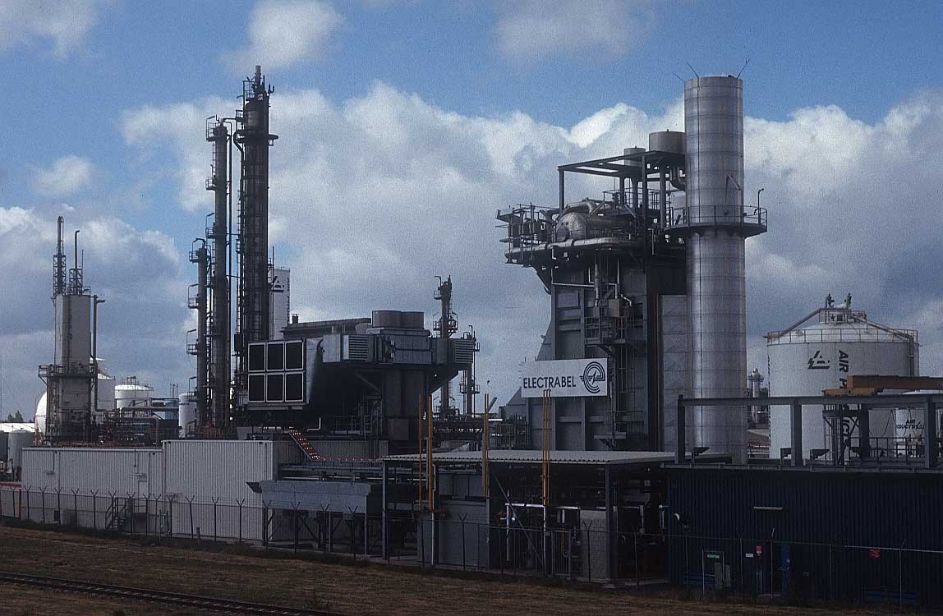
What spurred growth of industry?

Slide 2
What spurred growth of industry?
ANSWER!
Technological change

Slide 3
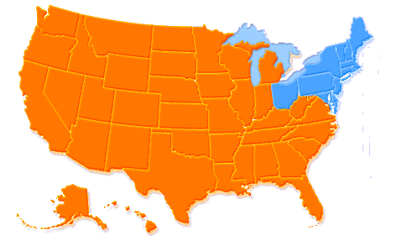
What region developed as the
industrial center of the U.S.?

Slide 4
What region developed as the
industrial center of the U.S.?
ANSWER!
Northeast

Slide 5
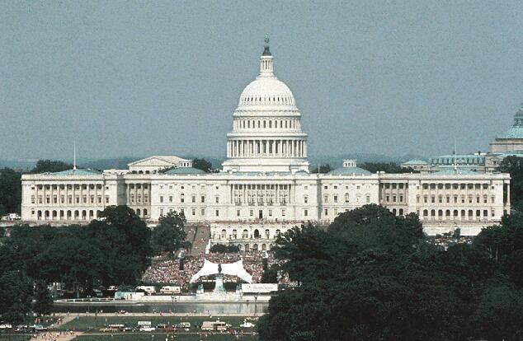
The rise of big business resulted from_________

Slide 6
The rise of big business resulted from_________
ANSWER!
Government policies of laissez-faire capitalism and
special considerations (land grants to build railroad)

Slide 7
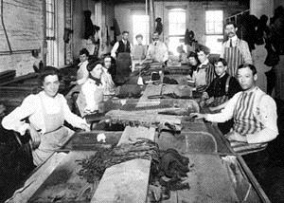
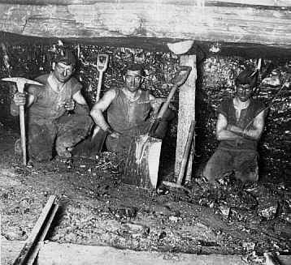
What acted as the primary labor source for
American industry at the turn of the 20th century?

Slide 8
What acted as the primary labor source for
American industry at the turn of the 20th century?
ANSWER!
Immigrants (southern and eastern Europe),
some workers came from farms for jobs in city

Slide 9
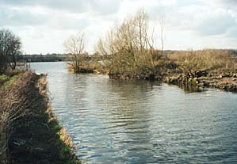
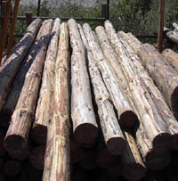
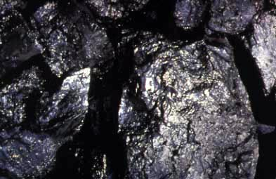
What resources contributed
to America’s economic
transformation at the turn of
the 20th century?

Slide 10
What resources contributed
to America’s economic
transformation at the turn of
the 20th century?
ANSWER!
Navigable rivers,
Natural resources (coal, timber)

Slide 11
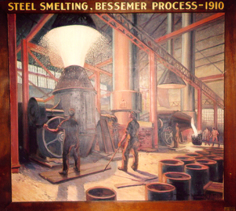
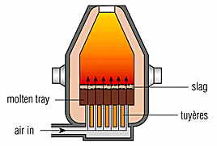
What innovation created a stronger steel
by taking out impurities?

Slide 12
What innovation created a stronger steel
by taking out impurities?
ANSWER!
Bessemer Steel Process

Slide 13
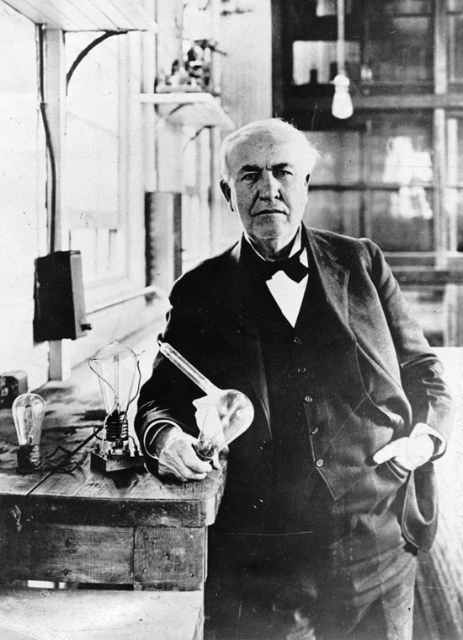
Who invented the light bulb
and electricity as a source
of power and light?

Slide 14
Who invented the light bulb
and electricity as a source
of power and light?
ANSWER!
Thomas Edison

Slide 15
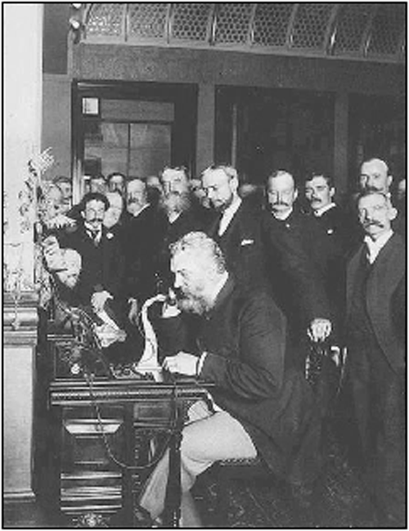
Who invented the telephone?

Slide 16
Who invented the telephone?
ANSWER!
Alexander Graham Bell

Slide 17
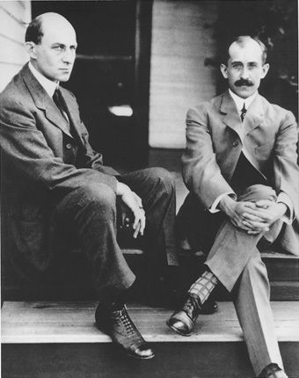
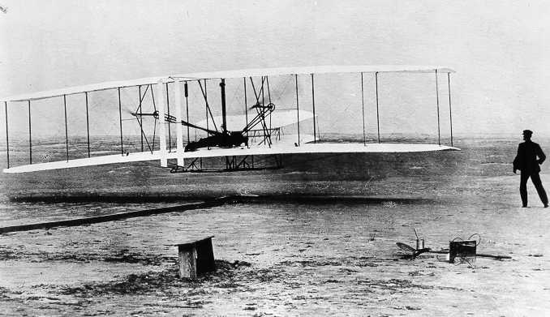
Who developed the airplane?

Slide 18
Who developed the airplane?
ANSWER!
Wright Brothers

Slide 19
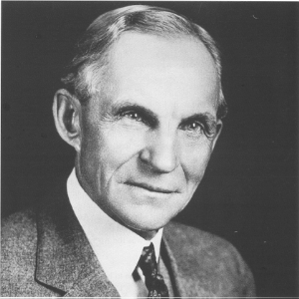
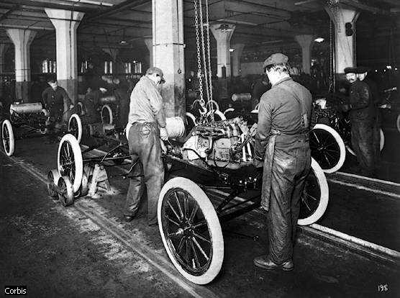
Who developed assembly line
manufacturing to mass-produce
automobiles—Model T?

Slide 20
Who developed assembly line
manufacturing to mass-produce
automobiles—Model T?
ANSWER!
Henry Ford

Slide 21
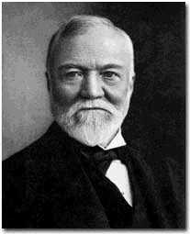
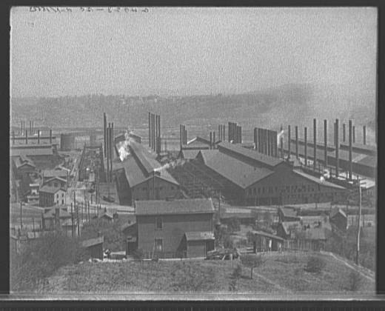
Who was leader of the steel industry
at the turn of the 20th century?

Slide 22
Who was leader of the steel industry
at the turn of the 20th century?
ANSWER!
Andrew Carnegie

Slide 23
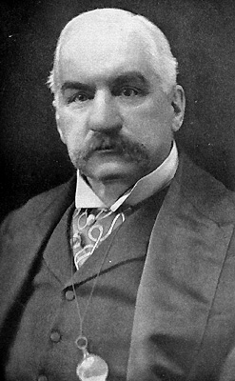
Who was leader of
finance and banking at
the turn of the 20th century?

Slide 24
Who was leader of
finance and banking at
the turn of the 20th century?
ANSWER!
J.P. Morgan

Slide 25
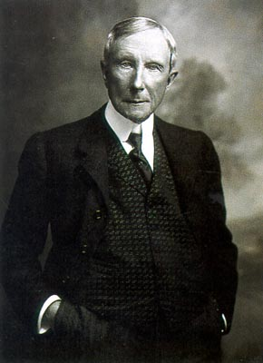
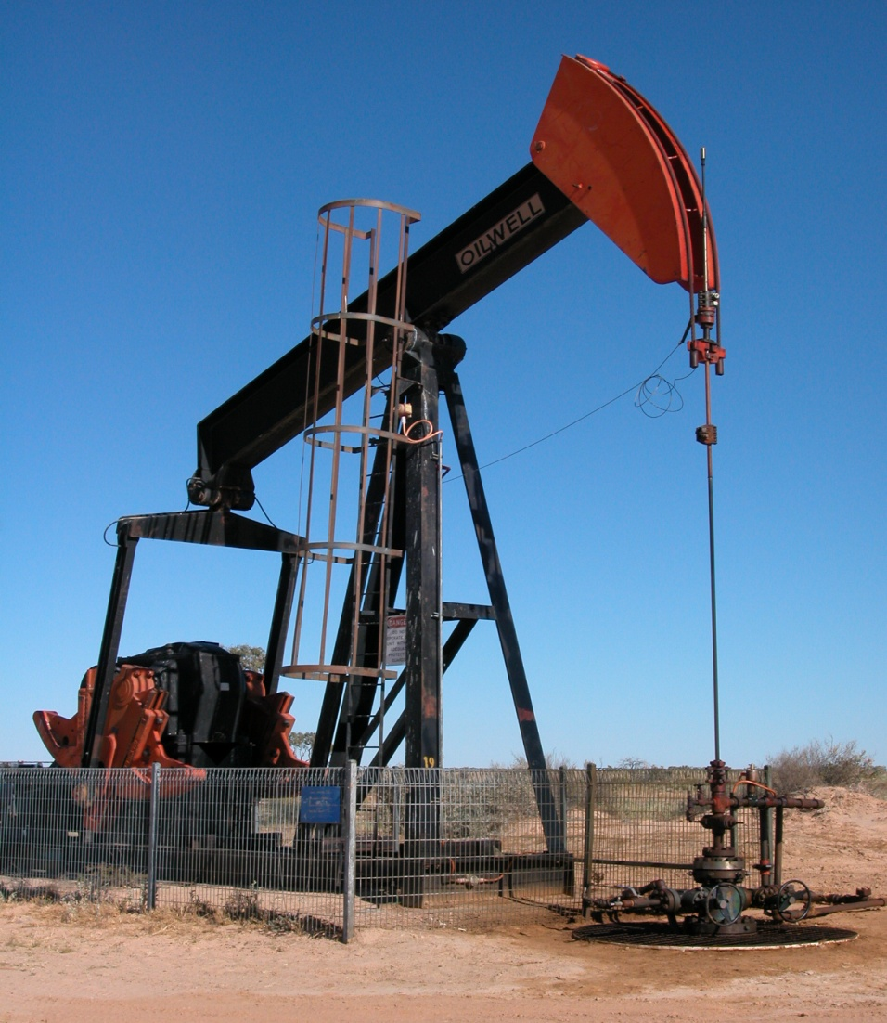
Who was leader of the
oil industry at the
turn of the twentieth century?

Slide 26
Who was leader of the
oil industry at the
turn of the twentieth century?
ANSWER!
John D. Rockefeller

Slide 27
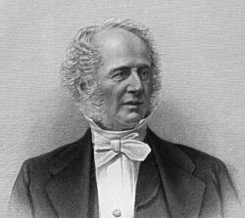
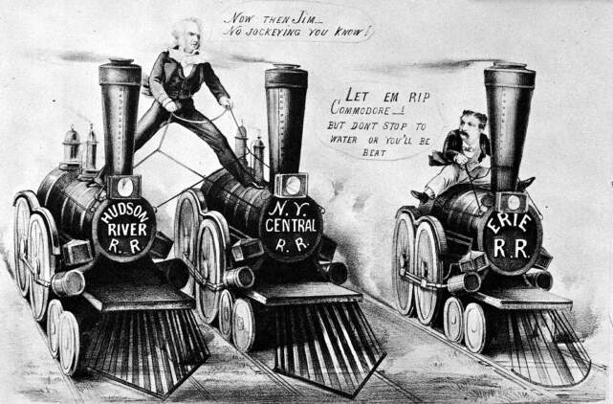
Who was leader of the
railroad industry in the northeast?

Slide 28
Who was leader of the
railroad industry in the northeast?
ANSWER!
Cornelius Vanderbilt

Slide 29
What innovation allowed
for “limited liability,”
separating personal
finance from big business?

Slide 30
What innovation allowed
for “limited liability,”
separating personal
finance from big business?
ANSWER!
Corporation

Slide 31
What spurred the growth of industry at the turn of the 20th century?

Slide 32
What spurred the growth of industry at the turn of the 20th century? | Technological change
What region developed as the industrial center of the U.S.?

Slide 33
What spurred the growth of industry at the turn of the 20th century? | Technological change
What region developed as the industrial center of the U.S.? | Northeast
What government policy contributed to growth of big business?

Slide 34
What spurred the growth of industry at the turn of the 20th century? | Technological change
What region developed as the industrial center of the U.S.? | Northeast
What government policy contributed to growth of big business? | laissez-faire capitalism (hands-off)
What was the primary labor source for factories at the turn of the 20th century?

Slide 35
What spurred the growth of industry at the turn of the 20th century? | Technological change
What region developed as the industrial center of the U.S.? | Northeast
What government policy contributed to growth of big business? | laissez-faire capitalism (hands-off)
What was the primary labor source for factories at the turn of the 20th century? | Immigrants (southern and eastern Europe)
What resources contributed to America’s economic transformation?

Slide 36
What spurred the growth of industry at the turn of the 20th century? | Technological change
What region developed as the industrial center of the U.S.? | Northeast
What government policy contributed to growth of big business? | laissez-faire capitalism (hands-off)
What was the primary labor source for factories at the turn of the 20th century? | Immigrants (southern and eastern Europe)
What resources contributed to America’s economic transformation? | Navigable rivers, natural resources (coal, timber)
Who was leader of the steel industry?

Slide 37
What spurred the growth of industry at the turn of the 20th century? | Technological change
What region developed as the industrial center of the U.S.? | Northeast
What government policy contributed to growth of big business? | laissez-faire capitalism (hands-off)
What was the primary labor source for factories at the turn of the 20th century? | Immigrants (southern and eastern Europe)
What resources contributed to America’s economic transformation? | Navigable rivers, natural resources (coal, timber)
Who was leader of the steel industry? | Andrew Carnegie

Slide 38
What innovation created a stronger steel, greater demand for steel?

Slide 39
What innovation created a stronger steel, greater demand for steel? | Bessemer steel process
Who was the leader of finance and banking at the turn of the 20th century?

Slide 40
What innovation created a stronger steel, greater demand for steel? | Bessemer steel process
Who was the leader of finance and banking at the turn of the 20th century? | J.P. Morgan
Who was the leader of the oil industry at the turn of the 20th century?

Slide 41
What innovation created a stronger steel, greater demand for steel? | Bessemer steel process
Who was the leader of finance and banking at the turn of the 20th century? | J.P. Morgan
Who was the leader of the oil industry at the turn of the 20th century? | John D. Rockefeller
Who was the leader of the railroad industry at the turn of the 20th century?

Slide 42
What innovation created a stronger steel, greater demand for steel? | Bessemer steel process
Who was the leader of finance and banking at the turn of the 20th century? | J.P. Morgan
Who was the leader of the oil industry at the turn of the 20th century? | John D. Rockefeller
Who was the leader of the railroad industry at the turn of the 20th century? | Cornelius Vanderbilt
Who developed assembly line manufacturing to mass-product Model T’s?

Slide 43
What innovation created a stronger steel, greater demand for steel? | Bessemer steel process
Who was the leader of finance and banking at the turn of the 20th century? | J.P. Morgan
Who was the leader of the oil industry at the turn of the 20th century? | John D. Rockefeller
Who was the leader of the railroad industry at the turn of the 20th century? | Cornelius Vanderbilt
Who developed assembly line manufacturing to mass-product Model T’s? | Henry Ford
Who developed the airplane?

Slide 44
What innovation created a stronger steel, greater demand for steel? | Bessemer steel process
Who was the leader of finance and banking at the turn of the 20th century? | J.P. Morgan
Who was the leader of the oil industry at the turn of the 20th century? | John D. Rockefeller
Who was the leader of the railroad industry at the turn of the 20th century? | Cornelius Vanderbilt
Who developed assembly line manufacturing to mass-product Model T’s? | Henry Ford
Who developed the airplane? | Wright brothers

Slide 45
Who invented the telephone?

Slide 46
Who invented the telephone? | Alexander Graham Bell
Who invented the light bulb and electricity as a source of power and light?

Slide 47
Who invented the telephone? | Alexander Graham Bell
Who invented the light bulb and electricity as a source of power and light? | Thomas Edison
What allowed for “limited liability,” separating personal finance from big business?

Slide 48
Who invented the telephone? | Alexander Graham Bell
Who invented the light bulb and electricity as a source of power and light? | Thomas Edison
What allowed for “limited liability,” separating personal finance from big business? | Corporation

