Slide 1
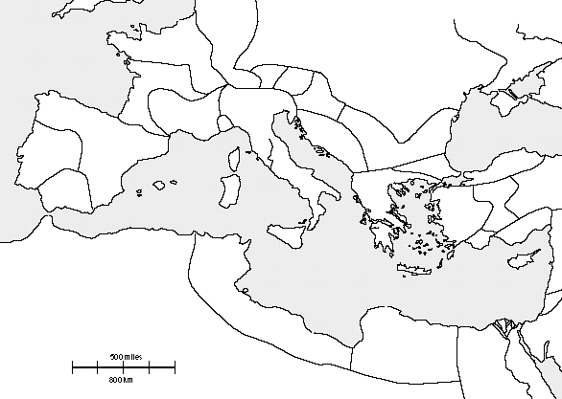
Map of Rome
Use p. 153, 159
Label the following:
Continents:
Europe
Asia
Africa
Places:
Rome (Italy)
Greece
Spain
Gaul
Egypt
Britain (tip)
Cities:
Carthage
Bodies of water:
Adriatic Sea
Mediterranean Sea
Nile River
Mountains:
Alps
Outline Peninsulas:
Balkan
Italian
Pg #

Slide 2
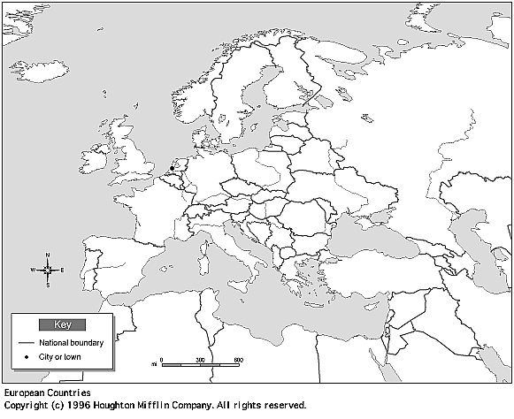
Map #1: Use p. 153 to help you
Shade in the following:
Greece/Balkan peninsula:
Roman Republic (Italian peninsula):
Label the Mediterranean Sea!
Map #2: Use p. 153 to help you
Shade in the following:
Roman Empire:
*Be sure to include all its territories – England, Gaul, Greece, etc.
Label the Mediterranean Sea!

Slide 3
Geography Questions: Rome
The textbook says (p. 155): Rome was built on seven rolling hills at a curve on the Tiber River, near the center of the Italian peninsula. It was midway between the Alps and Italy’s southern tip. Rome also was near the midpoint of the Mediterranean Sea.
Highlight the important geographical features that Rome was built on.
*Alps = major mountain range to the north of the Italian peninsula* How would the Alps have provided protection for Rome?
Why do you think people say that Rome was built in the perfect location?
Find the locations of Greece and Rome on the map. Based on their locations – do you think they interacted with each other? Explain.

