Slide 1
This group of colonists provided the troops for the American Army, led by George Washington, also of Virginia.
loyalist
Britain
Patriots
France

Slide 2
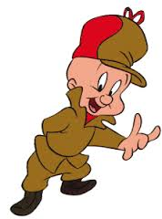

Slide 4
Whose idea? All original power resides in the people, and they consent to enter into a “social contract” among themselves to form a government to protect their rights
Thomas Jefferson
John Locke
George Mason
James Madison

Slide 5
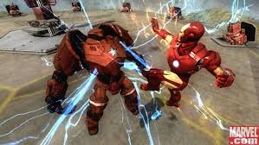

Slide 6
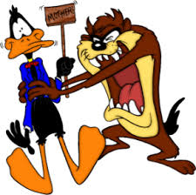

Slide 7
It made federal law the supreme law of the land, but otherwise gave the states considerable leeway to govern themselves.
Bill of Rights
Declaration of Independence
Va. Declaration of Rights
Constitution

Slide 10
They also argued that a national Bill of Rights would be redundant, because the Constitution itself protected basic rights, and because most states already had bills of rights that clearly defined basic rights that the governments could not abolish.
Federalist
Anti-Federalist
Loyalist
Patriots

Slide 13
James Madison consulted these documents when drafting the amendments that eventually became the United States Bill of Rights.
VA Declaration of Rights and the Constitution
VA Declaration of Rights and VA Statute of Religious Freedom
Articles of Confederation & VA Declaration of Rights
VA Statute of Religious Freedom & the Constitution

Slide 15
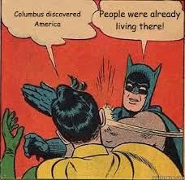

Slide 16
His election in 1800 was the first American presidential election in which power was peacefully transferred from one party to another.
Alexander Hamilton
James Madison
Thomas Jefferson
John Adams

Slide 19
This Supreme Court case prohibited the states from taxing agencies of the federal government (“the power to tax is the power to destroy”).
Plessy v. Ferguson
Marbury v. Madison
Gibbons v. Ogden
McCulloch v. Maryland

Slide 22
This Supreme Court case said that the Supreme Court has the power to determine whether a law or act is valid or whether it should be thrown out
Gibbons v. Ogden
McCulloch v. Maryland
Plessy v. Ferguson
Marbury v. Madison

Slide 24
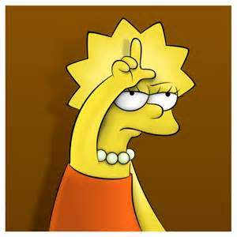

Slide 25
This Supreme Court case said that only the federal government can regulate interstate commerce.
Marbury v. Madison
Gibbons v. Ogden
McCulloch v. Maryland
Plessy v. Ferguson

Slide 26
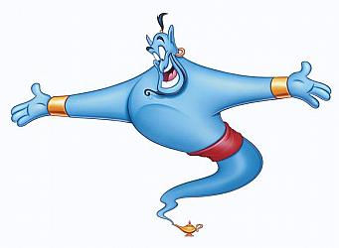

Slide 28
Increased power of the federal government by saying that if the power is necessary for the government to carry out one of their jobs then it is allowed or “constitutional” under the “necessary and proper clause” and it is an “implied power”
Marbury v. Madison
Gibbons v. Ogden
McCulloch v. Maryland
Plessy v. Ferguson

Slide 30
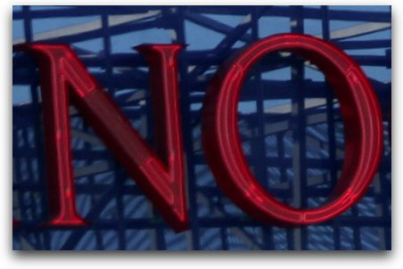

Slide 31
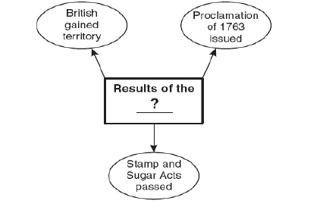
French & Indian War
Continental Congress
Monroe Doctrine
Articles of Confederation

Slide 32
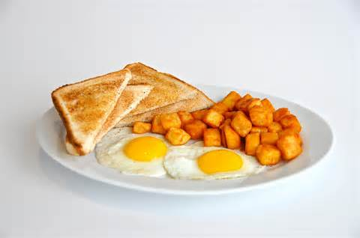

Slide 34
Robert E. Lee
Abraham Lincoln
Andrew Johnson
Ulysses S. Grant

Slide 37
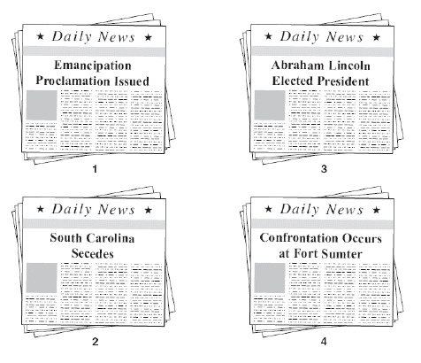
2,1,3,4
3,2,4,1
3,4,2,1
4,2,3,1

Slide 38
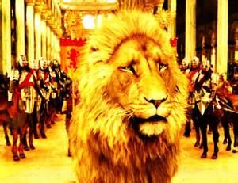

Slide 40
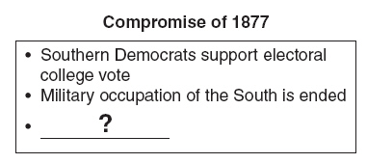
Emancipation Proclamation
Conclusion of Reconstruction
Impeachment of Andrew Johnson
End of Jim Crow Era

Slide 42
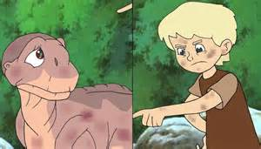

Slide 43
Which of the following BESTS completes the chart?
Frederick Douglass
Elizabeth Cady Stanton
Henry Bessemer
Eugene Debbs

Slide 45
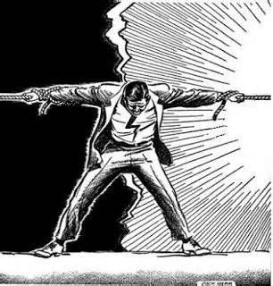

Slide 46
The End

