Slide 1
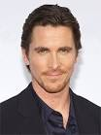
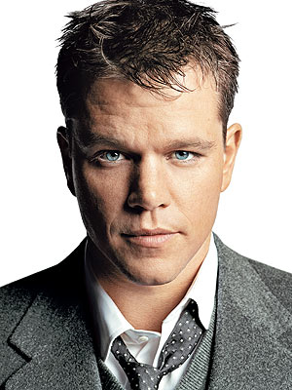
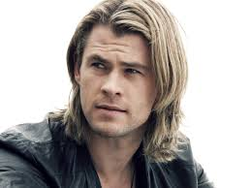
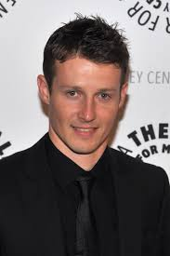
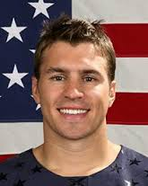
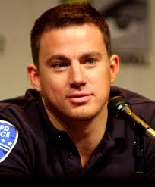
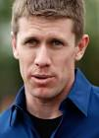
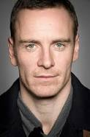
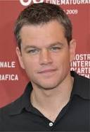
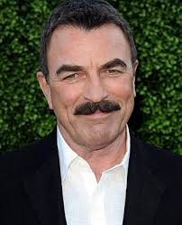
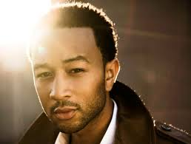
Christian
Bale
Chris Pine
Chris Hemsworth
Matt Damon
Jamie from Blue Bloods
Channing Tatum
Carl Edwards
Zach Parise
Matt Damon 2
Tom Selleck—Mrs. Poore likes him
Henry Cavill
Michael Fassbender
John Legend

Slide 2
Puerto Rico was annexed by the U.S. as a result of the U.S. victory in the ______________War.
A
Mexican-American War
B
Korean War
C
Spanish American War
D
Revolutionary War

Slide 3
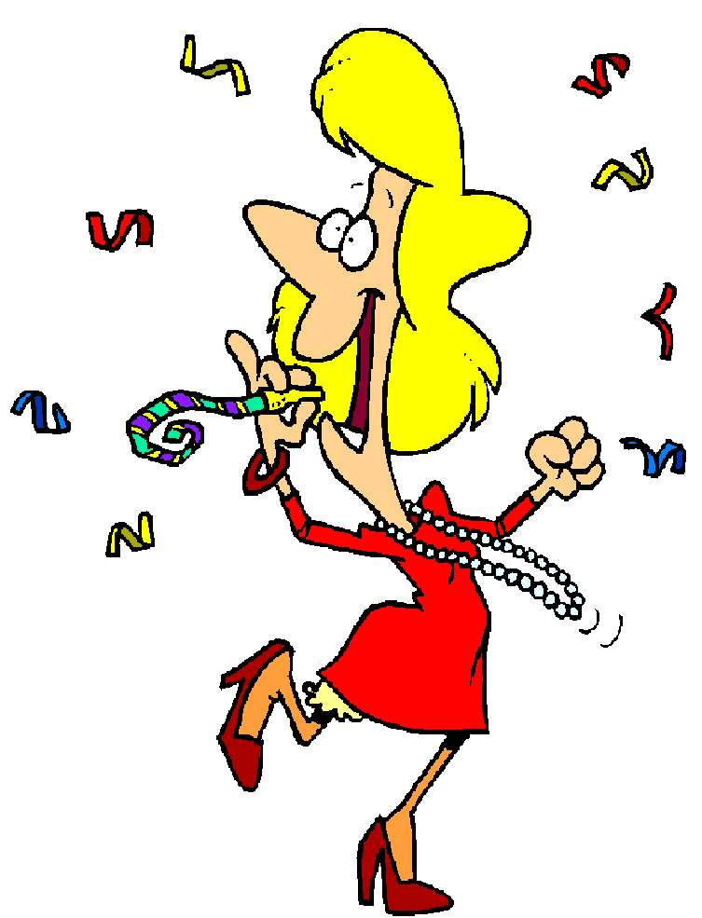
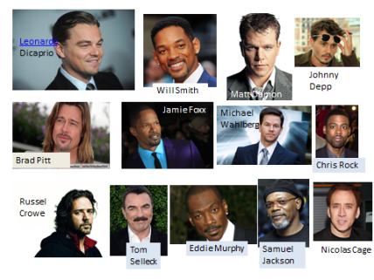

Slide 4
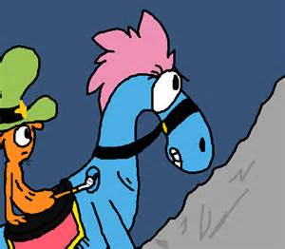
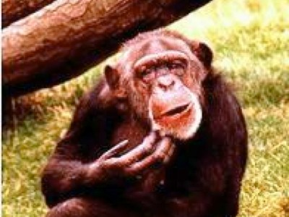
Try Again

Slide 5
Who urged American banks and businesses to invest in Latin America? He promised that the United States would step in if unrest threatened their investments.
A
Franklin Roosevelt
President Taft
Theodore Roosevelt
President Wilson
B
C
D

Slide 6
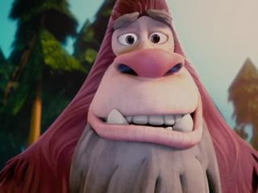

Slide 7
The Compromise of 1877 resulted in -
A
Abe Lincoln becoming President of the U.S.A
The end of slavery in the United States.
The end of Reconstruction in the American South.
The creation of the Louisiana Territory.
B
C
D

Slide 9
This act promised 160 acres of land to anyone who paid a small filing fee and agreed to live on the land for five (5) years. During the five years, they must improve the land by planting crops or building a home
A
Homestead Act
Dawes Act
Western Lands Act
Sedition Act
B
C
D

Slide 11
This invention ended the long drive of cattle and led to conflict between ranchers and farmers –
A
railroads and trains
barbed wire
assembly line
dry farming
B
C
D

Slide 12
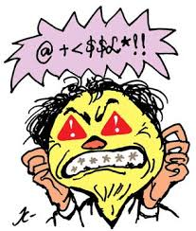

Slide 13
Overcrowded apartment buildings where immigrant families lived in poverty were called
A
Slums
public housing
Tenements
D. suburbs
B
C
D

Slide 14
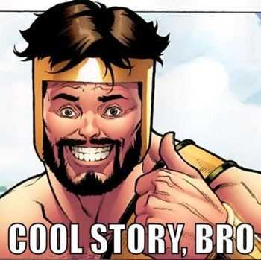

Slide 15
Parties who organized immigrant neighborhoods to vote for their candidates by providing favors or simply buying their votes were called
Political machines
Partisans
Libertarians
D. socialists

Slide 16
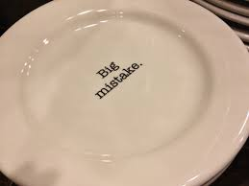

Slide 17
John D. Rockefeller was the entrepreneur who created a monopoly called –
U.S. Steel Corp
B & O Railroads
Ford
D. Standard Oil

Slide 18
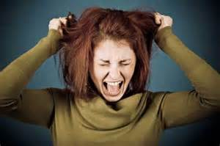

Slide 19
Samuel Gompers was the founder of this trade union –
A
Congress of Industrial
Trade Organizations
Knights of Labor
American Federation of Labor
B
C
D

Slide 20
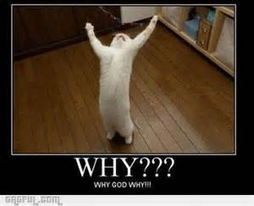

Slide 21
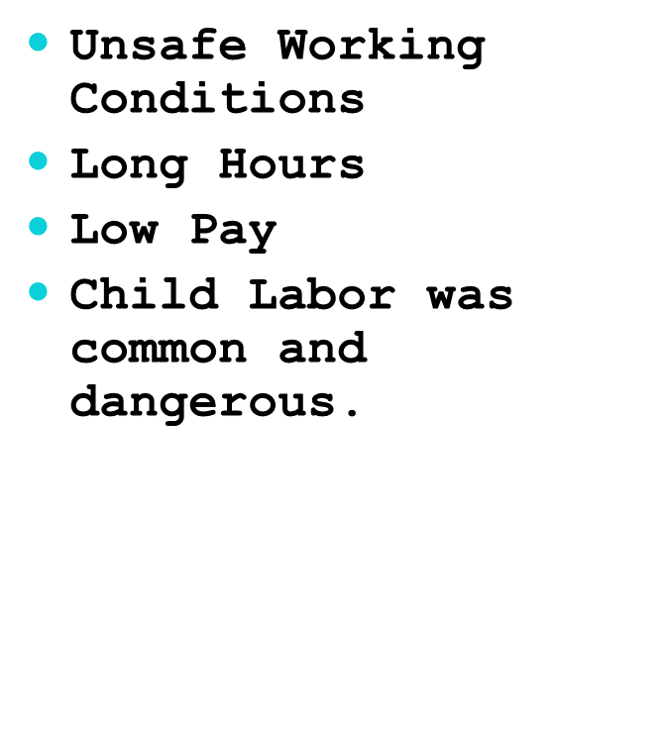
All of the problems in the text box above were opposed by –
A
Andrew Carnegie and other industrialists.
NAACP and the Niagara Movement.
Progressives and Union Leaders.
Suffragists
B
C
D

Slide 22
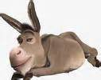

Slide 23
This African-American leader demanded immediate equality for people of color in the United States; he established both the NAACP and the Niagara Movement –
A
Elijah Lovejoy
Booker T. Washington
W.E.B. Dubois
George Washington Carver
B
C
D

Slide 24
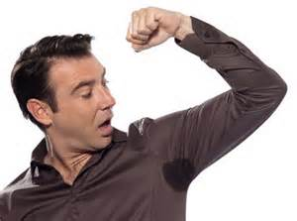

Slide 25
She was the organizer of the Seneca Falls Convention and helped to draft the Declaration of Sentiments, in which women demanded the right to vote for the first time publicly
A
Elizabeth Cady Stanton
Sojourner Truth
Eleanor Roosevelt
Shirley Chisholm
B
C
D

Slide 26
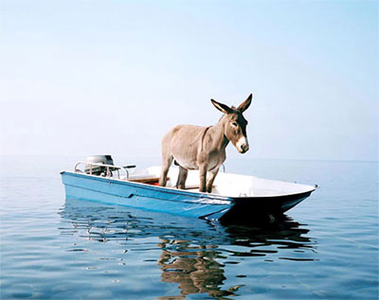

Slide 27
The woman’s suffrage movement’s goal was –
A
to end child labor.
to outlaw the consumption of alcohol and “demon rum.”
to gain the right to vote in national elections.
“equal pay for equal work.”
B
C
D

Slide 28
You are WRONG!

Slide 29
The temperance movement was devoted to the abolition of
A
Alcohol
Slavery
literacy tests
child labor laws
B
C
D

Slide 30
